Slide 1
Targeted Earlier Intervention Program
Webinar 4: Consent and Privacy
Live recording: https://www.youtube.com/watch?v=8Ogsf81URGg
Notes:
Hi everyone, and welcome to our Data Exchange webinar series for the Targeted Earlier Intervention program.
In today’s webinar, we are going to talk about privacy and consent.

Slide 2
Purpose
Key consent and privacy principles of the TEI program
Consent and Privacy practices for using DEX
Consent and Privacy FAQs
In this webinar we discuss:
Notes:
As always, there are three key topics we’ll discuss.
First, I’m going to talk about key privacy and consent principles for the whole TEI program. So we’ll talk about what sort of practices every single organisation should have in place.
Then we’re going to talk specifically about using the Data Exchange – so we’ll talk about what practices you need to have if you’re storing client’s personal information in the Data Exchange.
And then I’ll also go through some of the frequently asked questions we get about consent, so can a child consent? How do you determine if someone has capacity to consent? All the common issues everyone faces.

Slide 3
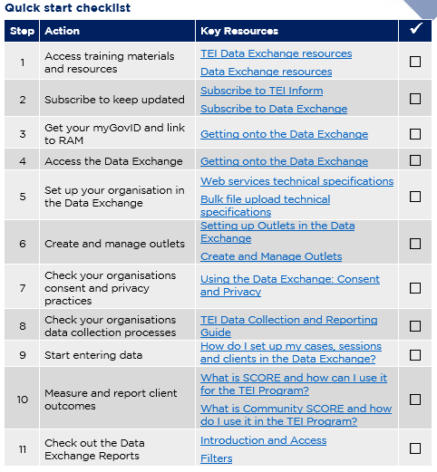

Data Exchange Quick Start Guide
Key resource: Quickstart guide to the Data Exchange
This document outlines the 11 key steps you need to follow to access and start using the Data Exchange.
It includes links to key resources for each step.
Notes:
In our previous webinar’s I introduced everyone to this document: the Data Exchange Quick Start Guide. This is a five page document that outlines the 11 key steps you need to follow to access and start using the Data Exchange. It includes links to all the key resources you need to action each step. And as you can see on the slide it includes this checklist, so you can keep track of where you’re up to.
In each of our webinar’s I’ve been taking everyone through each step in this document.
So in our first week, we looked at Steps 1 and 2, about where to find key resources and how to subscribe to our newsletter. Then we tackled Steps 3 and 4 about MyGovID, linking in RAM and accessing the Data Exchange for the first time. And then last week, we talked how about to set your organisation up in the Data Exchange, and how to create your outlets.

Slide 4
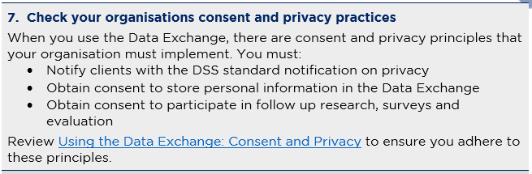
Quick start guide: step 7
Quickstart guide to the Data Exchange
Notes:
In today’s webinar we’re going to cover step 7.
Step 7 takes you through what you need to do to ensure your organisation lawfully collects and stores, and uses client’s information. There are specific practices and principles that we all need to follow. So today I’m going to take you through them, and we’ll break down what everything means, and what you actually need to do in practice

Slide 5
Privacy Obligations of TEI service providers
When you collect personal and health information from your clients, there are a key pieces of legislation that you must adhere to:
  Privacy and Personal Information Protection Act 1998
  Health Records and Information Privacy Act 2002
  Privacy Act 1988
Clause 18 of your contract (HSA) includes your obligation to comply with this legislation.
What is personal and health information?
Personal information: information about someone that can be used to identify them (e.g. their name or address).
Health information: information about someone's physical or mental health (e.g. counselling notes, medical records, Medicare number).
See Privacy Information Sheet for more information
Notes:
So the first thing we’re going to do is talk about your general privacy obligations in the TEI program. So this applies to every single organisation who receives funding from TEI.
So as part of the TEI program, when you collect personal and health information from your clients there are key pieces of legislation that you need to adhere to. So this is outlined in Clause 18 your contract. And you can see on the screen that there are three privacy acts. So there is the Privacy and Personal Information Protection Act 1998, the Health Records and Information Privacy Act 2002 and the Privacy Act 1988.
These documents are enormous and there is so much jargon in that anyone and everyone could get very lost and confused. So we have developed a resource called the ‘Privacy Information sheet’, you can see the hyperlink on the bottom right of the screen and in this resource we’ve attempted to break down all the privacy legislation and clearly explain what it is that you need to do to make sure that you lawfully collect and use client’s information.
So, the first thing everyone needs to get across is what actually is personal and health information. What do we mean by that?
So personal information, is information about someone that can be used to identify them. So, for example, this could be their name or their address. Health information, is information about someone’s physical or mental health, so this could be medical records, notes from a counselling session, a client’s medicare number. Any information about them that relates to their physical or mental health.
So when you collect information like this from your clients, there are a number of things you need to do make sure you adhere to this legislation.

Slide 6
Collecting personal or health information
A Privacy Notice must be given to clients when you collect personal/health information from them.
It should be in clear language that the client can understand.
A Privacy Notice should tell clients the following:
That information is being collected from them
Why the information is collected
How the information is used
Who the information is for
Who the information may be shared with and why
If the information they provide is required by law or voluntary
Any consequences for the client if the information is not provided
Their right to access and correct information
Who they can speak to if they have any questions
Notes:
So the first thing, is your client’s must be given a privacy notice. So this is normally just a one page document, that clearly explains why you’re collecting their information and what you’re going to do with it.
Any privacy notice should be written clearly and simply, and it should always be truthful. We cannot mislead our clients in any way.
So many of you will already have a privacy notice, that you’ve been using for quite some time. For those of you that don’t you must develop one for your clients to make sure your data collection practices are legal. As you can see there are 9 different points on this slide that start to cover what short of information should be in your privacy notice.
So first things first, you need to tell the client that information is actually collected from them, you need to explain why that information is being collected and how that information will be used, so for example, it could be for you to manage their case, to better understand their needs, to make sure they get access to the right kind of services.
You need to tell your client who the information is for and who it might be shared with, so is it just for your service, or will you share the information with other organisations to facilitate referrals?
You need to tell the client if the information they provide is required by law, or if it’s voluntary. In the vast majority of our circumstances, it’s always going to be voluntary. So you need to clearly communicate that to clients.
Any consequences if the client doesn’t provide certain information – so maybe you won’t be able to refer them to other organisations, if they don’t leave contact details you won’t be able to follow up with them. Those sorts of things.
And you should also include information about their right to access and correct the information they give you, and who they should speak to if they have any questions. So you should leave contact details for them to discuss any issues they might have about you storing their information, or how you’re going to use it.

Slide 7
Collecting personal or health information
This list is not exhaustive!
You should tailor your privacy notice to your organisation’s specific operating context.
A Privacy Notice must be given to clients when you collect personal/health information from them.
It should be in clear language that the client can understand.
It should tell clients the following:
That information is being collected from them
Why the information is collected
How the information is used
Who the information is for
Who the information may be shared with and why
If the information they provide is required by law or voluntary
Any consequences for the client if the information is not provided
Their right to access and correct information
Who they can speak to if they have any questions
Notes:
Now, its important to remember, that this is not an exhaustive list. There are over 550 TEI organisations who all engage with their clients and the service system in different ways. So you need to make sure that whatever privacy notice you develop, is tailored to your organisations specific operating context.

Slide 8
Using and disclosing clients’ personal/health information
You must ensure that your use and disclosure of clients’ personal/health information is lawful.
You can only use (handle) clients’ personal information if:
  The proposed use is consistent with the purpose for which it was collected
  The client has consented for their information to be used in that way
  It is necessary to prevent or lessen a serious and imminent threat to the client
You can only disclose clients’ personal information if:
  The disclosure is directly related to the purpose for which it was collected
  The client knows that their information could be disclosed for that purpose
  The disclosure is necessary to prevent or lessen a serious or imminent threat to the client
Notes:
So the next thing I want to discuss is using and disclosing client’s personal and health information.
So we all need to make sure that whenever we use clients personal and health information or whenever we disclose that information (which means passing it on to another party), our practices are lawful.
In order to do that, you should follow the advice on this slide.
So you can only use client’s personal information if, the proposed use is consistent with the purpose for which is was collected. So basically this means you can only use client’s personal or health information to make sure they receive the services they need to receive. You can’t use it for any other reason. So say for example, you have a list of your clients email addresses – you can’t use that list to promote your side business, or something like that.
You can only use client’s information if they have consented for their information to be used for that purpose. We’ll talk more about what this means in a minute. And the last one, is you can only use client’s information if it is necessary to prevent or lessen a serious threat – so if you have a serious reason to believe that a client’s life is in danger, you can use their personal information to prevent something terrible from happening.
Now, disclosures. To ‘disclose’ information means to give personal or health information collected by your organisation to a person or body outside your organisation. For example, your organisation may pass on client details to another organisation to organise a referral. Your organisation may also disclose personal or health information to a school or a parent, or to the police if you need to report abuse.
When considering whether a disclosure is permitted by privacy legislation you should check whether: The disclosure is directly related to the purpose for which the information was collected
The individual has been made aware that information of that kind is usually disclosed, so your privacy notice should clearly indicates that some of their information may be disclosed in certain circumstances.
And again, if the disclosure is necessary to prevent or lessen a serious and imminent threat to the life or health of the client.
Now, it’s really important to remember that these principles only apply to ‘personal information’. That is information that can use to identify a client, e.g. a client’s name or address. These privacy principles do NOT apply to de-identified information. That is, information that cannot be used to identify an individual.
So for example, the data you report to DCJ is de-identified – DCJ can’t see any personal information about your clients. So therefore, it’s not considered a disclosure because you’re not actually giving DCJ any information that could be used to identify your clients.

Slide 9
Consent to collect, use and disclose client’s information
Your organisation must obtain client consent to collect, use and disclose client’s personal/health information.
Consent must be:
Voluntary
  Client’s must be free to exercise genuine choice to provide or withhold consent. They can say no and still receive the service. They can say yes, but change their mind later on.
Informed
  Clients must be clearly informed about how their information will be used, so they can decide whether to give consent. If you provide incorrect or misleading information, the client’s consent could be invalid.
Specific
  Consent must be as specific as possible. Your consent form should include a request for each use and disclosure of their information. For example:
    I consent for [service provider name] to collect and store personal and health information about me
    I consent for [service provider name] to share my personal and health information with relevant agencies to provide me with support
    I consent for my personal and health information to be stored in the Data Exchange
    I consent to participate in follow up research, surveys or evaluation
Current
  You must not assume that consent given in particular circumstances applies indefinitely. Good practice is to check in with your clients to make sure they have not changed their mind about consent.
  Make it clear that a client is entitled to change their mind and revoke their consent later on.
Given by a person with capacity to give it
  A person has capacity to give consent if:
    they understand the general nature and effect of how their information will be used and disclosed
    they can communicate their consent
  Issues that could affect a client’s capacity to consent include: age, physical or mental disability, temporary incapacity (e.g. psychotic episode, in severe distress), limited understanding of English.
Notes:
So, in order for you to lawfully use client’s personal and health information, they need to give you their consent. This means you will need to develop a consent form, or include some consent statements at the end of your privacy notice.
When we obtain consent there are 5 principles that we need to adhere to.
Consent must be voluntary. Clients should never be coerced to give their consents. They must be free to exercise genuine choice to provide or withhold consent. They must be free to say no, and still receive the service. They must also be free to say yes, but change their mind at any time.
Consent must also be informed. Client’s must be clearly informed about how their personal and/or health information will be handled, so they can decide whether to give consent. If your organisation provides incorrect or misleading information, the client’s consent could be invalid.
Consent must be precise and as specific as possible. Your consent form should include a request for each use and disclosure of a client’s personal and/or health information. So you need to think through all the ways your organisation will use your client’s data, and you need to get your client’s permission to use their data in that way. So on the slide, you can see a few different examples:
I consent for [service provider name] to collect and store personal and health information about me
I consent for [service provider name] to share my personal and health information with relevant agencies to provide me with support
I consent for my personal and health information to be stored in the Data Exchange
I consent to participate in follow up research, surveys or evaluation
We’ll talk more about those last two later, but you get the idea.
Consent also needs to be current. You must not assume that consent given in particular circumstances applies indefinitely. Good practice is to check in with your clients to make sure they have not changed their mind about consent. Make it clear that a client is entitled to change their mind and revoke their consent later on.
You also need to check that a client has capacity to give consent. A person has capacity to give consent if:
they understand the general nature and effect of how their personal and/or health information will be used and disclosed
they can communicate their consent
It’s also a good idea to have a conversation with your clients about your privacy notice, about consent to make sure they understand everything. If they determine that they don’t have capacity to give consent, you should mark on their consent form that consent hasn’t been given.
This doesn’t mean that the client can’t receive the service, it just means you won’t collect and use their information the same you would other client’s. So you might de-identify them or use a pseudonym, or something like that.

Slide 10
Security of information
You must always take reasonable steps to ensure the personal and health information you hold is secure.
Consider the following:
  Physical Security: Where is the personal and health information held? Are paper stored in locked cabinets?
  ICT Security: How is the information protected from unauthorised access? Is it password protected or stored electronically with access restrictions?
  Access Security: Who can access the information? Is access restricted by role, work unit?
  Governance, culture and training: Do staff receive regular training in privacy obligations? Are they aware of security policies, privacy management plan and your organisation’s privacy policy?
  Data breaches: Are staff aware of their obligations when faced with a data breach?
  Sensitive information: Is sensitive information, such as psychology reports, subject to increased security safeguards?
  De-identification: how and when is client information de-identified?
  Destruction: How and when are documents containing personal and/or health information destroyed?
Notes:
So, another thing everyone needs to do to make sure they’re adhering to privacy legislation is to make sure the information the collect is secure. You need to remember, that some of your organisations will have very private and personal information on hundreds, sometimes thousands of people from your communities. So you need to make sure this information is securely stored and only the right people have access to it.
So on the screen there are number of different things you should consider. Like physical security, if you have paper documents you should check that these are securing stored in a locked cabinet, if you have online records, who can access these? Are they password protected?
You should also think about the governance within your organisation – are staff training to make sure client’s information is secure? Do you have a privacy management plan or a privacy policy?
What would you do if there is ever a data breach? What do you do with sensitive information, like psychology reports? How do you de-identify data? How long to you hold client records for?
Your organisation really should have a privacy policy that addresses each of these points to make sure the information you hold about your clients is safe and secure. And you should have clear practices to follow if there is every a security breach.

Slide 11
Privacy Obligations of TEI service providers
All organisations should have privacy policies and practices to ensure they lawfully collect, store, use and disclose clients’ personal and health information.
Check the practices in your organisation to make sure you address these key principles.
Do you have a privacy notice?
Do you obtain clients’ consent to collect, use and disclose their personal/health information?
Is your client’s information secure?
See Privacy Information Sheet for more information
Notes:
So, to quickly sum up, there are three key things your organisation needs to do to adhere to the privacy legislation in your contract.
You need to have a privacy notice that tells clients why you’re collecting their information and what you’re going to do with it. You need to obtain client consent – you need their permission to use and share their personal information. And you need to ensure the information you collect is secure.
I strongly encourage each and every one of your to take a look at this document, ‘Privacy Information sheet’. It goes through all of the things I’ve just talked about – take a look at that document and make sure your organisation has the right policies and practices in place. Because we need to make sure we’re doing by our clients.

Slide 12
Using the Data Exchange: Privacy and Consent
If your organisation stores clients’ personal information in the Data Exchange, there are additional privacy principles we must adhere to.
These principles only apply to organisations who upload/enter clients’ personal information into DEX.
In the Data Exchange, personal information is the client’s:
First name
Last name
Street-level address (e.g. 1 Main Street)
See Using the Data Exchange: Consent and Privacy for more information
Notes:
Ok, so to add another layer of complexity to this, I’m now going to go through what you need to do to adhere to the privacy principles of the Data Exchange.
So when you start to create client records in the data exchange, you will enter a client’s name, and possibly their street-level address. So this is obviously personal information – so that means we need to make sure we have client’s permission to store their personal information in the Data Exchange.

Slide 13
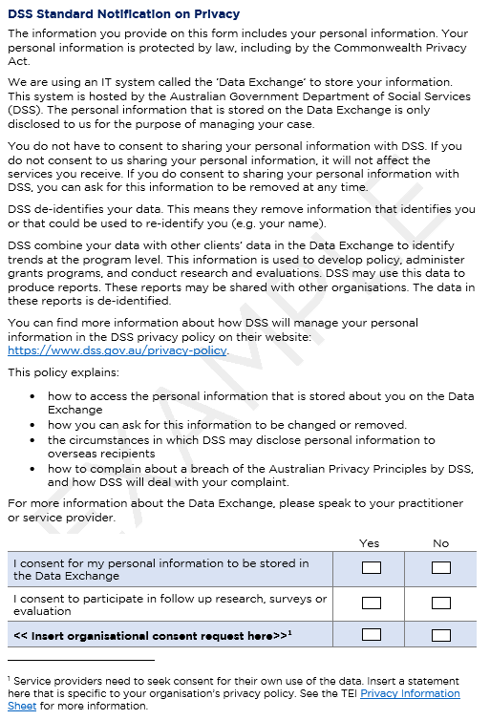
Using the Data Exchange
Before you can store clients’ personal information in the Data Exchange, you must:
1 | Use the DSS standard notification on privacy (or similar) to notify clients about the Data Exchange
2 | Obtain consent to store clients’ personal information in the Data Exchange
3 | Obtain consent from clients to participate in follow up research, surveys, and evaluation
See Example client intake form
Notes:
To do this, there are three things you need to do:
You must use the DSS standard notification on privacy (or a similar privacy notice) to notify clients about the Data Exchange.
So the DSS standard notification, is similar to any privacy notice. It tells client’s why their information is being collected, that consent is voluntary, where to go if they have questions, all the things we spoke about earlier. You can use this statement verbatim, or you can adapt it and tailor it to your organisation.
You also need to obtain client consent. So you need to ask clients if they consent to their personal information being stored in the Data Exchange, number 2 on the slide. And you also need to ask them if they consent to participate in follow up research, number 3.
So the image you can see on the right side of the screen is from a document we developed that is an example of client intake form. So at the top we’ve got the DSS standard notification on privacy. We tweaked it a little bit, to make it easier to understand. And then, as you can see down the bottom, we’ve included our two consent statements.
So the first one, ‘I consent for my personal information to be stored in the Data Exchange’. This is compulsory for all organisations who enter client’s personal information in the Data Exchange to include. You must have this question on your privacy notices or consent forms.
Then we’ve got our second statement about participating in follow up research.
And you can see the bold text – we’ve left space for any additional statements that are specific to your organisation. So like we talked about earlier, if you use a client’s personal information to organise referrals, you will have to ask clients for their permission to do that. So you could include an extra consent statement there for things that are specific to your organisation.
And you can also play around with the privacy notice itself – to make sure it’s as relevant to your organisation as possible.

Slide 14
What if my organisation does NOT store personal information in DEX?
If your organisation conducts bulk uploads or system-to-system transfers, you may choose to not store client’s personal information in the Data Exchange.
To do this, you will:
  remove clients’ personal information (i.e. full name and street-level address) before your upload or transfer.
  indicate client consent has not been provided
  generate SLKs for your clients
The DSS Standard Notification arrangements do not apply to your organisation if you choose not to store clients’ personal information in the Data Exchange.
However, you still need to:
Obtain consent from clients to participate in follow up research, surveys or evaluation
Distribute your own privacy notice
Obtain consent for your own organisation to collect, store, use and disclose client’s personal information
Notes:
So, some of you may choose to not store client’s personal information in the Data Exchange. You might have your own client management system that you use, and when you upload or transfer data to DEX, any personal information is removed.
So for you, the DSS standard notification principles don’t apply, because you’re not storing client’s personal in DEX.
BUT, there are other principles you still need to follow. So you still need to ask clients if they consent to participate in follow up research, you still need to have your own privacy notice, that outlines how your organisation uses client’s information, and you still need obtain consent for your own organisation to use client’s personal information. So all of the stuff that I talked about in the first half of this webinar.

Slide 15
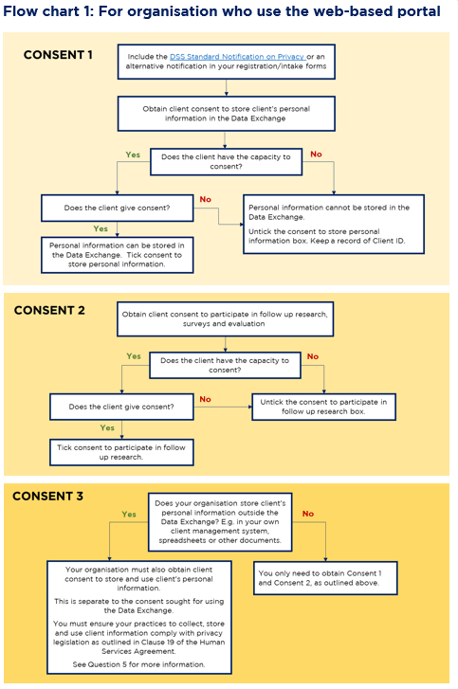
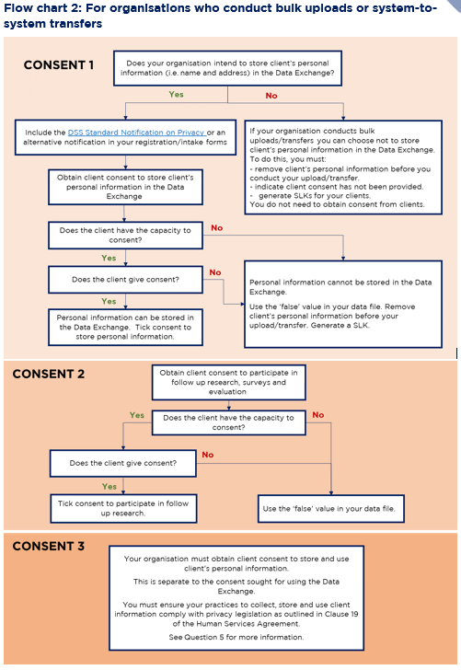
See Using the Data Exchange: Consent and Privacy for more information
Notes:
So, I know this is a little bit confusing and overwhelming. So we’ve developed some flow charts to help you figure out what consent you need to obtain. So the yellow one, on the left is for organisations who use the web-based portal directly, so you can figure out what you need to do. And the orange flow chart on the right, is for organisations who conduct bulk uploads or system-to-system transfers.
I’m not going to go through these now, because they’re pretty self explanatory, but please, if you’re ever confused, download this resource: using the data exchange: consent and privacy and you can work your way through these flowcharts.

Slide 16
What happens if a client does not give consent?
 | Consent to store personal information in the Data Exchange | Consent to participate in follow-up research, surveys, and evaluation
For service providers using the web-based portal | Untick the ‘consent to store personal information’ box in the client’s record. The client’s name and street-level address will not be stored in the Data Exchange. You must still enter this information in the client’s record so a Statistical Linkage Key (SLK) can be generated. You must keep a record of the client’s Client ID. This will enable you to update the client’s information as they continue to participate in your service (e.g. to add additional SCOREs). You will not be able to search for the client by their name in the Data Exchange. You will have to use their Client ID to find them. | Untick the ‘consent to participate in follow-up research’ box in the client’s record.
For service providers conducting bulk uploads or system-to-system transfers | Use the ‘false’ value in your data file. You must generate a SLK or configure your existing system to push SLKs across to the Data Exchange. You can remove a client’s personal information from your XML file or system before uploading it to the Data Exchange. | Use the ‘false’ value in your data file.
Notes:
Ok, so before we wrap up I’m going to address some of the most common questions we get about consent and privacy. All of the questions I’m going to go through are in the document I just mentioned. I’m only going to go through 2 or 3, but there 20 different FAQs in this resource, so if you ever have any questions about consent and privacy, please take a look at this document.
Ok, so the first one is what to do if a client doesn’t give consent to have their personal information stored in the Data Exchange.
The answer to this depends on how you enter or upload your data to DEX. So for organisations who are using the web-based platform directly. All you need to do is ‘untick’ the consent boxes in the client record.

Slide 17
What happens if a client does not give consent?
Notes:
I’ll just show you what this looks like. So the image on the left, is what the data exchange portal looks like when you create a client record. So you can see see the box highlighted red down the bottom, has the two Data Exchange consent statements. All you need to do is untick these, and the client’s personal information won’t be stored in the Data exchange. So if you look at the the screen shot on the far right, you can see the box highlighted red, that says ‘name hidden’, this is what will happen when you untick that consent box. The client’s personal information will be removed.

Slide 18
What happens if a client does not give consent?
 | Consent to store personal information in the Data Exchange | Consent to participate in follow-up research, surveys, and evaluation
For service providers using the web-based portal | Untick the ‘consent to store personal information’ box in the client’s record. The client’s name and street-level address will not be stored in the Data Exchange. You must still enter this information in the client’s record so a Statistical Linkage Key (SLK) can be generated. You must keep a record of the client’s Client ID. This will enable you to update the client’s information as they continue to participate in your service (e.g. to add additional SCOREs). You will not be able to search for the client by their name in the Data Exchange. You will have to use their Client ID to find them. | Untick the ‘consent to participate in follow-up research’ box in the client’s record.
For service providers conducting bulk uploads or system-to-system transfers | Use the ‘false’ value in your data file. You must generate a SLK or configure your existing system to push SLKs across to the Data Exchange. You can remove a client’s personal information from your XML file or system before uploading it to the Data Exchange. | Use the ‘false’ value in your data file.
Notes:
So if we just go back to my table quickly. You’ll untick that box, BUT you must still enter the the client’s in the client record. This is so a Statistical Linkage Key (SLK) can be generated. So their name won’t be stored in the data exchange, but the system will quickly generate a code, an SLK to deidentify the client record.
And then you must keep a record of the client’s Client ID. So you can go back into DEX to update their record as they continue to participate in your service, so if they participate in another activity, or to add SCORE information. So you need to keep a record of the Client ID so you can find the client in the Data Exchange.

Slide 19
Capacity to consent
Can children, young adults or someone with compromised capacity give consent?
For a child, it is best practice to seek consent from their parent or guardian.
However, if you determine a child or young person fully understands what they are consenting to, you can get their consent directly.
DSS propose a general rule: a young person aged 15 and over has the capacity to consent, unless there is something to suggest otherwise. Children and young people aged under 15 are presumed not to have capacity to consent.
You may have clients whose capacity to consent is compromised (e.g. people with disabilities). You may have to implement special practices. You should use your professional experience to determine the best way to obtain consent. For example, a guardian may provide consent on behalf of a client.
What happens when a client does not have the capacity to give consent?
Organisations should use their professional judgement to assess whether a client is capable of giving informed consent.
If you determine that a client does not have the capacity to consent, and there is no one to provide consent on their behalf, you should assume that consent has not been given.
Notes:
Some other common questions are about who has the capacity to consent.
So, for children, it is best practice to see consent from their parent or guardian. A general rule of them, is that anyone under the age of 15 should have a parent or guardian consent on their behalf.
You may have other clients whose capacity to consent is compromised. In these situations, you will have to use your own professional judgement to determine if a client can consent. Have a conversation with them about their data, what your organise will do with it, etc. and try to determine if they fully understand what you’re saying. If you determine they don’t have capacity to consent, you might be able to find someone who can consent on their behalf, like a guardian for example. If there is no one, then you should just assume that consent hasn’t been given.

Slide 20
Key Resources for Privacy and Consent
Data Exchange privacy obligations
Using the Data Exchange: Consent and Privacy
Example client intake form
General privacy obligations
Privacy Information Sheet
Fams have translated the DSS Standard Notification on Privacy into 14 different languages. See the Fams website.
Notes:
Here are all the key resources we looked at today.
On the left are the two resources about the Data exchange. So the top one includes all of the FAQs you could ever ask for. And there is the example client intake form that I showed you.
Also! Fams have translated the DSS privacy notice into 14 different languages – so for those of you who work with clients and English is not their first language, you can use these translated documents to help you talk to them about privacy and consent.
And then the document on the right, is the privacy information sheet that talks about all the privacy stuff we all need to do. Regardless of whether we use DEX to store personal information or not.

Slide 21
Where can I go for help?
Contact | Type of Support
DSS Data Exchange Website | Training resources for the Data Exchange
DSS Helpline: dssdataexchange.helpdesk@dss.gov.au or 1800 020 283 (8.30am – 5.30pm Monday to Friday) | Technical issues with the Data Exchange web platform (NB: not myGovID or RAM)
TEI Website | Training resources tailored to the TEI program
TEI Inbox: tei@facs.nsw.gov.au | TEI specific questions which are unavailable in existing resources
myGovID and RAM support line: 1300 287 539 | Support for issues with myGovID and RAM
myGovID ‘Need help?’ webpage | Support resources for myGovID
RAM ‘Help’ webpage | Support resources for RAM
Notes:
And as always. here are all the places you can go for help if needed.
Thanks everyone.

