Slide 1
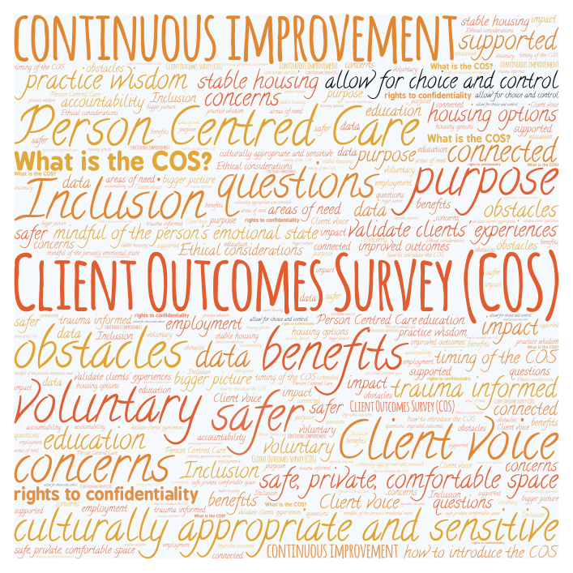
Client Outcomes Survey (COS) SHS Sector Training

Slide 2
We acknowledge Aboriginal people as the First Nations Peoples of NSW and pay our respects to Elders past and present and to Aboriginal colleagues with us today.
We acknowledge the ongoing
connection Aboriginal people have
to this land and recognise
Aboriginal people as the original
custodians of this land.

Slide 3

SHS Outcomes Framework recap; Development of the COS; Why use a COS?
The COS and how to administer it
Using the COS well for the benefit of clients; Building buy-in
Safe and appropriate use of COS surveys with Aboriginal clients
Developing strategies to address potential barriers
Creating a positive data culture; Reporting; CIMS demonstration
Embedding the COS into practice; Next steps

Slide 4
SHS Outcomes Framework recap; Development of the COS; Why use a COS?
The SHS Recommissioning Plan outlined the key work to take place
leading up to and during the current contract term (2021-2024).
These areas include:
Strengthening the focus on client outcomes
Improving service quality with accreditation
Improving services by and for Aboriginal people
Sector development
Implementation of a Program Management Framework
Notes:
Before we look at the COS and learn about putting it into practice, we want to do a recap of the Outcomes Framework and a bit of the journey that the sector has been on in the last few years to bring us to this point.
You may recognise some of this information from the Outcomes Framework training in 2021, and from content in the Framework documents and your Program Specifications and HSA’s. Its significant to remember that the COS is not coming out of nowhere, and is a continuation of a lot of collaboration and conversation between the sector and DCJ.
The SHS Recommissioning Plan outlined the key work that would take place leading up to and during the current contract term (2021-2024).
These areas include:
Strengthening the focus on client outcomes – so that contracts have a focus on measuring, monitoring and driving client outcomes, and the rest of our training today sits within this area of outcomes.
At the same time, we are all working on Improving service quality with accreditation.
Improving services by and for Aboriginal people – through the Aboriginal Sector Growth Project and the Aboriginal Homelessness Sector Action Plan.
In Sector development - DCJ continues to fund the Industry Partnership (IP) to develop strategies and undertake activities and training to support the specialist homelessness services sector and workforce development
And finally there is the Implementation of a Program Management Framework - transitioning to the HSA; development of the SHS Program Specifications; development of an SHS governance structure.

Slide 5
SHS Outcomes Framework recap; Development of the COS; Why use a COS?
DCJ will move towards commissioning for outcomes through
identifying, measuring and driving outcomes.
The following key principles are embedded in the outcomes approach:
That contract payments will not be directly linked to outcomes.
A developmental approach to outcomes management and reporting will be implemented during the term of new contracts between 2021-2024.
A partnership approach recognising that funded services, DCJ and service system partners all have an active role to play in responding to outcomes information.
Addressing systemic barriers and holding other parts of DCJ and other NSW government agencies accountable for whole of government responsibilities under the NSW Homelessness Strategy.
Notes:
DCJ will move towards commissioning for outcomes through identifying, measuring and driving outcomes from its contracted homelessness service providers. This approach shifts the emphasis from the services a provider offers to the outcomes they achieve for their clients.
A set of principles came about to address concerns the sector had during our previous consultations. The following principles remain embedded in the commissioning for outcomes approach:
1. That contract payments will not be directly linked to outcomes. DCJ will continue to advocate this position going forward.
2. A developmental approach to outcomes management and reporting will be implemented during the term of contracts between 2021-2024, recognising that the framework will need to be reviewed over that period.
3. A partnership approach recognising that funded services, DCJ and service system partners all have an active role to play in interpreting and responding to outcomes information.
4. Addressing systemic barriers and committing DCJ to lead and engage with other NSW government agencies to hold them accountable for whole of government responsibilities.

Slide 6
SHS Outcomes Framework recap; Development of the COS; Why use a COS?
SHS HSAs include milestones outlining provider requirements for participating in the Outcomes Framework
Stepped out over the 3 year period from July 2021 to June 2024, nominated deliverables support:
  Progressive trialling of the Outcomes Framework
  Implementation of the Outcomes Framework
  Working towards full implementation of key program expectations
Notes:
Included in the SHS HSAs are milestones outlining participation DCJ is seeking of providers during the current contract in order to implement the Outcomes Framework.
The HSA milestones broadly step out scheduling of deliverables over the contract term, including:
progressive trialling of the Framework;
Implementation of the Framework; and
Working towards full implementation of key program expectations.
The COS rollout sits within the second dot point of implementation and is a Year 2 milestone in your contracts

Slide 7
SHS Outcomes Framework recap; Development of the COS; Why use a COS?
SHS Outcomes Framework.
Domains | Core outcomes
Safety | Clients feel safer
 | Clients make progress addressing their safety needs
Housing | Clients make progress addressing their housing needs
 | Clients sustain their tenancy
Wellbeing | Clients have improved personal wellbeing
 | Clients have improved capacity to tackle future challenges
Companion documents: the Program Logic; the Outcomes Framework Toolkit.
Providers are not solely accountable for Safety, Housing or Wellbeing. Clients don’t have control over all factors that impact safety, housing or wellbeing.
The Outcomes Framework Guide considers context, constraints and attributability.
Three tools will be used to collect data under the Outcomes Framework:
  Client information management systems – provider reported
  PWI – client reported
  COS – client reported
Client participation in the PWI and COS is voluntary.
Notes:
The SHS Outcomes Framework has been developed with three outcomes domains that reflect the HSOF – Safety, Housing and Wellbeing. The wellbeing domain includes social & community, education and skills, health, economic and empowerment domains from the HSOF.
These core client outcomes were developed through sector consultation that stretches back to 2015 and the Industry Partnership Homelessness Outcomes Implementation Group (HOIG) project
The Outcomes Framework Guide is available from the DCJ website, and it includes the Program Logic and the Framework Toolkit. These provide detailed background for each output and outcome, prescribing the indicators and data sources associated with each one, and will help us achieve reporting consistency against these outputs and outcomes.
Two important messages from the Framework are that Providers are not considered solely accountable for Safety, Housing or Wellbeing. And that Clients don’t have control over all factors that impact safety, housing or wellbeing. The Outcomes Framework Guide also ensures that DCJ considers context, constraints and attributability when reviewing outcomes information
There are three tools service providers are required to use to collect data under the Outcomes Framework:
CIMS (or equivalent) – which is provider reported- and which we are already using
PWI – this is client reported and is now rolled out across the sector with strong uptake already
COS – this is also client reported – and these tools have been introduced to ensure inclusion of client voice and their subjective experience in reporting to DCJ.
Note that client participation in the PWI and COS is voluntary, so providers are expected to be trained and equipped to use them, and offer them to clients, but clients can choose to participate with no impact on providers.
CIMS has undergone enhancements to achieve alignment with the PWI and the COS, and these have been replicated in the data systems of providers that are not using CIMS.
Further CIMS enhancements will be developed to achieve full alignment with the Program Specifications, and information, consultation and training in these enhancements will be rolled out prior to their implementation.

Slide 8
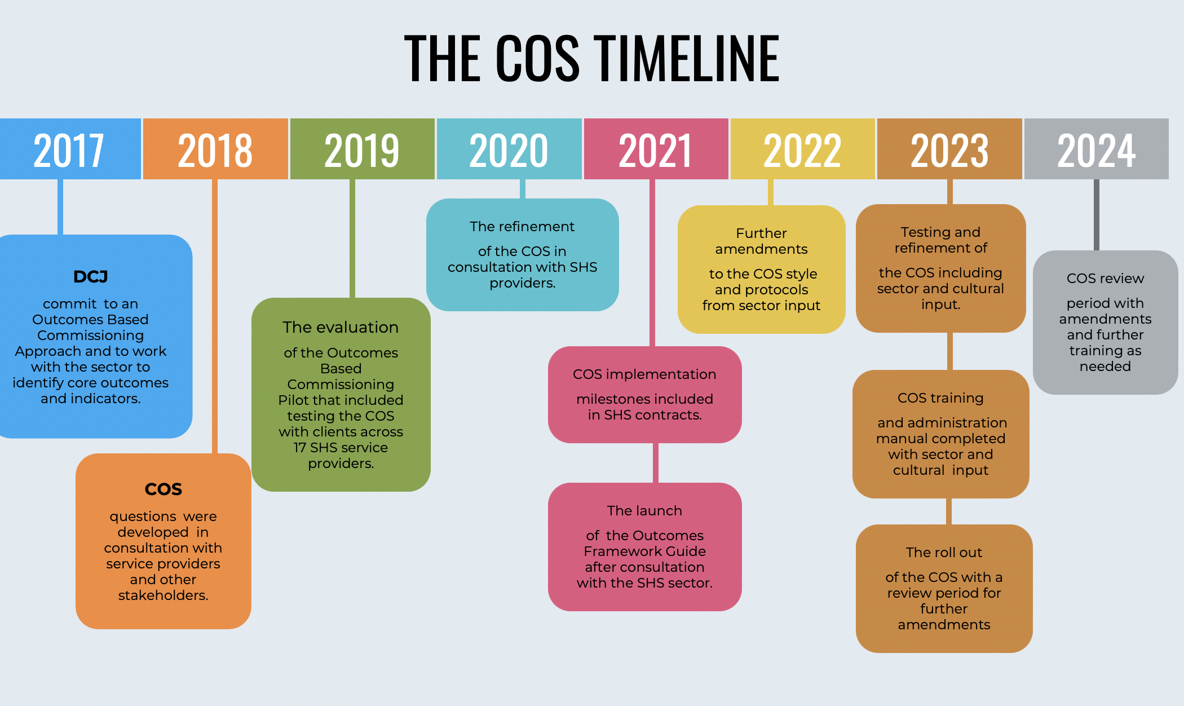
SHS Outcomes Framework recap; Development of the COS; Why use a COS?
Notes:
This graphic details the timeline for the collaborative journey we have been on, to be at the point of rolling out the COS.
In 2017 there was work with the sector to identify core outcomes and indicators.
In 2018 a draft tool was developed.
In 2019 this was used and evaluated in the Outcomes Pilot.
In 2020 the COS received further refinements through extensive sector consultation process and work with peaks and representatives.
In 2021 the COS was included in contracts and launched as part of the Outcomes Framework
In 2022 there was further work on refining the tool based on learnings from the PWI rollout
In 2023 we have continued work with sector representatives through the Practitioner Advisory Group and with peaks and district staff, and with Curijo and Insight, to finalise the tool and processes, develop the manual and training guidance and be here today rolling out the COS.
From now and through to June 2024 there will be an open period of feedback and DCJ will concurrently run preliminary data analysis to understand participation levels and work with the sector to make adjustments as needed and agreed to.

Slide 9
SHS Outcomes Framework recap; Development of the COS; Why use a COS?
The COS Tool refinements, the Administration Manual and the Training Resources have been developed by
Insight Consulting and Curijo Consulting,
in collaboration with the Practitioner Advisory Group (PAG),
representatives from HNSW, DVNSW, Yfoundations,
and DCJ District representatives.
PAG representatives:
  Andrea Davidson - YP Space
  Angela Daynes - Uniting - Western Sydney
  Brett Macklin - St Vincent de Paul Society (Inner City Homelessness Service)
  Gabrielle Ewers – Nova Women’s Accommodation and Support Inc.
  Hernan Guarnaschelli - Wesley Mission - Fairfield
  Kristy Benham and Terry Tupper - Orange Local Aboriginal Land Council
  Lesley Labka – Supported Accommodation & Homelessness Services Shoalhaven Illawarra (SAHSSI)
  Miley Nixon - Bungree Aboriginal Association
Notes:
DCJ acknowledges the contributions of a number of people and organisations noted on this slide, that have worked tirelessly to deliver the tool and guidance that we are presenting today.

Slide 10
SHS Outcomes Framework recap; Development of the COS; Why use a COS?
Notes:
The WHY is critical to understand because it helps SHS staff understand how their efforts contribute to the broader goal of improving the quality of services for clients.

Slide 11
SHS Outcomes Framework recap; Development of the COS; Why use a COS?
Notes:
There has been a policy shift from measuring outputs to outcomes.
Measuring outputs focused on who we reached and what we did, for example, the number of clients who use the program, the number of programs run, and the number of clients using the refuge. This information is important, but it doesn’t tell us the impact of these programs or services.
Outcome measures are important because they help answer the question -are we making a difference in the lives of people that engage with our services?

Slide 12

The COS puts the client at the centre of what funders and providers do
SHS Outcomes Framework recap; Development of the COS; Why use a COS?
Notes:
The COS aligns with person-centered care.
Person-centred care is driven by the person who is receiving the service and is respectful of their needs, values and preferences. Person reported measures collect information from the perspective of the person about their experience with the service, as opposed to measures based on information from SHS staff.
A person-centered measure like the COS acknowledges that the client is a critical and reliable reporter of their safety, housing and wellbeing needs. The aim of the COS is to better understand client needs and experiences.
The evidence supports the use of client outcome measures:
- Whilst there are many different types of measures – recent research indicates that all stakeholders, including funders, providers, and clients, thought that person centred outcomes were important measures.
- There is strong evidence that wellbeing and safety are critical for housing stability.
- Person centred outcome measures, like the COS and the PWI, have been successfully implemented into health services and found to improve outcomes for clients.

Slide 13

The COS is one piece of the puzzle in understanding the impact of SHS service delivery
SHS Outcomes Framework recap; Development of the COS; Why use a COS?
Notes:
Evidence indicates that client outcomes are a critical piece of the puzzle to improve services. The COS however is only one piece of the puzzle that also requires contextual information and practice wisdom.

Slide 14
The focus of the COS is creating a culture of learning and continuous quality improvement
SHS Outcomes Framework recap; Development of the COS; Why use a COS?
Notes:
The COS requires staff practice wisdom to administer the COS – this can ensure the data quality is high. (The way the COS is administered is just as important as the measure)
The COS will provide valuable data, but the interpretation and contextualisation requires practice wisdom. SHS staff can identify patterns and potential factors that may have influenced the outcomes of the COS.
SHS staff wisdom facilitates an ongoing feedback loop between outcome measures and service delivery.
Provides cultural perspective (Aboriginal SHS staff or CALD staff)
Staff wisdom plays a critical role in overcoming obstacles and addressing unforeseen issues.
It’s staff wisdom that encourages reflection and learning from experiences with the COS.
SHS staff wisdom enables the adaption of services gained from their insights and the data.

Slide 15
SHS Outcomes Framework recap; development of the COS; Why use a COS?
The COS and how to administer it
Using the COS well for the benefit of clients; Building buy-in
Safe and appropriate use of COS surveys with Aboriginal clients
Developing strategies to address potential barriers
Creating a positive data culture; Reporting; CIMS demonstration
Embedding the COS into practice; Next steps

Slide 16
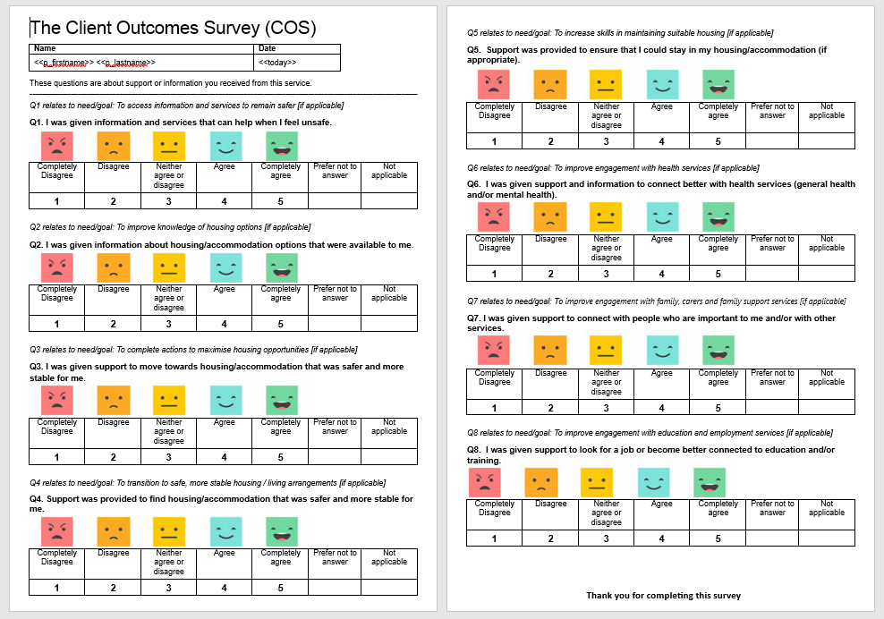
The COS and how to administer it
Notes:
This is the COS Tool, which has been emailed to all providers, and is available to download from the DCJ website.
The COS Tool contains 8 questions which are only to be applied if they are relevant to the individual case plan.
Each question has the option of ‘prefer not to answer’ and ‘not applicable’, and the scale for responses is 1 to 5, from completely disagree to completely agree.
We have used an emoji scale as well to allow choice for clients in what style of response is most meaningful for them.
There is just one version of the COS at this stage, to be used across the board with all cohorts and ages. Unlike the PWI, the COS is not bound by the same restrictions on whether wording can be explained if someone needs assistance to understand a concept. The COS is not measuring a standardized attribute like personal wellbeing, but is asking individuals about their view on the support provided to them. So we want individuals to understand what each question is asking in ways that make sense to them. The ready reckoner and support matcher, presented later in the training, can support with this explanation.
The COS is downloadable as a paper form, and is also built into CIMS and equivalent non CIMS systems – and we’ll see this later in the training.
The COS is subjective, so it is to be answered directly by clients, it is not for providers to create their own responses based on their view of the clients outcomes.

Slide 17
The COS and how to administer it
WHAT | The COS is a voluntary self-report survey that asks clients, who are accessing support, to provide feedback on the progress of their goals in relation to safety, housing and wellbeing.
WHO | The COS can be completed by any SHS client that is aged 12 years and above, who is actively involved in case management, and who gives informed consent.
WHEN | The COS will be administered to clients once towards the end of case management or support period (2-4 weeks prior to exit), for example as part of closing a client’s case plan. Whilst the COS is administered at exit the concept needs to be introduced in the early stages of case management to encourage participation and allow informed consent. Agencies may also choose to use the COS periodically, for example as part of case plan reviews (recommended timeframes are either 3 months or 6 months).
HOW | The COS is administered in a private space where the client is comfortable. Workers can explain the COS and leave clients to complete it, or complete it together. You can use pen and paper or an electronic device, with results entered into your client information management system.
Notes:
Before we discuss the ‘why’, we will look at the what, who, when and how of the COS:
WHAT
The COS is a voluntary self-report survey that asks clients, who are accessing support, to provide feedback on the progress of their goals in relation to safety, housing and wellbeing.
WHO
The COS can be completed by any SHS client that is aged 12 years and above, who is actively involved in case management, and who gives informed consent.
WHEN
The COS will be administered to clients once towards the end of case management or support period (2-4 weeks prior to exit), for example as part of closing a client’s case plan. Whilst the COS is administered at exit the concept needs to be introduced in the early stages of case management to encourage participation and allow informed consent.
Agencies may also choose to use the COS periodically, for example as part of case plan reviews (recommended timeframes are either 3 months or 6 months).
HOW
The COS should be administered in a private space where the client is comfortable. Workers can explain the COS and leave clients to complete it, or complete it together. You can use pen and paper or an electronic device, with results entered into your client information management system.

Slide 18
The COS and how to administer it
Useful tips!
Clients are only expected to answer questions that are relevant to their case plan and support needs. Discuss with the client prior to completing the survey whether any questions may be “Not applicable”.
Some clients and workers may feel more comfortable if the survey is administered by someone that is not the clients primary case manager – providers should discuss this and determine their preferred way of working which may be subject to worker availability.
The COS is not the PWI – clients can have questions rephrased to enable a better understanding, can have the wording explained and examples given if this is helpful to the client.
Notes:
The following points are some useful tips for administering the COS, developed out of consultation.
Clients are only expected to answer questions that are relevant to their case plan and support needs. You can discuss with the client prior to completing the survey whether any questions may be “Not applicable”, or address this as you go through each question.
Some clients and workers may feel more comfortable if the survey is administered by someone that is not the clients primary case manager – providers should discuss this and determine their preferred way of working which may be subject to worker availability. In this case, that worker may want to talk with the primary worker first to understand whether some questions will be not applicable.
The COS is not the PWI – clients can have questions rephrased to enable a better understanding, can have the wording explained and examples given if this is helpful to the client.

Slide 19
The COS and how to administer it
This is critical! -
The COS focuses on the range of supports and services that a client may have received while with an SHS – rather than just the physical or practical end result.
The COS asks the client to comment on whether the assistance received, assisted them towards their goals.
The COS questions ask directly about the support outcomes that the SHS sector selected as most important to measure.
The COS asks about the quality of service supports in terms of outcomes because of the impact these can have on other tangible outcomes and at a later point in time if resources are not currently available. Eg budgeting skills assist a persons housing readiness even though a house may not be ready.
Ready Reckoner and Support Matcher provided to assist in interpreting the COS
Notes:
There are some critical aspects of the COS to understand that will help in using it purposefully.
The COS focuses on the range of supports and services that a client may have received while with an SHS – rather than just the physical or practical end result.
The COS asks the client to comment on whether the assistance received, assisted them towards their goals.
The COS questions ask directly about the support outcomes that the SHS sector selected as most important to measure.
The COS asks about the quality of service supports as outcomes because of the impact these can have on other tangible outcomes and at a later point in time if resources are not currently available. Eg budgeting skills assist a persons housing readiness even though a house may not be ready.
A Ready Reckoner and Support Matcher have been developed to assist you in administering the COS and we’ll look at these now.

Slide 20
The COS and how to administer it
Client Outcomes Survey (COS) Ready Reckoner
Domain | Outcome Detail | COS Question
Determinants of exiting homelessness | Specific things that can help clients get that end result | The way we will ask the client about their view on how well the SHS provided those specific things*
Safety | Clients have been supported to access information and services to remain safer | Q1. I was given information and services that can help when I feel unsafe.
Housing | Clients have further increased knowledge of housing options (if applicable); | Q2. I was given information about housing/accommodation options that were available to me.
Housing | Clients have completed actions to maximise housing opportunities (if applicable); | Q3. I was given support to move towards housing/accommodation that was safer and more stable for me.
Housing | Clients have transitioned to safer, more stable living arrangements (return to home, transitional accommodation, tenancy) (if applicable). | Q4. Support was provided to find housing/accommodation that was safer and more stable for me.
Housing | Clients have further increased skills in maintaining suitable housing (if applicable); | Q5. Support was provided to ensure that I could stay in my housing/accommodation (if appropriate).
Wellbeing | Clients have increased engagement with health / mental health services (if applicable); | Q6. I was given support and information to connect better with health services (general health and/or mental health).
Wellbeing | Clients have improved relationships with family (where appropriate) and support networks (if applicable); | Q7. I was given support to connect with people who are important to me and/or with other services.
Wellbeing | Clients have increased connection to education and employment (if applicable). | Q8. I was given support to look for a job or become better connected to education and/or training.
* Remember, we will use lots of other data to also work out how well SHS’s supported clients to achieve outcomes. The COS is just one way of particularly asking the clients view of how well SHS’s did in supporting them to achieve these outcomes.
Notes:
This is the Ready reckoner and it is available in the Administration Manual.
The ready reckoner connects the original Domain, with the outcome, with the COS question.
Another way of wording this is that the domain, which is a broad determinant of exiting homelessness, is related to the specific things that can help clients get an end result, which is related to the way we will ask the client about their view on how well the SHS provided those specific things.
So, our reason for asking these exact questions is purposeful and related to identified needs and agreed case plans, based on evidence of support that can assist a person to move closer to resolving homelessness.
There is one safety question which asks whether clients were supported with access to information and services about becoming or remaining safe.
There are 4 housing questions. A simple way of describing these questions in order is that Q2 asks about housing information; Q3 asks about housing readiness; Q4 asks about physically moving into housing and Q5 asks about maintaining housing – so the questions follow a logical order, although not each question may be relevant. Please also remember that housing questions are relevant for clients receiving crisis , transitional and independent accommodation or returning to home or remaining in existing accommodation.
There are 3 wellbeing questions which focus on the areas of health, community connections and education and employment. While SHSs may not be delivering these supports, SHSs are involved in information, warm referrals, joined up service delivery, advocacy and direct support in some instances, and we know these areas feature strongly in a lot of individuals expressed goals.
Finally, its critical to remember that DCJ will use lots of other data to also contribute to an understanding of how SHSs support clients, the COS is just one way of seeking the clients subjective view on this.

Slide 21
The COS and how to administer it
COS Support Matcher
Outcome Detail | COS Question | Support types
Specific things that can help clients get that end result. | The way we will ask the client about their view on how well the SHS provided those specific things | The range of supports we may have offered this client to enable this outcome (links to client information management system). Can be used as examples when discussing this question with a client.
Clients have been supported to access information and services to remain safer | Q1. I was given information and services that can help when I feel unsafe. | Assistance for family/domestic violence - victim support services Assistance for incest/sexual assault Child protection services
Clients have further increased knowledge of housing options (if applicable) | Q2. I was given information about housing/accommodation options that were available to me. | Assertive outreach for rough sleepers Advice/information Advocacy/liaison on behalf of client
Clients have completed actions to maximise housing opportunities (if applicable) | Q3. I was given support to move towards housing/accommodation that was safer and more stable for me. | Material aid/brokerage Living skills/personal development Retrieval/storage/removal of personal belongings Advocacy/liaison on behalf of client Financial advice and counselling Assistance to obtain/maintain government allowance Financial information Transport
Notes:
A support Matcher has been developed to provide a broad and holistic view of the specific types of assistance that are relevant to each COS question.
The support matcher is available in the admin manual, and it links each original outcome with the relevant COS questions, and to the range of supports an SHS may have offered a client to enable that outcome.
The list of supports are taken directly from CIMS so will be familiar to you. And these support types may be helpful when discussing the COS questions with clients.
The support matcher may be a useful document to have on hand at work for quick reference when administering the COS.
The current support matcher has not been extensively tested, so we are keen to receive your feedback on any adjustments we need to make for it to be accurate.

Slide 22
The COS and how to administer it
Specific things that can help clients get that end result. | The way we will ask the client about their view on how well the SHS provided those specific things* | The range of supports we may have offered this client to enable this outcome (links to client information management system). Can be used as examples when discussing this question with a client.
Clients have transitioned to safer, more stable living arrangements (return to home, transitional accommodation, tenancy) (if applicable) | Q4. Support was provided to find housing/accommodation that was safer and more stable for me. | Short term or emergency accommodation Medium term/transitional housing Long term housing Material aid/brokerage Advocacy/liaison on behalf of client Transport
Clients have further increased skills in maintaining suitable housing (if applicable) | Q5. Support was provided to ensure that I could stay in my housing. | Assistance to sustain tenancy or prevent tenancy failure or eviction Assistance to prevent foreclosures or for mortgage arrears Material aid/brokerage Living skills/personal development Transport
Clients have increased engagement with health / mental health services (if applicable) | Q6. I was given support and information to connect better with health services (general health and/or mental health). | Material aid/brokerage Counselling for problem gambling Drug/alcohol counselling Specialist counselling services Child specific specialist counselling services Psychological services Psychiatric services Mental health services Pregnancy assistance Family planning support Physical disability services Intellectual disability services Health/medical services

Slide 23
The COS and how to administer it
Specific things that can help clients get that end result. | The way we will ask the client about their view on how well the SHS provided those specific things* | The range of supports we may have offered this client to enable this outcome (links to client information management system). Can be used as examples when discussing this question with a client.
Clients have improved relationships with family (where appropriate) and support networks (if applicable) | Q7. I was given support to connect with people who are important to me and with other services. | Assistance to obtain/maintain government allowance Financial information Family/relationship assistance Assistance for trauma Assistance with challenging social/behavioural problems Legal information Court support Advice/information Advocacy/liaison on behalf of client Child care Structured play/skills development Child contact and residence arrangements Recreation Transport Parenting skills education Professional legal services Financial advice and counselling Interpreter services Assistance with immigration services Culturally specific services Assistance to connect culturally
Clients have increased connection to education and employment (if applicable) | Q8. I was given support to look for a job or become better connected to education and/or training. | Employment assistance Training assistance Educational assistance Material aid/brokerage Advocacy/liaison on behalf of client School liaison

Slide 24
The COS and how to administer it
The COS will apply to :
• Specialist Homelessness Services
• Domestic Violence Response Enhancement
• Core and Cluster
• Aboriginal Homelessness Sector Growth
The COS rollout does not apply to the Premiers Youth Initiative, Universal Support Screening, Together Home or Sustaining Tenancies in Social Housing programs.
The COS can be used by HYAP providers if they opt-in, although there is no program requirement for them to do so until July 2024.
What
Why
Who
When
How
The COS Administration Manual
Notes:
The COS will apply to the following homelessness programs and initiatives:
• Specialist Homelessness Services
• Domestic Violence Response Enhancement
• Core and Cluster
• Aboriginal Homelessness Sector Growth
The COS rollout does not apply to the Premiers Youth Initiative, Universal Support Screening, Together Home or Sustaining Tenancies in Social Housing programs.
The COS can be used by HYAP providers if they opt-in, although there is no program requirement for them to do so until July 2024.
The administration manual sets out how the COS can be administered alongside the practice wisdom of the SHS staff member and includes a script for your use. The Admin Manual will be emailed to you after this session using the email you used to join us today.
The COS must always be administered within SHS policies of trauma informed and culturally safe practices

Slide 25
SHS Outcomes Framework recap; development of the COS; Why use a COS?
The COS and how to administer it
Using the COS well for the benefit of clients; Building buy-in
Safe and appropriate use of COS surveys with Aboriginal clients
Developing strategies to address potential barriers
Creating a positive data culture; Reporting; CIMS demonstration
Embedding the COS into practice; Next steps

Slide 26
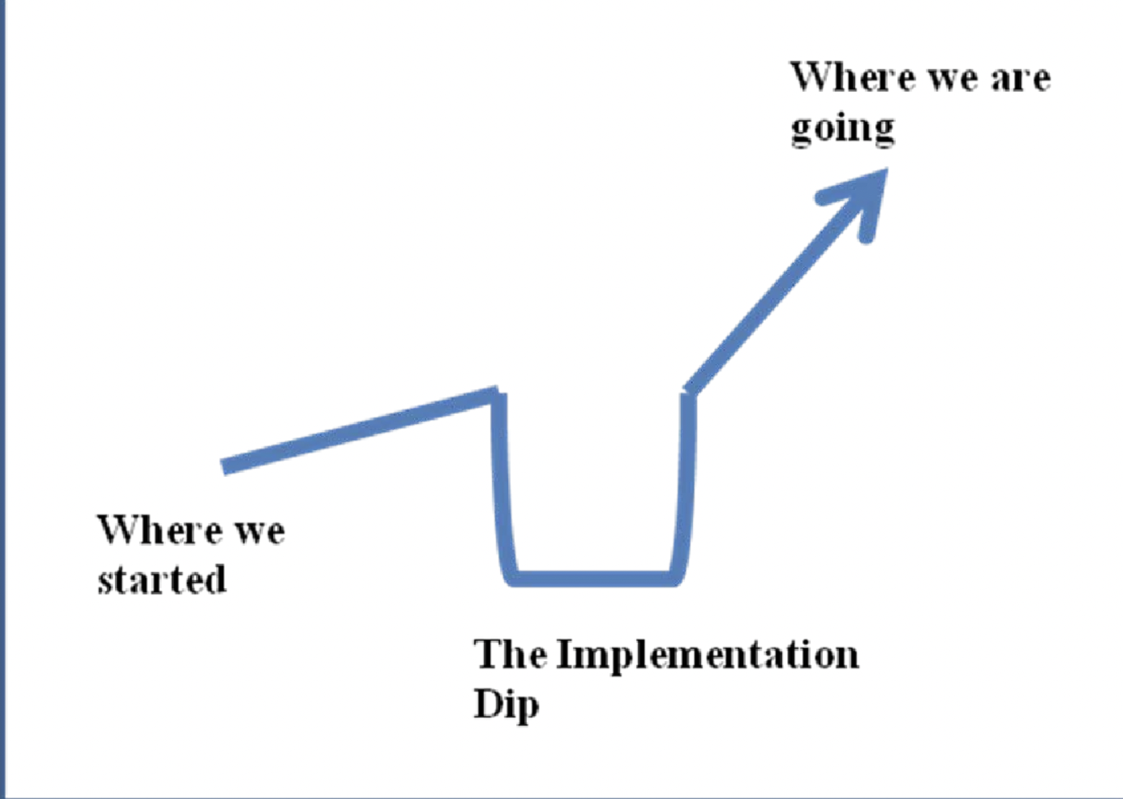
Implementing outcomes involves a shift in mindset, skill sets and data culture.
__________
Using the COS well for the benefit of clients; Building buy-in
Notes:
Implementing the COS into a diverse sector takes time and commitment.
The diagram illustrates the implementation dip that occurs when implementation strategies are not used to embed outcomes into practice.
There are three critical drivers for implementation – leadership, capacity building and organizational factors.

Slide 27
Managers:
Using the COS well for the benefit of clients; Building buy-in
set
the vision for the COS rollout and demonstrate its value
communicate
the plan including the details and expectations
maintain
the focus and set goals
build
a culture of learning and improvement.
understand
issues that may impact the rollout and be able to answer SHS staff questions about the process
Notes:
Convincing SHS staff to commit to the necessary changes requires managers who truly believe in the approach and are willing to model the necessary changes.
Whilst implementation will start with managers, in implementation terms, ‘leadership’ is not exercised by a single person but a range of people, including frontline staff who will use different types of leadership, for example, modelling and sharing practice wisdom. It is these different types of leadership that ensure the outcomes are adopted and embedded sustainably into practice.

Slide 28

Organisational readiness
Using the COS well for the benefit of clients; Building buy-in
What is the climate for change?
What are SHS staff beliefs, fears, knowledge and experience of using measures?
Notes:
This step is often ignored but is critical if you want to capture quality data.
Addressing fear - Encourage an open and non-judgemental space where staff can share their fears, concerns and practice wisdom. Fear looks different for CEOs, managers, frontline staff, and clients.
For example, some Managers/leaders were concerned about how the data will impact funding. This requires fostering trust and transparency between funders and agencies including open communication.
Some SHS staff were concerned the data would be used to judge their work.
• No staff data is being collected by DCJ. The emphasis is on improvement and services not on blaming individuals or teams.
• Individual agencies will create their own continuous quality improvement using data, but it is important to create a culture where there is no bad data. All data is an opportunity to get curious about what may be happening – bringing in the context – looking at it from different perspectives – using staff wisdom.
• It’s important to set up a process that staff can follow when they feel fear or are provided with negative data.
If the COS is only used as a feedback form, it’s best practice that SHS staff don’t see their client’s feedback whilst the client is still in the service. (Note this will be different if the COS is being used as a case management tool). If this is not possible, SHS staff should have a process to follow so that fear is not projected (often unconsciously through body language) onto clients.
Examples include:
o opportunities to debrief with a supervisor – sharing your concerns with others who understand your work can provide validation, perspective, and emotional support.
o Promote self-care strategies and emotional wellbeing at work. Recognise the negative data does not define your competence but is an opportunity to get curious about the clients’ perspective.
o Foster a culture where team members can learn from each other, share strategies for managing difficult data and celebrate successes together.
o Celebrate learning and growth. Encourage staff to view negative data as an opportunity for growth and improvement rather than a measure of failure. Foster an environment where mistakes are seen as learning opportunities and where continuous improvement is valued and celebrated. Focus on the positive impact you can make through learning.
o Reflect on the meaning of the data. Negative data may be an opportunity for improvement. Reflect on how the data can inform your practice.
Addressing past negative experiences using feedback forms - Managers need to know what experiences their staff have had with feedback forms. Some staff have had negative experiences. In some cases, staff never received training, understood the why, or ever saw the data. This impacted the way staff administered the feedback form.
‘DCJ want you to do this.’ - This impacts the message to clients. In another example, no instructions were provided to the client. They were just handed the feedback form. This client asked why they needed to fill it out and another client told them it was, so they get funding. The quality of the data depends on the way the COS will be administered.

Slide 29
How fears, beliefs and past negative experiences can impact the roll out of the COS - Learnings from the Pilot
Using the COS well for the benefit of clients; Building buy-in
“We need to do this because if we don’t get the funding we are stuffed.”
“It made me angry.”
“We didn’t have a choice. it was just rolled out.”
“We’re just ground-level workers, our thoughts and opinions don’t matter.”
“It was a top-down delivery. (Manager)
“How do you sell the benefits of the COS if staff don’t know it or believe it or see it yet ourselves?” SHS Manager
Notes:
Because of the quick rollout in the outcomes based commissioning pilot, many frontline staff didn’t receive the training or time to process the COS, or have their fears or concerns addressed. This created an implementation dip with the following consequences.
1) Staff didn’t feel like they were part of the process.
2) Staff thought that the reason for the COS was based only on funding. This impacted the way they introduced the COS and the way the clients filled out the COS.
3) This meant many staff did not have buy-in for the use of the COS and some staff were angry that they had to administer the COS to clients when they thought the only benefit was to the funder and this was not aligned with their values.
Every agency will have different levels of organisational readiness for using the COS and will need to create a plan that includes both top down and bottom-up strategies that make sure SHS staff get the support they need.
This takes time.
Before you start using the COS, each agency will need to make sure their staff have buy-in for administering the COS (best practice) or be building buy-in for using the COS.

Slide 30

What is buy-in?
Using the COS well for the benefit of clients; Building buy-in
Buy-in doesn’t mean ignoring your beliefs or minimizing your fears. Buy-in is having an open mind to the potential benefits of using the COS with clients.
Buy-in is making sure that your mindset doesn’t become fixed on only the negative.
Buy-in includes having bottom-up strategies so SHS staff can share their practice wisdom and any of the obstacles they are facing or concerns they have.
Notes:
Buy-in is having a growth mindset for the use of the COS. That doesn’t mean fears or concerns are ignored or repressed. It means having an open mind or a curiosity about the potential benefits of the COS for both clients and SHS staff and the agency.

Slide 31
How do SHS staff benefit from administering the COS?
Using the COS well for the benefit of clients; Building buy-in
The COS, alongside your practice wisdom, will be part of the continuous quality improvement of your service.
COS data across the SHS sector can also provide you with a bigger picture to help you understand how SHS services overall are impacting clients.
COS data can increase accountability by demonstrating the effectiveness of your service to both funders and clients.
Notes:
This data, when used by agencies, can help build trust and confidence in the work that you do and can enhance your credibility as a service provider, not just to funders but to clients too.
Clients want to know that their voices are informing service improvements.

Slide 32
Indirect benefit - What you measure you focus on For example – Safety
Using the COS well for the benefit of clients; Building buy-in
What we know about safety is that:
trauma disrupts clients’ feelings of safety
it is mainly unconscious
when you feel unsafe you are in a defensive state (FFF) and this impacts the way you see the world (focused on danger)
when clients feel unsafe it is difficult to think or plan for the future
you can’t heal when you feel unsafe
humans are social beings who rely on social connection for safety and wellbeing
Notes:
The COS focuses on housing, safety and wellbeing. What you measure you focus on and this can have several indirect benefits to SHS staff.
For example, there has been a dramatic increase in our understanding of how safety impacts a client’s ability to recover from trauma, in the last five years.

Slide 33
Helping clients feel safe
Using the COS well for the benefit of clients; Building buy-in
Trust
Active listening by fully focusing on the client’s words, tone and non-verbal cues. Provide non-verbal feedback to show that you are present and attentive.
Tone of voice
Body language (warm, calming presence)
Verbal acknowledgement of distress
Modelling of behaviours that can lower the stress response
An environment that supports emotional and physical safety.
Notes:
This focus on safety could help facilitate discussions that could enhance staff ability to respond to a client’s stress response and also remind them of the importance of taking care of their own nervous system response.
The discussion could start with staff sharing their practice wisdom on how they facilitate a feeling of safety for their clients.
To prompt the discussion, you could ask:
What are the signs a client doesn’t feel safe? What are the strategies they use to help clients feel safer? Do these strategies change depending on the culture/age/gender of the client? Are there times you can’t help a client feel safe?
The discussion could also focus on the prevention of vicarious trauma. This starts with awareness. What does it feel like for SHS staff to hold the space when clients don’t feel safe? It is important to pay attention to your physical and emotional state during interactions with clients. Human beings co-regulate so whilst you may be able to send cues of safety to clients your nervous system may be picking up cues of threat from your client. Vicarious trauma is contagious and there needs to be strategies in place that prevent it.
Create a culture where staff learn from each other - What strategies do SHS staff use to help ensure they don’t become dysregulated by the client?

Slide 34
Consequences of a lack of buy-in from SHS staff
Using the COS well for the benefit of clients; Building buy-in
“Staff have to ask the questions because it’s their job but really do they care? They don’t really care about you, it’s just their job. Otherwise, they’ll probably get in trouble by their boss or whoever comes to check things.”
“I just went tick, tick, tick.”
“DCJ want you to fill this out.” SHS staff
“They only get us to fill this out, so they get funding.” Client
Notes:
We’ve looked at some of the reasons why the COS may benefit staff and help improve buy-in from SHS. Now we will go over a few reasons why SHS staff should have buy-in for the COS.
A lack of buy-in (fixed mindset) leads to resistance. This then impacts how SHS staff interpret obstacles. For example, SHS staff who lacked buy-in reported higher numbers of refusals as articulated by the following worker and these refusals were seen as evidence that the COS was inappropriate for clients.
“I reckon more than 50% of my clients just blatantly refuse to do it.”
This is consistent with previous studies which found a lack of buy-in means implementation barriers are unlikely to be resolved.
As mentioned previously, SHS staff buy-in impacts client buy-in and the quality of the data.

Slide 35
Case study
Using the COS well for the benefit of clients; Building buy-in
“the worker made me feel like they really wanted to understand what I had to say.
They gave me the piece of paper to do it and at first, I thought it was going to be just another useless form for me to fill out, but it was about my goals. I answered it honestly.”
Notes:
In a case study from the pilot -
• The worker was concerned about DCJ involvement, and this made them resistant to using the COS.
• The worker also felt like they were letting the agency down by not administering the COS.
• The worker didn’t want to give it to any of their clients without understanding how the COS could benefit them and be administered in a way that supported their values.
• They started with a few clients. It’s ok to start with clients you think will be more receptive to build your confidence. In the beginning, it may feel a bit forced when you are administering the COS. It’s important to share your practice wisdom with the group so you can learn from each other.
• Whilst it is ok to start slow it is important that the COS is administered in a way that includes all clients.
Tips in the administration of the COS:
• Include frontline staff in the implementation of the COS by having bottom-up strategies.
• Introduce the why of the COS early in case management so clients can make an informed decision about filling out the COS (should be empowering).
• It is best practice that the COS be administered by another colleague.
• It is best practice that the data be given to the team leader and not be looked at by the frontline worker before the client exits.
• Address concerns and challenges as they arise.
• Celebrate the successes
SHS staff should feel essential, valued, and knowledgeable partners in the change process.

Slide 36
SHS Outcomes Framework recap; development of the COS; Why use a COS?
The COS and how to administer it
Using the COS well for the benefit of clients; Building buy-in
Safe and appropriate use of COS surveys with Aboriginal clients
Developing strategies to address potential barriers
Creating a positive data culture; Reporting; CIMS demonstration
Embedding the COS into practice; Next steps

Slide 37
Building Trust and Safety for Aboriginal clients when administering the COS
Safe and appropriate use of COS surveys with Aboriginal clients
Respecting cultural diversity, values and beliefs
Understanding and acknowledging cultural differences
Recognising that language barriers, discrimination, racism and historical trauma have an impact on our client’s experience
Being transparent and inclusive in our actions and decisions
Notes:
As an Aboriginal business, Curijo has contributed to the development of the COS Administration Guide and training to assist workers in developing a greater understanding of culturally safe language when using the COS and tips and strategies for implementing the processes. What supports culturally safety is the delivery, we have accountability in our approach to support cultural responsiveness and safety.
When using the COS with Aboriginal clients in is important to understand the impacts of ongoing practices including colonisation, Stolen Generations, racism and discrimination that have created an inherent distrust of government authorities and those who administer its services.
In order to build trust, we need to build relationships, there are many ways to build strong, positive and professional relationships when using the COS, some of these include:
• Deep listening - cross cultural communication requires a person to have the ability to stand back at times and wait for your turn to talk instead of jumping in and being impatient and pushy
• Silence is ok – we often want to fill the silence with what we think is the answer
• Take into consideration your role, any power imbalances when asking questions or providing information about the COS and what it is being used for
• Adapt your communication style
• Be respectful with your words and actions
• Use a strength-based approach
• Use a trauma informed approach
It is important to remember that relationships, engagement and rapport building are all intertwined.

Slide 38

Culturally responsive bias relevant to the COS Survey
Safe and appropriate use of COS surveys with Aboriginal clients
Culture can also teach people to respond to personal questions with various levels of caution. For example, Aboriginal people have experienced and still experience systematic racism in Australia and these experiences makes some Aboriginal people reluctant to answer questions.
"
Notes:
It is important to practice cultural humility by acknowledging that your own experience may limit your understanding and ability to fully grasp the experience of another.
This will include reflecting on your biases. It is critical to acknowledge that western society is built upon white ideals expecting all others to fit within the box.
As shared in the COS Administration Guide – “Bias may not be intentional but implicit. Implicit bias refer to the attitudes, beliefs and stereotypes that unconsciously affect your actions and decisions. It is ingrained in your socialisation and early experiences. Implicit bias may manifest in your body language, and words without your conscious awareness.”
When using the COS some tips and strategies include;
• Acknowledge that there will always be cultural differences
• Understand that our implicit bias is learned through one’s exposure to different experiences - good or bad, race, ability and other lived experiences
• Our bias could be considered discriminatory or racist whether deliberate or unintentional
• Can be caused by subconscious responses or reaction based on experiences
• Understand the impact caused by labelling Aboriginals as the same
• Be prepared to address discrimination or racism
There is over 150 types of bias, so how do we deal with these:
• Know your biases well – read about them to understand – know that they exist
• Always think critically – look at problems as diamonds with many facets and not like a coin with only two sides.
• Challenge assumptions and traditions – always practice empathy and take a contrary view and ask why and why not and always embrace diversity and difference – see difference as a strength
• Use reflective practice regularly – ask your peers for constructive feedback

Slide 39

Safe and appropriate use of COS surveys with Aboriginal clients
Buy-in for the COS from an Aboriginal cultural perspective
Notes:
Aboriginal clients may feel reluctant to complete the COS because of past negative experiences of filling out forms. This includes past practices that have devalued Aboriginal peoples’ cultures that are integral to improving outcomes for Aboriginal peoples. Research indicates that people from minority cultures are more likely to feel judged and misunderstood when engaging with services, which can lead to mistrust and may make clients reluctant to complete the COS.
When using the COS it is important to first put the client at the of what we are doing and for Aboriginal peoples this should include:
• Explaining the purpose and benefits of participating
• Emphasise the importance of feedback
• Encourage clients to see the COS as an opportunity to provide feedback and help improve services
• Be respectful if they don’t want to participate – choice is important
• Aim to deliver a safe, accessible and responsive service free of authoritative overtones
• Acknowledge any worries, fears or challenges that may be shared with you
• Stay engaged, repeat that you are there to support them (walk to talk)

Slide 40
Cultural tips when administering the COS
Safe and appropriate use of COS surveys with Aboriginal clients
Respect
Protocols
Two-way Communication
Have a yarn
Have a cuppa
Time
Networks
Be approachable
Be real
Notes:
Some cultural tips and considerations when using the COS are:
• Be respectful in your engagement, take your time and don’t rush the process
• Remind them you are there to help if they need it
• Allow the decision making to be done by the client, without influence
• Be prepared to listen – truly listen
• Be honest in your approach
• Be sensitive in the way you speak
Advise participants of the three T’s being time, trust and tea. We need to allow time to build trust and always have a cup of tea if this is offered to you.
It is beneficial to get to know the local Aboriginal community in which you deliver services too, even as Aboriginal people we have to follow the local protocols of the community. You should research the local protocols and follow these.
And always be real – be a genuine ally, for those who are not Aboriginal. Thinking about your intent to work alongside and support Aboriginal clients, is your intent genuine or performative. It is key to identify intent.

Slide 41
Safe and appropriate use of COS surveys with Aboriginal clients
Creating cultural safety when administering
the COS
Cultural Safety
Cultural Capability
Knowing
Doing
Being
Cultural Awareness
Cultural Sensitivity
Notes:
It is also important to recognise that culture has been a protective factor against over two centuries of colonisation and the imposition of a dominant culture on all aspects of Aboriginal and Torres Strait Islander peoples’ lives and should be part of all discussions about increasing the wellbeing of Aboriginal clients.
Cultural safety requires actions that recognise, respect and nurture the unique cultural identity of a person and safety meets their needs, expectations and rights.
It means working from the cultural perspective of the other person, not for your own perspective.
Creating cultural safety when using the COS means:
• Using clear, value-free, open and respectful communication
• Trust between workers and clients with all contributions valued
• Stereotypical barrier recognised and avoided
• Everyone is engaged in a two-way dialogue where knowledge is shared
Cultural Safety is not something that can be claimed by workers or the organisation, it is an experience by the Aboriginal or Torres Strait Islander peoples.
It takes time and commitment to create cultural safety in the workplace
• Knowledge and understanding of cultural differences and history
• Learning and practicing sensitive and effective behaviours with clients when using the COS
• Building trust and genuine partnerships inside the workplace as well as with your community
If your workplace is culturally safe, then the work environment is spiritually, socially, emotionally, and physically safe for everyone. Remember this is determined by the person, not the organisation and we are accountable to create cultural safety for all who we work with.

Slide 42
SHS Outcomes Framework recap; development of the COS; Why use a COS?
The COS and how to administer it
Using the COS well for the benefit of clients; Building buy-in
Safe and appropriate use of COS surveys with Aboriginal clients
Developing strategies to address potential barriers
Creating a positive data culture; Reporting; CIMS demonstration
Embedding the COS into practice; Next steps

Slide 43
Social desirability bias
Developing strategies to address potential barriers
Social desirability is a human phenomenon.
‘I think you’re always going to have a problem with people sitting in homelessness that want to tell you what you want to hear. This makes clients vulnerable to being exploited. If funding requires favourable responses how do you ensure these tools are delivered ethically?’
Notes:
We’ve looked at some of the implementation barriers relating to fear and resistance, staff and client buy-in, including time to embed the COS.
Social desirability highlights the critical importance of HOW the COS is administered.
The presence of the social desirability bias has been found in all types of self-reported measures. Research indicates that social desirability ranges from approximately 5% to 40% and can increase depending on the vulnerability of the people and the circumstances. For example, research has shown that the social desirability bias can increase up to 40% for people with an intellectual disability.

Slide 44
Addressing social desirability
Developing strategies to address potential barriers
Understanding what motivates people to answer questions with a socially desirable response
Introduce the COS early to ensure that people accessing services understand the ‘why’ of the COS
Helping people understand there are no right or wrong responses
Being mindful of how a SHS staffs' manner could send subtle messages about desirable responses
Reassuring people accessing services that their data will be used to improve services not judge SHS staff
Using another SHS staff member to introduce the COS
Notes:
What is the key message you want a client to get when you administer the COS?
Some clients felt they had to fill out outcome measures positively for organisations, so they get funding. It is important that clients get the message that the COS is about improving the quality of services.

Slide 45

The client is concerned about how the data will be used.
Developing strategies to address potential barriers
Be transparent
Explain the steps that will be taken to protect their data
Let them know de-identified data(their name is not included) is sent to DCJ
Share previous results.
Notes:
Be transparent in describing how the COS data will be stored and shared. If a client expresses privacy concerns, explain the steps that will be taken to protect their personal information, such as using secure storage and limiting access to authorised workers only. Let clients know that data provided to DCJ is de-identified which means that their name will not be transferred with the data.
Let them know that their worker will not see the individual results.
Share the results you receive from DCJ that shows how the data is being used by your service so they can understand this is about the bigger picture of using all client’s data rather than looking at individual results.

Slide 46
Clients leaving before the end of the service
Developing strategies to address potential barriers
Introduce the COS early so clients understand the why
Administer the COS early when you notice signs a client may be about to leave.
Administer the COS over the phone (using a different SHS staff staff member)
Mailing out the COS to the client (if appropriate)
Using the COS periodically throughout their case management.
Notes:
You need strategies such as these ones to prevent missing data (you want to be as inclusive as possible)

Slide 47
SHS Outcomes Framework recap; development of the COS; Why use a COS?
The COS and how to administer it
Using the COS well for the benefit of clients; Building buy-in
Safe and appropriate use of COS surveys with Aboriginal clients
Developing strategies to address potential barriers
Creating a positive data culture; Reporting; CIMS demonstration
Embedding the COS into practice; Next steps

Slide 48

Creating a positive data culture
Notes:
Creating a positive data culture starts by talking about fear of data. Show how your agency will use data as a tool to enhance their work, not to criticise their performance.
Developing a culture across the sector of monitoring and learning which values data as evidence - means staff need to see data being used within their organization to reflect on and improve services.
Encourage a collaborative approach where SHS staff can contribute their insights and expertise to shape the data practices.
Start small to build SHS staff confidence in using data.
Recognise and celebrate successes and achievements resulting from the use of the data.

Slide 49
Continuous Quality Improvement with a focus on improving outcomes for clients
Creating a positive data culture
Plan
Do
Analyse and interpret
Act
Notes:
Accountability cannot be the main driver for continuous quality improvement. This can create a fear-based response that hinders a focus on quality improvement.
The focus should be on sector improvement that holds both DCJ and the agency accountable for improving client outcomes.

Slide 50
Getting comfortable with negative data
Creating a positive data culture
‘I’ve been in the industry a long time. I’m very sceptical about data and data use. The way the numbers are crunched. The pressure is to always show improvement. It’s not based on reality. Just look at our annual reports or the annual reports of any organisation. We only highlight the positive. The negative gets covered up. It’s been like that for years. How do you change that?’ Team leader
In the early stages of implementation there needs to be a culture that provides permission to ‘fail and learn from it’.
Notes:
This is an example from the pilot of an agency where insights from negative data led to a positive outcome for clients.
An agency found that safety data was declining at exit.
This created a lot of fear for some staff and some of the staff felt judged. The Managers and the CEO created a safe space that allowed staff to speak freely about their fears and concerns. This opened a discussion that felt non-threatening to staff. These discussions led to a change in case work that included earlier and more frequent discussions about leaving the service which led to an increase in strategies and/or referrals that helped clients feel safer at exit.
This led to staff being more curious about the data from the COS and the PWI as they wanted to see if the new strategies, they were implementing would lead to changes in outcomes from the client perspective.

Slide 51
Reporting
The primary purpose for collecting and reporting data is to identify and
implement evidence-based responses to improve client outcomes.
Measuring client outcomes, program activity data and provider performance allows the provision of regular feedback to service providers to enable them to make iterative improvements.
Communicating performance feedback gives providers an opportunity to:
  Understand their contribution to different measures of success
  Align strategies to deliver desired outcomes
  Agree on how responses, if required, will be made.
  share scenarios where they are being impacted by external factors.
Performance monitoring enables providers and stakeholders to monitor activities and to demonstrate what interventions are most effective, where innovation is required and what support is required to enable change.
Continuous learning, innovation and improved service delivery for clients
Notes:
The primary purpose for collecting and reporting data through CIMS (and equivalents), the PWI and the COS, is to identify and implement evidence-based responses to improve client outcomes.
Measuring client outcomes, program activity data and provider performance allows the provision of regular feedback to service providers to enable them to make iterative improvements throughout the term of the contract.
Communicating performance feedback gives providers an opportunity to:
Understand their contribution to different measures of success
Align strategies to deliver desired outcomes
Agree on how responses, if required, will be made.
It also helps providers to share scenarios where they are being impacted by external factors.
Understanding these elements of a program is essential for quality improvement as it assists the sector to demonstrate what interventions are most effective, where innovation is required and what support is required to enable change within an organisation and their delivery practices.
This process supports continuous learning, innovation and improved service delivery for clients

Slide 52
Reporting
A positive working relationship between DCJ and service providers is crucial to a contract’s success and the achievement of client outcomes.
The Funded Contract Management Framework (FCMF) requires collaboration, regular interaction and communication, and recognition that each provider is different.
Performance monitoring includes regular and annual monitoring processes.
An intention for Outcomes Framework data, including COS results, is promoting outcomes-focused, evidence-based discussions covering:
  A strengths-based review of the key achievements in relation in promoting client safety, housing and wellbeing
  A collaborative, partnership-based review of key opportunities and agreed responses to improve client outcomes within the HSA constraints / local context
  Clear processes for identifying and documenting barriers to the achievement of client outcomes – and protocols for escalation of unresolved barriers to district or state-wide homelessness program forums.
Notes:
A positive working relationship between DCJ and service providers is crucial to a contract’s success and the achievement of client outcomes.
Funded Contract Management Framework (FCMF) is strengths-based and grounded in the shared goals to achieve client outcomes – requiring collaboration, facilitated by regular interaction and communication, and recognition that each service provider is different and requires individual attention.
Performance monitoring is integral to funded contract management and includes regular and annual monitoring processes.
An intention for Outcomes Framework data, including COS results is that this information would be used to promote outcomes-focused, evidence-based discussions about individual contracted performance (under the FCMF) and broader program performance - covering:
A strengths-based review of the key achievements in relation in promoting client safety, housing and wellbeing
A collaborative, partnership-based review of key opportunities and agreed responses to improve client outcomes within the HSA constraints / local context
Clear processes for identifying and documenting barriers to the achievement of client outcomes – and protocols for escalation of unresolved barriers to district or state-wide homelessness program forums.
This is not new – this is all taken from current outcomes framework in your program specifications.

Slide 53
Reporting
The Outcomes Framework Guide explains how outcomes information
will be used: this involves four reports and three levels of accountability.
Reports:
Outcomes Report - Specialist Homelessness Services ‘case management’
Outcomes Report - Shared Service System (in development)
Outcomes Report - Client Participation
Outcomes Report - Access Clients (in development)
Accountability:
Level 1: accountability will occur within the individual relationship between provider and
contract manager.
Level 2: accountability will occur within the District Governance Groups.
Level 3: accountability will occur within the Program Steering Committee.
These levels correspond to governance structures in the SHS Program Specifications.
Notes:
The Outcomes Framework Guide explains how outcomes information will be used:
this involves four reports and three levels of accountability.
These reports will be automatically generated based on the information that is entered into CIMS as part of everyday practice. This is designed to minimise the extra workload required by an outcomes framework.. The four reports are as follows:
1. Outcomes Report - Specialist Homelessness Services (Section 2.3/Table 3)
The client outcomes detailed in this report, are mostly applicable for Case Management clients. While the report function for the PWI already exists, the function for the COS is still in final stages of development and will be available shortly. Work will be underway to develop a report template that brings this data together with other CIMS data for case managed clients to create the Outcomes report
2. Outcomes Report - Shared Service System (Section 2.4/Table 4)
This report outlines the draft shared service system outcomes, where there is shared responsibility across all service system partners. These outcomes wont yet be reported against.
This report and the set of outcomes and indicators behind it, will be built on over the coming months and years.
3. Outcomes Report - Client Participation (Section 2.5/Table 5)
These are additional outputs and outcomes that specialist homelessness service providers are expected to collect and report on in relation to the participation of Case Management clients. This information is designed to capture rates of participation. This will support service providers to demonstrate their achievements with regards to this participation milestone. We’ll be rolling out this report template and function shortly
4. Outcomes Report - Access Clients (Section 2.6/Table 6)
Service delivery with Access clients is an important contributor to overall outcomes in addressing homelessness. due to the requirement for clients to be involved in case management before the COS can be applied, a number of other outputs and outcomes have been designed to capture data and performance information that is applicable to Access clients. Work will be underway to develop a report template that brings this data together for access clients to create the Outcomes report
Over time, DCJ is interested in exploring other indicators to better understand the contribution of the brief interventions to client’s safety, housing and wellbeing.
These four reports will be used to identify responses to outcomes data at the three levels of accountability.
Level 1: accountability will occur within the individual relationship between provider and contract manager.
Level 2: accountability will occur within the District Governance Groups.
Level 3: accountability will occur within the Program Steering Committee.
Level 1 meetings are the equivalent to the contract mgmt. meetings that you have now with your CPO. Outcomes data will be an addition to the content that’s discussed in those meetings now.
There is an expectation that issues can be escalated between these levels.
Accountability is not one-way – there is mutual obligations between providers and Districts, between Districts and Commissioning staff, and between DCJ Commissioning and providers.

Slide 54
Reporting
Notes:
The elements of the Outcomes Framework that we have discussed so far, are presented here as a process map outlining the steps in collecting and using outcomes information.
It shows that the primary purpose for collecting outcomes data is to implement responses to improve client outcomes. And this responding to outcomes data is what happens at levels 1, 2 and 3.
It assists the sector to demonstrate what interventions are most effective, where innovation is required and what support is required to support change within an organisation and within the sector and beyond.

Slide 55
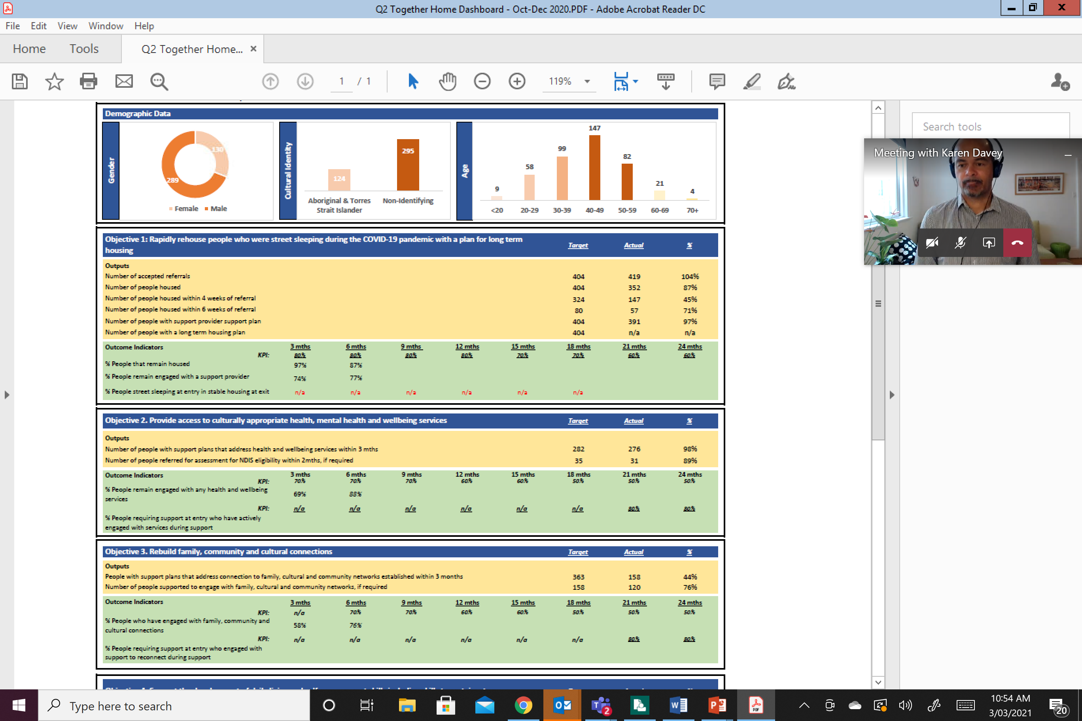
Outcomes data dashboard - Example only
Reporting
Notes:
To give you an idea of what reporting will look like, this is an example of the Together Home program dashboard, which is using an outcomes framework. The dashboard is a high level view bringing together data from each of the reports.
A dashboard similar to this will be created once data is populated in CIMS, and merged with non-CIMS data. This will be used at the contract mgmt. meetings, and at the levels of governance within SHS.

Slide 56
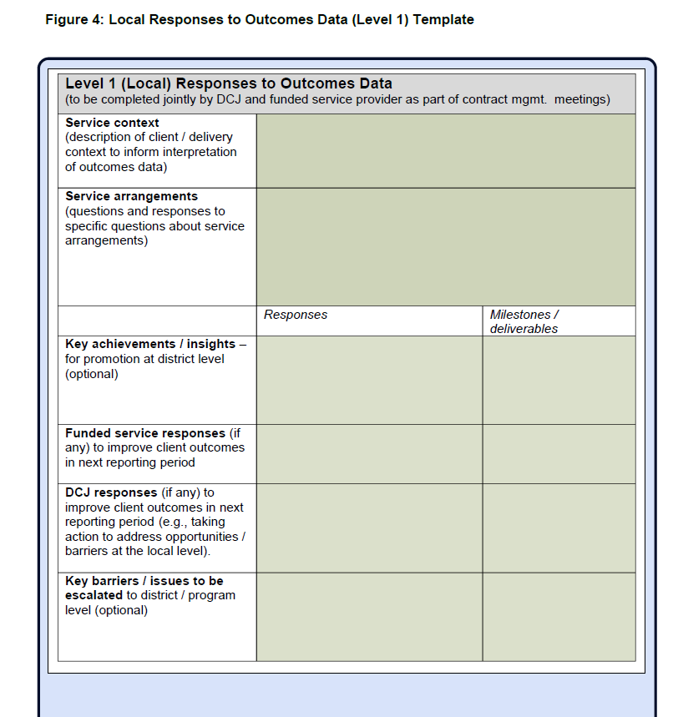
Outcomes Reporting Template - draft
Reporting
Notes:
This is the draft outcomes reporting template that will accompany the data reports just discussed. This template is included in the Framework guide. While the look of this may change before we start using it in accountability discussions, the feature to notice is that this report seeks qualitative information from providers to balance the quantitative data and to tell a complete story. This template provides the opportunity to address context, cohort specific information, location specific information, highlights, barriers, constraints and issues, and to record planned responses that both providers and DCJ have agreed to pursue, and issues to be escalated.

Slide 57
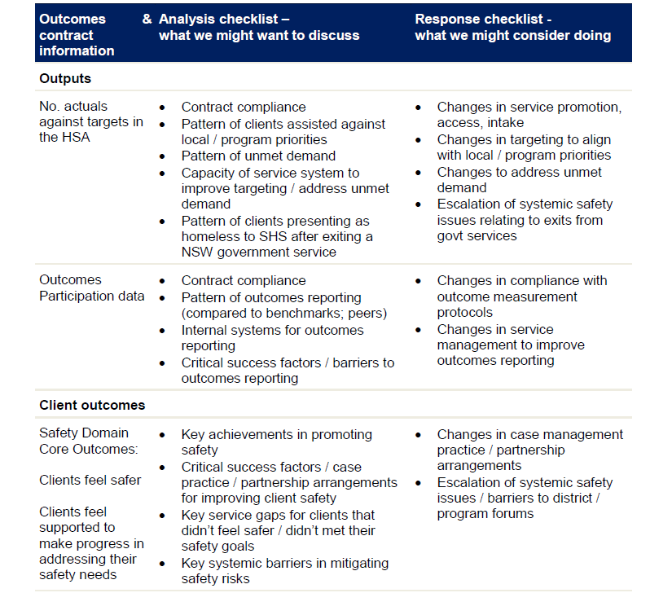
DCJ District Guidance Template - draft
Reporting
Notes:
The District Guidance template, also included in the Framework guide, shows the types of information that District will be seeking at that Level 1 conversation with providers to also add to the interpretation of outcomes data. This includes things such as :
Key achievements in promoting client safety, housing and wellbeing
Key opportunities to improve client outcomes within the HSA constraints / local context
Changes to patterns
Capacity of the service system
Critical success factors
Service gaps and systemic barriers

Slide 58
Reporting
Key takeaways:
Providers own data that they enter into a client information management system – and clients are entitled to view records subject to privacy legislation
DCJ sees de-identified, aggregate data with less detail than providers
AIHW requires data extracts and DCJ receives reports on these – also de-identified and aggregate
DCJ cannot see any information relating to individual clients or workers
Providers can use COS data to inform their own practice and to support annual reporting
DCJ will use COS data to support reporting and to build an evidence base and advocacy for sector enhancements and innovation.
Expectations of client participation will be realistic and reasonable.
Notes:
Some key takeaways on creating a positive data culture are that:
Providers own the data that they enter into a client information management system – and clients are entitled to view records subject to privacy legislation
DCJ sees de-identified, aggregate data with less detail than providers
AIHW requires data extracts and DCJ receives reports on these – also de-identified and aggregate
DCJ cannot see any information relating to individual clients or workers
Providers can use COS data to inform their own practice and to support annual reporting
DCJ will use COS data to support annual reporting and to build an evidence base and advocacy for sector enhancements and innovation.
And finally, DCJs analysis of client participation in outcomes tools will be realistic. DCJ does not expect to see 100% participation or even close to that, and this is not achieved in other sectors or in general survey use. We will look to providers own views on reasonable rates of client participation based on surveys they may already use, to guide DCJs expectations in this area.

Slide 59
CIMS Demonstration
SHS – Client Outcomes Survey (COS)
Client Information Management System (CIMS)
      Need Assistance?
      Email: CIMS@facs.nsw.gov.au

Slide 60
CIMS Demonstration
Topics
Generating the COS form
        Printable version
        Fillable version (for emailing to clients)
The COS tab
        recording non-participation
        recording COS responses
      COS list and report

Slide 61
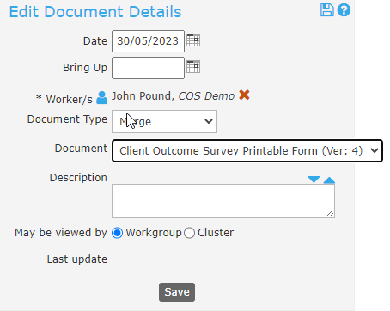
Generating the Printable COS form in CIMS
CIMS Demonstration
To create a new COS, pre-filled with the client’s name and current date:
        Go to the Person/Documents tab.
        Click the “Create New Document” button.
        Select “Document Type” = Merge.
        Select “Document” = Client Outcome Survey Printable form
        Click the Save button.
        Click the “View Document” button which appears after Save to download and print the form.
      Existing documents can be reused after updating the date.
      Old documents can be deleted.

Slide 62
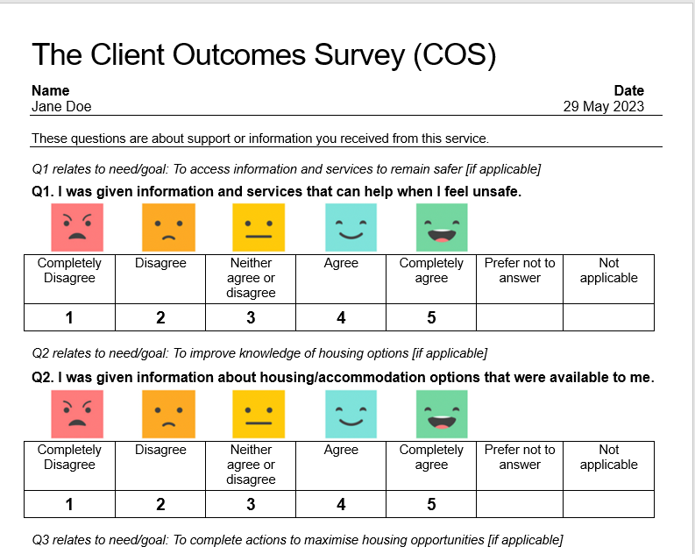
Generating the Printable COS form in CIMS
CIMS Demonstration
A blank COS form can be accessed by selecting the “SHS: Client Outcome Survey Printable PDF” item on the Admin/Documents page.
The client name and COS date will need to be entered once the document is downloaded and before printing.
The form should be provided to case managed clients to complete:
  Periodically during case plan reviews, or
  At the end of support during exit planning, between 2 and 4 weeks prior to actual exit.

Slide 63
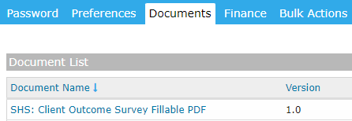
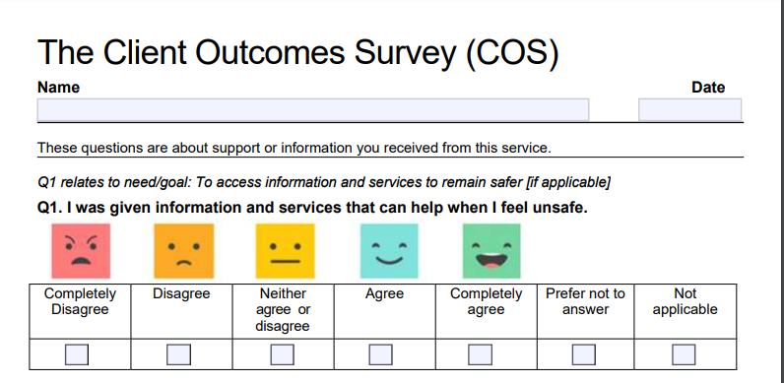
Generating the Fillable COS form in CIMS
CIMS Demonstration
The fillable COS form can be accessed by selecting the “SHS: Client Outcome Survey Fillable PDF” item on Admin/Documents tab
Click on the document name to download the form
The name of the client and the date can be entered on the form and emailed to the client
The client can complete the form electronically and return it via email

Slide 64
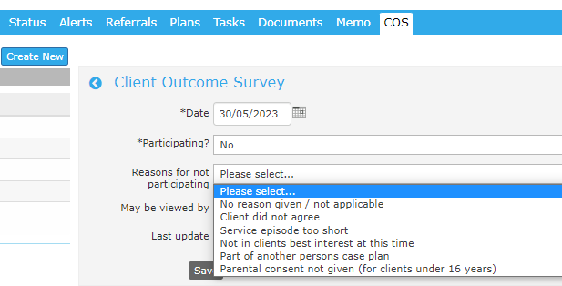
COS tab – Adding a Non-participation record
CIMS Demonstration
Go to the Person record and confirm that a support period exists for the person
Go to the COS tab and select ‘Create New’ button to display the COS form
For non-participating clients:
  Select ‘No’ in the Participating? field
  Select a reason from the Reasons for not participating field
      Save the record

Slide 65
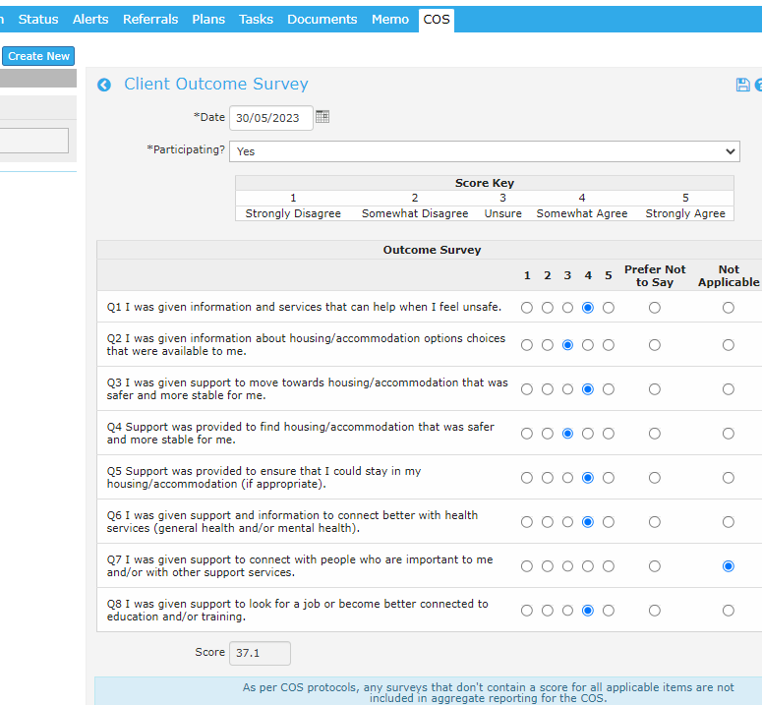
COS tab – Adding a COS record
CIMS Demonstration
Go to the Person record and confirm that a support period exists for the person
Go to the COS tab and select ‘Create New’ button to display the COS form
Update the Date field to the date the COS form was provided to the client
Select ‘Yes’ in the Participating? field to display the COS questions
Select the responses as provided by the client and save the record
A score will be displayed if all of the questions have a score or Not Applicable is selected

Slide 66
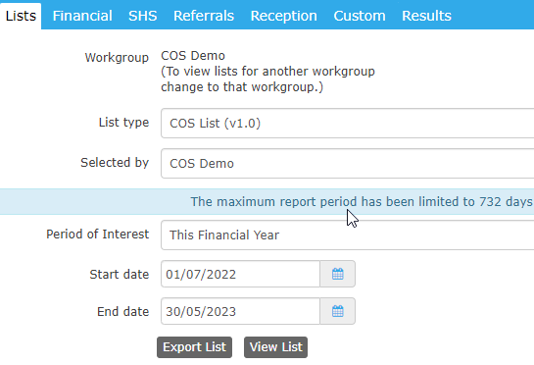
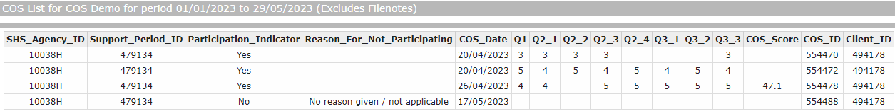
COS list
CIMS Demonstration
The COS list is accessible from the Reports/Lists tab in CIMS.
Select “List type” = COS List (v1.0)
Pick the required workgroup in the
“Selected by” list
Select the required “Period of Interest” or manually set
the start and end dates.
An example of the output format is shown below.

Slide 67
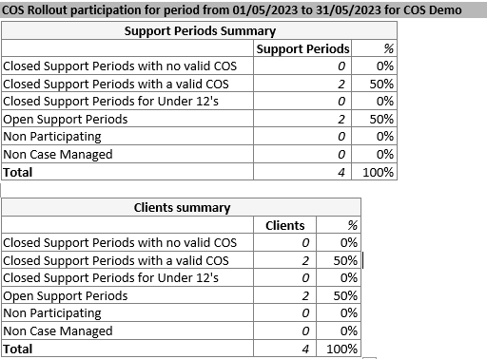
COS report
CIMS Demonstration
The COS participation report is accessible from the Reports->Reports tab in CIMS.
Select “Report type” = COS Rollout Participation (V1.0)
Pick the required workgroup (or contract if available) in the “Selected by” list
Select the required “Period of Interest” or manually set the start and end dates.
An example of the output format is shown below.
      Need Assistance?
      Email: CIMS@facs.nsw.gov.au

Slide 68
SHS Outcomes Framework recap; development of the COS; Why use a COS?
The COS and how to administer it
Using the COS well for the benefit of clients; Building buy-in
Safe and appropriate use of COS surveys with Aboriginal clients
Developing strategies to address potential barriers
Creating a positive data culture; Reporting; CIMS demonstration
Embedding the COS into practice; Next steps

Slide 69
Embedding the COS into practice; Next steps
Reflections on administering the COS from Curijo –
The importance of applying a cultural lens in their dealings with Aboriginal clients
The importance of explaining the purpose of the survey and how the data being used
The importance of ongoing reflection for practice growth
Reflections on administering the COS from Insight –
Humility
Practice the administration of the COS prior to using it with a client
It’s ok to re-start the process
Make sure the client knows they are in charge
Notes:
Curijo reflections:
When dealing with an Aboriginal client or family, there are three important points that case workers need to remember that will ensure engagement and buy-in to the COS process if applied effectively. These are:
• Applying a cultural lens which can support cultural safety
• Explaining the purpose of the survey and how the data will be used
• Ongoing personal reflection for practice growth
Cultural Lens -
This approach can help to understand why is it a natural tendency to perceive things differently and then form judgements what is okay or not. These views are formed based on experiences, values, knowledge and attitudes often developed shared and social context.
Purpose of Survey -
Aboriginal people have an inherent lack of trust with people they don’t always understand concepts or processes that they have no familiarity and experience with. It is crucial to allow sufficient time to fully explain the purpose of the survey and how that information/data will be used.
Personal Reflection -
Always reflect on what has happened and how things turned out when dealing with clients. Through self-reflection, it can result in creating a strength based approach when working better and more effective with clients. Benefits may included improving the way one approaches their work, improving one’s knowledge and understanding, and allowing personal growth.
Insight reflections:
We’ve spent over 20 years administering measures to children as young as 18 months and to vulnerable clients. These are the things we’ve learnt:
Approach the administration with humility. Every client will be different.
Memorise the administration process before administering the COS with a client. It doesn’t have to be perfect in the beginning, but you can’t read from a script. You need to be able to stay in touch with the client (reading their body language to adapt the process if necessary).
It’s ok to restart the administration process if you see a client showing signs of fear. This may mean getting them a cup of tea and restarting in a way that helps address their fears and concerns.
Make sure the client knows they are in charge. They need to decide if they want to participate and if they do, they can still choose to not answer a question if they don’t want to.

Slide 70

Embedding the COS into practice
Embedding the COS into practice; Next steps
Dealing with competing priorities
Staff changeover
Buy-in needs to be monitored
Using the data regularly
Ongoing training
Notes:
Agencies will need to consider how the COS data will be incorporated into existing structures of reflective practice, supervision, and staff meetings.
Given staff turnover and competing priorities and the tendency for buy-in drift to occur, training will need to be ongoing.
Ongoing training assists workers to embed the tool into practice. Training resources will be available from DCJ website, including a printable training manual, a video of a live session and the slide pack with notes which teams could run through again together. We encourage managers and staff to download or print the resources, discuss them in team meetings, ensure that all staff have received the training prior to using the COS and that new staff have these training resources included in their induction.

Slide 71
Next steps
Embedding the COS into practice; Next steps
Ongoing feedback and support – DCJ Feedback and Support Request Form, open from 13 June 2023 to 13 June 2024.
DCJ will work with providers with exit surveys to customise these so that COS data is recorded and questions are not duplicated (during 2023 – 24).
FAQs will be provided and updated
SHS Client Satisfaction Survey – Homelessness NSW acknowledges that there is some duplication in the type of information that is being requested in the Client Outcomes Survey, Client Wellbeing Survey and the Personal Wellbeing Index. In response, HNSW have started reviewing this issue in collaboration with key stakeholders. HNSW is planning further consultation on this issue, including with SHS, to determine recommendations on the most appropriate course of action
Notes:
There are a number of next steps for the COS rollout.
Firstly – there will be an ongoing opportunity for feedback and support, and we are launching a Feedback and Support Request Form to capture this, that will be open from June 13 2023 until June13 2024. The Link to this survey will be provided within the COS admin manual and will be emailed to providers in a sector update.
Secondly – DCJ will offer intensive one on one support to providers who have existing exit surveys, to customise these so that COS data is still recorded while questions are not duplicated, and questions of importance to a provider can still be asked. This work will commence shortly. There will be further information on this process in a sector update email. And we encourage providers with existing surveys to email DCJ program mailbox with this information.
Thirdly – we will be producing FAQs that will be available on the website and updated as needed. All the website links will be sent in sector update emails.
Finally – we are aware there is potential duplication between the PWI, the COS and the SHS Client Satisfaction Survey administered by CHIA. This issue is being discussed with Homelessness NSW who also agree that there is some duplication. In response, HNSW have started reviewing this issue in collaboration with key stakeholders. HNSW is planning further consultation on this issue, including with SHS, to determine recommendations on the most appropriate course of action

Slide 72
For COS resources visit https://www.facs.nsw.gov.au/providers/homelessness-services/resources/tools
Comments and questions to
SHSProgram@dcj.nsw.gov.au

