Slide 1
Targeted Earlier Intervention Program
Webinar 3: Set up your organisation and create outlets
Live recording: https://www.youtube.com/watch?v=GV6mRVUkVz4
Notes:
Hi everyone, and welcome to week 3 of our Data Exchange webinar series.
In today’s webinar, we are going to talk about setting up your organisation in the Data Exchange and creating outlets.

Slide 2
Purpose
In this webinar we discuss:
How do I set up my organisation in the Data Exchange?
How do we create outlets?
What are outlets?
Notes:
So as always there are three key things we will discuss – I’ve talk about how to set up your organisation in the Data Exchange, some of the key things you need to do before you can start reporting, and then we’ll also talk about outlets – what they are, why they’re important and how we create them.
SLIDE 3
Before we begin, I’d like to spend a little bit of time talking about why we’re all using the Data Exchange, and collecting and reporting information about the services we deliver and the clients we work with.
Using the Data Exchange will help us to clearly understand who are clients are, we’ll be able to track our client’s journey through the service system and we can also use the data we report to demonstrate the impact of our services on client and community outcomes.
Our ultimate goal is to have a high-quality data set that clearly tells us who are clients are, what services they receive and what their needs are. So we can then use that information to make sure the right people, get the right support at the right time.
The data we report into the Data Exchange is going to help us understand what works for our clients and what we can do better to achieve greater outcomes for our clients and communities.

Slide 3
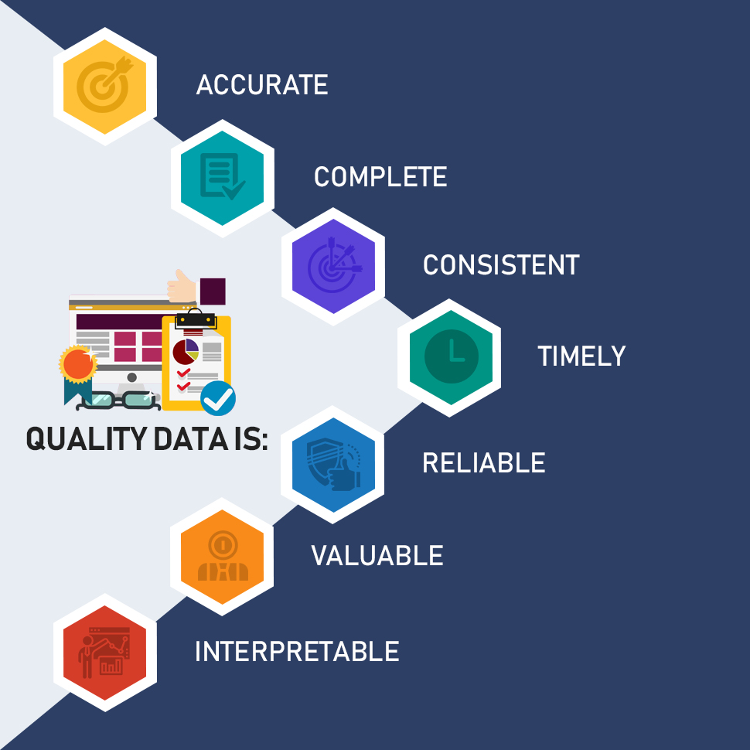
Why do we need high-quality data?
Our ultimate goal is to clearly understand our client’s needs, in real time, so we can make sure people get the right support at the right time.
High-quality data helps us understand what works and what we can do better to achieve greater outcomes for our clients and communities.
It can be a powerful tool for planning, decision-making, evaluation and advocacy.
Notes:
When data correctly represents what is happening in your organisations and communities, it becomes a powerful tool for planning, decision-making, evaluation and advocacy.
Incomplete or inaccurate data severely limits the usefulness of data, and can lead to poor decision-making by organisations and government.

Slide 4
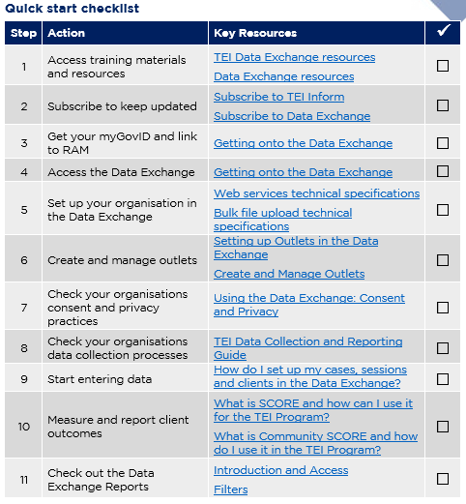
Data Exchange Quick Start Guide
Key resource: Quickstart guide to the Data Exchange
This document outlines the 11 key steps you need to follow to access and start using the Data Exchange.
It includes links to key resources for each step.
Notes:
In our previous webinar’s I introduced everyone to this document: the Data Exchange Quick Start Guide. This is a five page document that outlines the 11 key steps you need to follow to access and start using the Data Exchange. It includes links to all the key resources you need to action each step.
In each of our webinar’s I’ve been taking everyone through each step in this document.
So in our first week, we looked at Steps 1 and 2, about where to find key resources and how to subscribe to our newsletter. Last week, we talked through Steps 3 and 4 about MyGovID, linking in RAM and accessing the Data Exchange for the first time.

Slide 5
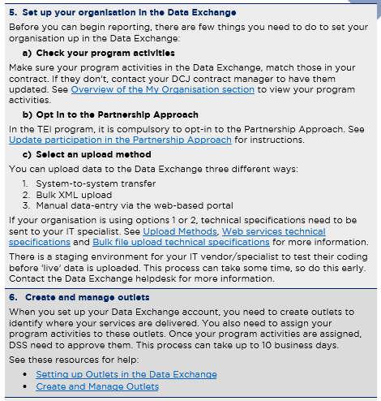
Quick start guide: steps 5 and 6
Quickstart guide to the Data Exchange
Notes:
In today’s webinar we’re going to cover steps 5 and 6.
Step 5 takes you through what you need to do to set your organisation up in the Data Exchange. This includes checking your program activities, opting in to the Partnership Approach, picking an upload method – so how you’re going to actually enter your data.
Step 6 is about creating and managing your outlets.

Slide 6
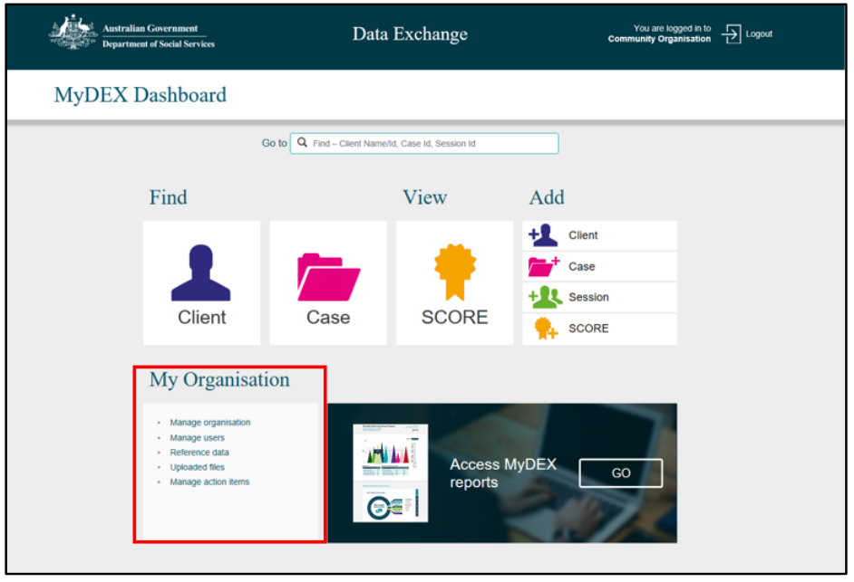
Setting up your organisation in DEX
Only organisation administrators can complete these tasks.
Review your program activities
Opt in to the Partnership Approach
Select an upload method
Add delivery organisations
Create outlets
Add and edit users
Taskcard: Overview of the My Organisation section
Notes:
So, we’re going to start with Step 5. Setting up your organisation.
When you log into the Data Exchange, the first thing you’ll see is the screen shot on the right hand side of the ppt. This is your DEX dashboard.
All of the tasks we’re going to discuss today, can be completed by going to the ‘My Organisation section’ on your dashboard. Here is where you can review your program activities, upload files, opt in to the Partnership Approach, create outlets.
BUT, you can only complete these tasks if you are an organisation administrator.
We talked about this briefly in our last webinar. An organisation administrator is the first person in your organisation to access the Data Exchange. They will most likely be the person who has, or who will, give you access to DEX.
So if you’re not an organisation administrator, you won’t be able to complete the tasks we go through today. You will either have to get your organisation administrator to do it for you, OR you can ask them to make you an organisation administrator as well, so you have the same access they do.
So, if we look at the ‘My Organisation’ section in the red box, on the screen. The first line of text, says manage organisation.

Slide 7
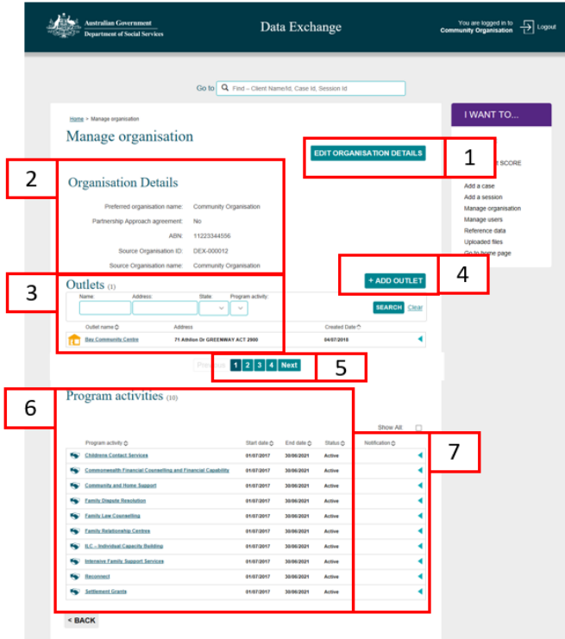
Check your program activities
Check your program activities to make sure they match your contract.
If they don’t, get in touch with your contract manager. DCJ can update your program activities for you.
Key:
Edit organisation details
Organisation details section
Outlets listing
Add outlets button
Search different pages
List of program activities
Notifications
Notes:
When you click manage organisation, you’ll be taken to a screen that looks like this. And as you can see, there are lots of things to do here. You can edit your organisations details, you can create outlets (which I’ll talk about in more detail later) and you can also view your program activities.
One of the first things you will need do when you access to the data exchange, is to check your program activities. You need to make sure the program activities you have in the DEX, so the ones you’ll see here, match the program activities in your DCJ contract.
If the program activities you see here, don’t match the program activities in your contract, you need to get in contact with your DCJ contract manager. And we can then update the program activities for you.
It’s really important that you check these, because you need to make sure you report information under the correct program activities, and you obviously can’t do that, if they’re not right to begin with.
So once you’ve checked your program activities, the next thing you should do is opt in to the Partnership Approach. To do this, you’ll click the ‘edit organisations details button.

Slide 8
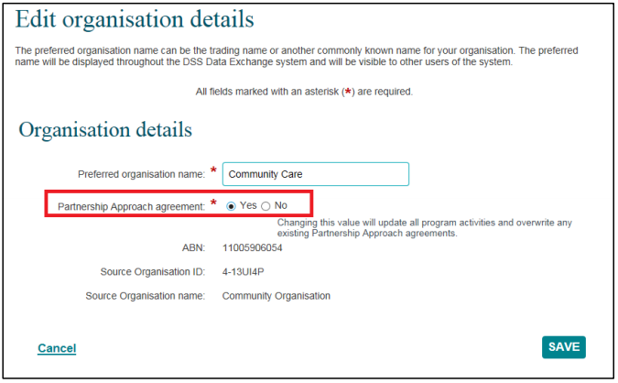
Opt in to the Partnership Approach
In the TEI program, it is compulsory to participate in the Partnership Approach.
You can opt in your whole organisation OR you can just sign up individual program activities.
Opting in to the partnership approach means you will have access to extra reports, including a report designed specifically for the TEI program.
Taskcard: Update participation in the partnership approach
Notes:
And you’ll be taken to a screen that looks like this. And all you need to do is select ‘yes’ for the partnership approach agreement.
So, super important to remember, it is compulsory to opt in to the partnership approach in the TEI program. So this, means you all have to do it.
For those of you who don’t know what the partnership approach is, it’s basically an agreement between the TEI program and DSS that says we agree to report certain pieces of information, like client referrals, outcomes data, so SCORE and Community SCORE, and in exchange for reporting that information, we get access to additional reports. That’s it.
All you need to do is tick that ‘yes’ button.
If you want, instead of opting in your whole organisation, you can just sign up individual program activities. I haven’t got it on the slide, but if you go to this document ‘update participation in the partnership approach’ it shows you step by step instructions to do that.
Signing up individual program activities is only really going to be relevant to organisations who use the data exchange to report to other funding bodies, like DSS, for example. If you only use the Data Exchange for the TEI program, then don’t worry about that, and you can just click ‘yes’ like whats on the screen.

Slide 9
Select an upload method
There are three different ways you can enter/upload data into the Data Exchange:
1. Bulk upload
2. System-to-system transfer
3. Manual data entry via the web-based portal
If you choose option 1 or 2, technical specifications need to be sent to your IT specialist. Web services technical specifications and Bulk file upload technical specifications provide more information.
There is a staging environment for your IT vendor/specialist to test their coding before ‘live’ data is uploaded. This process can take some time, so do this early.
See Upload methods for more information.
Contact the Data Exchange helpdesk for assistance.
If you choose option 3, use the taskcards and learning module on the Data Exchange website to learn how to use the portal.
Notes:
Alright, so you’ve checked your program activities, you’ve opted into the partnership approach.
Now, you need to decide how you are going to entire or upload your data into the Data Exchange.
So there are three different methods you can use. You can conduct a bulk upload, so you can upload a spreadsheet with all of your data in it, or you can conduct a system-to-system transfer, so this is where you already have a client management system that you use, and you can set your system up so talks to DEX, OR you can manually enter your data via the web-based portal.
If you choose options 1 or 2, there is some work that you will need to do to make sure that the files you upload or the transfers you complete meet certain technical specifications. There are two documents on the screen, web services technical specifications and bulk file upload technical specifications that provide more information about this. You can also take a look at the ‘upload methods’ document that discusses these two options in more detail.
Its important for you to know as well, that if you choose method one or two, DCJ cannot provide technical assistance to you. This is because we’re not IT specialists, and we don’t have the skills or the capacity to support you to set your own system up. You will have to contact the Data Exchange if you need support to do this. And you should also reach out to your own IT specialist to help you.
For those of you who are going with option 3, to manually enter data, there are lots of task cards and learning modules available on the Data exchange website. I showed everyone how to access these in our first webinar. And in each of our upcoming webinars, we will be quite focused on this method of data entry too, so you can use these webinars to help you navigate and understand how to use the platform.

Slide 10
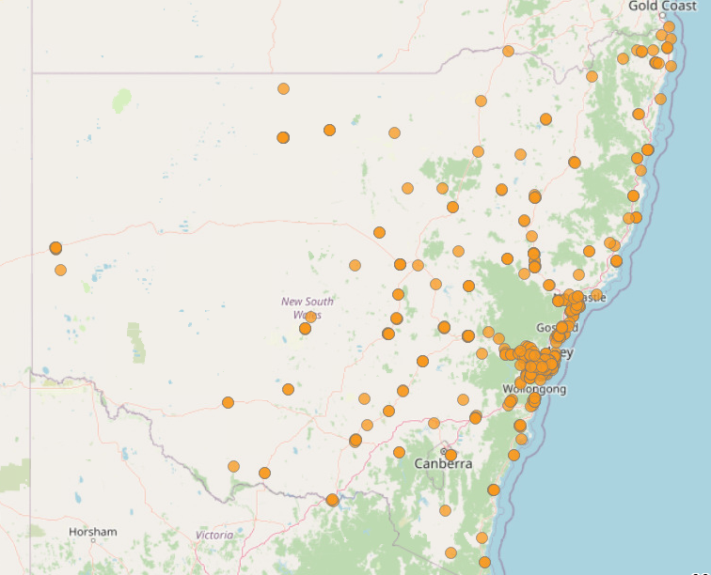
What is an outlet?
In the Data Exchange, an outlet is the location where a service took place or where staff travelled from to deliver a service.
When you set up outlets in the Data Exchange, you need the name of the outlet and the street-level address.
The Data Exchange system uses the address (i.e. postcode) to identify the LGA your outlet is located in.
Notes:
Alright, so once you’ve decided on an upload method, the next thing to do, is to create your outlets.
So in the Data Exchange, an outlet is the location where a service is delivered, or where staff travelled from to deliver a service.
When you create your outlets, you need to know the street address, for the space or the building you work in.
The Data Exchange system, will use that address to map the location of your service delivery. It will identify the LGA and the DCJ District you work in.
In the image on this slide, this is actually a map of all the outlets that have been created in the Data Exchange for the TEI program so far. So those orange dots are the actual physical locations our services are delivered in.

Slide 11
How to create an outlet in the Data Exchange
Taskcard: Create and manage outlets
Notes:
So to create your outlets, you need to go to the my organisation section, on your DEX Dashboard.
And select ‘manage organisation’.

Slide 12
How to create an outlet in the Data Exchange
Create and manage outlets
Only organisation administrators can create outlets.
If you’re NOT an organisation administrator you won’t see this button.
Notes:
Then you’ll be taken to this screen that I showed you earlier. So you can see at number three, there is a section for your outlets.
Once you’ve created your outlets, you’ll be able to see them all listed here, and you can use those search filters to search for a specific outlet.
For most of you who have never created an outlet before, this area will be blank. To create a new outlet, select the ‘add outlet’ button.
So, its very important to remember that only organisation administrators can create outlets. If you’re not an organisation administrator, you won’t be able to see this button. So if the button isn’t there, you need to find the organisation administrator in your service and have them make the outlets for you.
So, for those of you who are org. administrators, hit the ‘add outlet’ button and you’ll be taken to a screen that looks like this…

Slide 13
How to create an outlet in the Data Exchange
Create and manage outlets
DCJ can see the name of your outlets in the Data Exchange reports. Make sure you name them something we can easily understand and identify.
Notes:
Here is where you add in the information about your outlet.
So you need to give your outlet a name – this can be anything you want it to be. BUT remember that your contract manager will see the name of your outlets in the Data Exchange reports. So try to make it something that they will be able to easily understand.
And then you just need to enter the address for the space or building you worked in.
Once all the info is complete, hit the save button.

Slide 14
How to create an outlet in the Data Exchange
Create and manage outlets
Notes:
Then, you’ll be able to see your new outlet in the list.
Now, you’re not done yet. Everyone gets tripped up on this.
Before you can use you’re outlets, you need to assign program activities to them. To do this, just select an outlet from the list. You’ll be taken to a screen that looks like this.

Slide 15
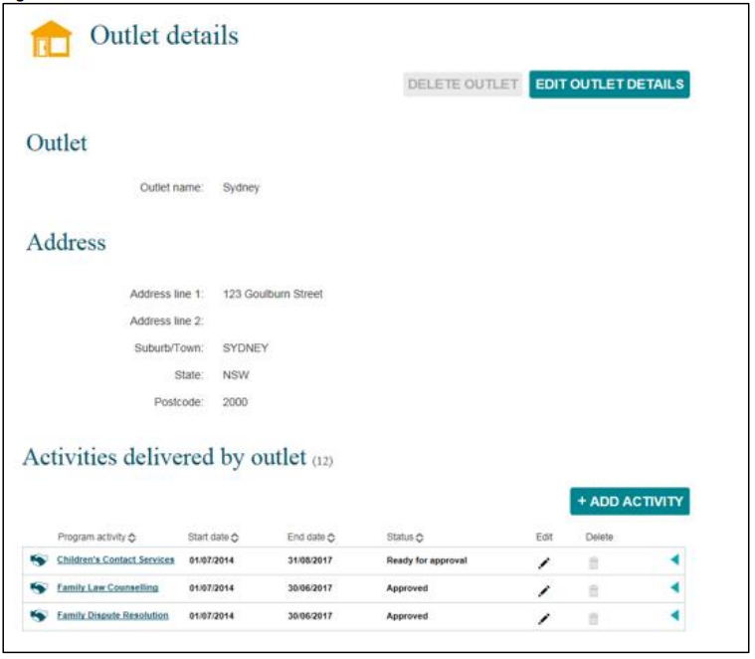
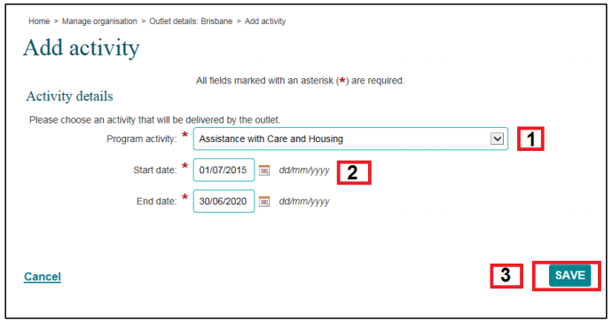
How to create an outlet in the Data Exchange
Create and manage outlets
You must assign program activities to your outlets. You cannot use them until you’ve done this.
Notes:
You’ll be able to see the name of the outlet and the address and then you can see a list of activities delivered by the outlet. So what you need to do is hit the ‘add activity’ button and then you’ll see a screen that looks like this. There is a drop down menu of the program activities you’re organisation has. You need to pick the program activities that will be delivered at that outlet. And then click save. You will need to do this individually for every program activity that will be delivered from the outlet.
So if there are 3 program activities are being delivered from your community centre – you will need to add all three program activities to the outlet for your centre.
Once you’ve done this you’ll see them pop up here in this list.
Once you’ve added your program activities, they need to be approved by DSS.
This is an automatic process, you don’t need to do anything. You can see in the status column here, that one of the program activities says ‘ready for approval’ this means its been sent to DSS and you’re just waiting for them to approve it. ‘Approved’ means DSS have approved it, and you report under that program activity for this outlet. It can take DSS up to 10 days to approve a program activity for an outlet. So please make sure you take that into consideration when you’re setting up your org.
Its also important to remember, that if you’re program activities ever change, so say for example, you have a program activity added to your contract, you need to remember that you won’t be able to use it, until its been assigned to an outlet and approved by DSS.
So if your program activities are ever updated, you need to go back to your outlets in the Data Exchange, and make sure you assign the new program activity to an outlet, before you can use it.
And that’s kind of it, in a nut shell.
This document, create and manage outlets, takes you through the process that I just outlined.
So if you ever need any help please make sure you check it out.

Slide 16
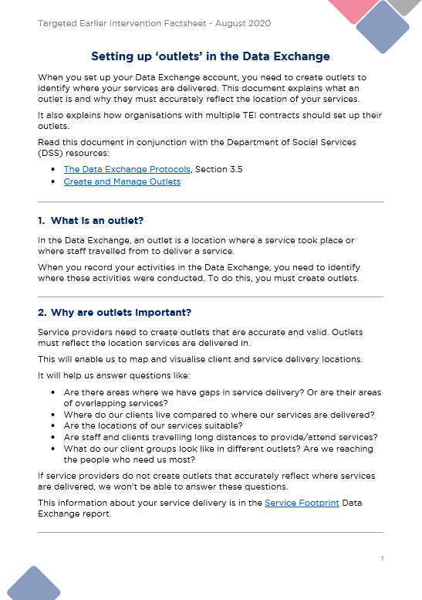
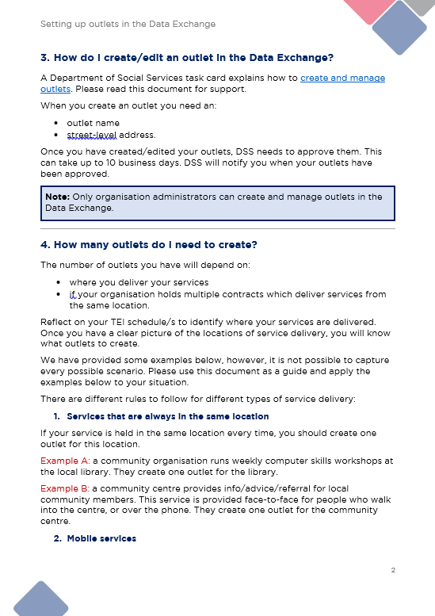
Setting up outlets in the Data Exchange
See Setting up Outlets in the Data Exchange for more information
This includes answers to commonly asked questions like:
What if I deliver a service in a client’s home?
How do I delete an outlet?
Can outlets have the same name and address?
Notes:
Now, we’re going to talk about some of the rules you need to follow for setting up your outlets.
Over the last few months we’re received lots of questions from people about how many outlets they need, what to do if a service is delivered in a client’s home, how do they differentiate between contracts, how do you delete an outlet. All the fun stuff.
To help everyone navigate those tricky situations and to answer those questions, we’ve developed a resource called ‘setting up outlets in the data exchange’. This includes as many FAQs that we could think of. I’m going to go through a number of them now, but please download this document and read it before you create your outlets to make sure you’re doing it correctly.

Slide 17
How many outlets do I need to create?
There are different rules for different types of services:
See Setting up Outlets in the Data Exchange for more information
Services that are always in the same location
If your service is held in the same location every time, you should create one outlet for this location.
Mobile services
If you provide a mobile service (e.g. home visiting, food deliveries, or school excursions), the outlet should be your nearest office building.
Example A: a community organisation runs weekly computer skills workshops at the local library. They create one outlet for the library.
Example B: a community centre provides info/advice/referral for local community members. This service is provided face-to-face for people who walk into the centre, or over the phone. They create one outlet for the community centre.
Example: a service conducts school excursions with local school children. Each fortnight they take a group of students to a different location (e.g. a park, library, or museum). The outlet created for this service is the location of the school.
Example: an organisation provides intensive family therapy to many different families. The therapy is provided in the families homes. The outlet created for this service is the location of the organisation’s nearest office building.
Notes:
Ok, so the first question I want to tackle is how many outlets do you need to create.
There is no easy answer to this unfortunately. It is going to depend on where you deliver your services and what type of services you deliver. HOWEVER, we’ve come up with some rules and guidance to help everyone figure this out based on their own organisations unique context.
So I’m going to go through some of the most common scenarios and some concrete examples, that will hopefully help you figure out what your organisation needs.
So the first scenario is the easiest one: services that are always delivered in the same location.
So if your service is held in the same location every time, you only need one outlet. An example of this might be an organisation who runs weekly computer skills workshops at the local library. The workshops are at the same library every week. So they just create one outlet for the library.
Another example might be, a community centre that provides info and advice for local community members. This service is provided face-to-face for people who walk into the centre, or over the phone. The service is always provided from the community centres building. So they create one outlet for the community centre.
Another common scenario is mobile services. A service is considered ‘mobile’, if the location of service delivery frequently changes, so this could be activities such as home visiting, food deliveries, or school excursions. If you provide a mobile service, the outlet should be your nearest office building.
So for example, a community centre runs a weekly playgroup for first-time parents. The location of the playgroup changes each week. They often meet in different local parks, at the public library, the community centre etc. The outlet they create for this activity is the location of the community centre. This is because it is the nearest office building where staff are located.
Another example could be a service who conducts school excursions with local school children. Each fortnight they take a group of students to a different location (e.g. a park, library, or museum).
The outlet they create is the location of the school. This is because it is where the group is travelling from.
Another example could be an organisation who provides intensive family therapy to many different families. The therapy is provided in the families homes. The outlet they would create for this activity is the location of the organisation’s nearest office building. This is because an outlet should never be a client’s home.

Slide 18
How many outlets do I need to create?
There are different rules for different types of services:
See Setting up Outlets in the Data Exchange for more information
Services delivered in different locations to different clients
If you deliver a service to different clients in different locations, you should create an outlet for each of those locations. This will give us a more accurate picture of where services are delivered.
One-off occasions of service
If you provide a one-off service (e.g. a community event), the outlet should reflect the location of the session. You can:
Online or over the phone services
create a new outlet. For example, a community event that is held in a local park.
use an existing outlet. For example, an information night held in your community centre.
Example: an Aboriginal organisation delivers weekly language workshops in three local schools. Three outlets are created, one for each school.
Example: an organisation runs parenting education workshops in 10 different community centres throughout the year. They run 6 workshops in each centre. They create 10 outlets, one for each community centre.
If you provide activities online or over the phone, the outlet should be the office building staff work from.
Many organisations have changed how they deliver services due to COVID-19. If you are now delivering services online, you should record your outlet as the office building staff would usually work in.
Example: an organisation is providing counselling sessions over the phone. The outlet they use is the organisation’s closest office building.
See Recording alternate forms of service delivery for more information. Organisations should only record virtual/telephone services that can be expected to lead to a measurable outcome.
Notes:
Another common scenario is when the same activity is delivered in different locations. So say for example, your organisations delivers weekly language workshops in three different local schools. You would have to create three outlets, one for each school.
Or another example might be, you run parenting education workshops in 10 different community centres throughout the year. You would have to create 10 different outlets, one for each community centre.
This is because your outlets need to accurately reflect where your services are delivered. So whenever you deliver a service in a different location, you should create an outlet for that location.
Another common scenario is one-off occasions of service. So this might be, a community event, for example. The outlet should reflect the location of service delivery. So you could create a new outlet if the event is held in a new space you’ve never used before, or you can use one of your existing outlets, if the event is held in or near your community centre for example.
Another common scenario is for activities that are hosted online or over the phone. In these situations, the outlet should be the office building that staff work from.
We know that many organisations have changed how they deliver services due to COVID-19. If you are now delivering services online, your outlet should the office building staff are working in. Or if staff are working from home, it would be the office building that staff would usually work in.
So for example, your organisation might provide counselling sessions over the phone. The outlet you would use would be the office building you would normally work in.
I know there are lots of other scenarios that we could go through, but unfortunately, we can’t address everything. Please take a look at the setting up outlets document and try to use the information that’s in there to help you figure out how many outlets your organisation needs. And of course, if you need help doing this, you can always email TEI@facs.nsw.gov.au

Slide 19
Setting up outlets when you have multiple TEI contracts
DSS use organisation names and ABNs to set services up in the Data Exchange. Services are not set up by contract.
This means we need to use outlets to help us differentiate between contracts.
Example 1: A service called ‘Playgroup Vic’ has 2 TEI contracts. They follow the rules outlined earlier and set up their outlets as follows:
Contract/operating name | Geelong Playgroup | Moorabool Playgroup
Program Activities | Targeted Support | Targeted Support
Outlet name | Geelong Playgroup | Moorabool Playgroup
Outlet address | 55 Little Malop St, Geelong VIC 3220 | 265 Ballan Rd, Moorabool VIC 3213
Notes:
Another common issue I want to talk about is for those organisations who have multiple contracts for the TEI program. So I know this doesn’t apply to everyone, but I want to talk about it anyway, because it is really important for those orgs with multiple contracts to get this right.
So in the Data Exchange, DSS use organisation names and ABNs to set services up in the Data Exchange. You’re not set up by contract. So this means we need to use outlets to help us differentiate between those contracts.
So you can see on the slide we’ve got an example there for you.
This organisation has two separate contracts – one for the Geelong playgroup and another for Moorabool playgroup. So they need to make sure they have two outlets to separate the data that is collected for Geelong and the data that is collected for Moorabool.
So you can see they’ve set up an outlet for each playgroup, and the address for each is different because they’re in separate locations.

Slide 20
Setting up outlets when you have multiple TEI contracts
Example 2: Warragul Family Support Service Inc has 3 TEI contracts that each deliver different program activities. They follow the rules outlined earlier and set up their outlets as follows:
Contract/operating name | Warragul Family Support Service |  | Warragul Drop In Centre | Warragul Supported Playgroup
Program Activities | Community Connections | Community Centres | Community Centres | Targeted Support
Outlet name | WFSS - Civic Park | WFSS - Community Centre | Warragul Drop In Centre | Warragul Supported Playgroup
Outlet address | Clifford St, Warragul VIC 3820 | 170 Normanby St, Warragul VIC 3820 | 170 Normanby St, Warragul VIC 3820 | 143 Queen St, Warragul VIC 3820
See Setting up Outlets in the Data Exchange for more information
Notes:
So, our second example is slightly more complicated.
In this example, we have a service called Warragul Family Support Service and they have 3 contracts, all for different program activities.
They’ve got one contract for Community Connections and Community Centres. Another contract that is also for Community Centres. And another contract that is for Targeted Support. So what we need this org. to do is (1) set up outlets so they reflect where their services are actually delivered, but (2) set up outlets to help us differentiate between the contracts.
So for community connections, let’s say they’re contracted to run a couple of community events – so they set up an outlet for the park they use. You can see they’ve called it civic park, and that is obviously the address for the park.
For community centre, they set up an outlet for their actual community centre – because that’s where they provide info/advice and they run some group workshops and classes for the community.
Then for their second contract, this is for their youth drop in centre. So they have a breakfast club, some after-school activities, computers kids can use and a basketball court. Now this drop in centre, is actually in the same physical location as the community centre – it’s the same building right.
But they wanted separate contracts because one targeted towards young people and the other is targeted at other groups in the community. So because they have two separate contracts, we need them to set up a separate outlet to help us separate the data they report.
So you can see here they’ve created an outlet called ‘Warragul Drop in centre’, and its got the same address as the community centre because its in the same building. But this means, that when they go to look at their data, they can select the WFSS – Community Centre outlet, or the Warragul Drop In Centre outlet, and they’ll be able to see all the data for the relevant contract.
And then for the last contract, that’s simple enough.
It’s just a playgroup. It’s in a different location anyway, as you can see by the address, so they set up another outlet for that too.
All of this information, is in this document, setting up outlets in the data exchange, so again, please make sure you take a look at that before creating your outlets – just to make sure you’re across everything you need to know.

Slide 21
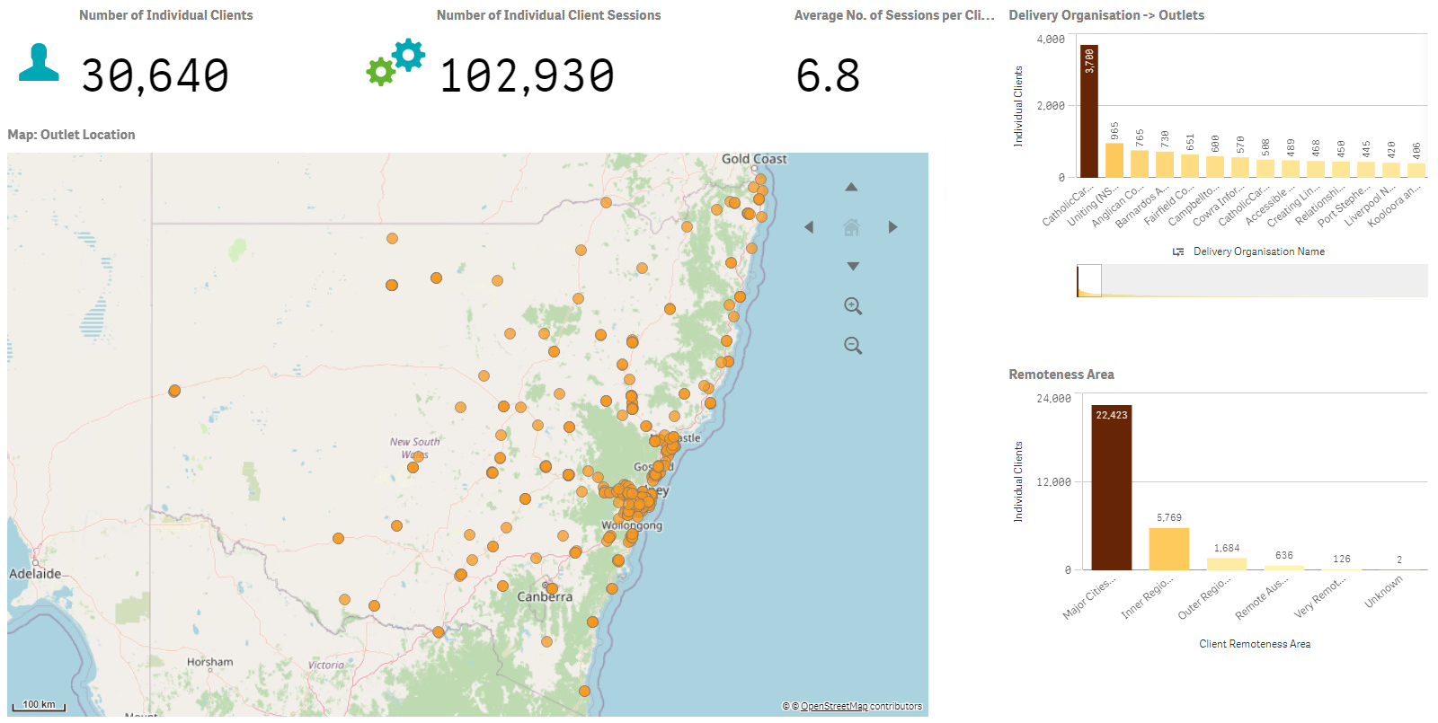
Why is it important to create an accurate outlet?
Org 1
Org 2
Org 3
Org 4
Org 4
Org 5
Org 6
Org 7
Org 8
Org 9
Org 10
Org 11
Org 12
Org 13
Org 14
Notes:
Before we finish up I just want to spend some time showing you why it’s really important to create accurate outlets.
Over the last 12 months, we’ve seen lots of organisations try to short cut this, some people have just set up one outlet for everything, even though they work in 5 different locations, some people have change locations but they haven’t updated their outlets. So I just want to take some time to talk about why it’s really important to do this properly.
So I showed this map, early in the webinar – so again, the orange dots represent the outlets that have been created so far. And we can use this information to look at the services that are delivered in those outlets and if they meet the needs of local communities. We can also look at how far clients need to travel to participate in services, or how far staff need to travel to deliver services.

Slide 22
Why it is important to create an accurate outlet?
Are there areas with overlapping services?
Where do clients live compared to where our services are delivered?
Are staff and clients travelling long distances to attend or deliver services?
Are we reaching the people who need us most?
What do our clients look like in different outlets?
Are the locations of our services suitable?
Are there areas where we have gaps in services?
Notes:
And we can use all this information to better plan our services, to make it easier for clients to access and participate in them. So if your outlets aren’t set up accurately, it’s going to really impact our ability and your ability to use this data to do that.
A really great example of how this information has been used in the past, is back in 2017, when tropical cyclone Debbie hit in NSW and QLD, the Data Exchange actually provided information to emergency management and relief services about service providers and where their offices were located in the affected areas. And they used to information to figure out if more services were needed, what services were impacted by the cyclone themselves, what capacity those organisations had to support their communities, all that sort of stuff. So there are some incredible things we can do with this information, we just need to make sure that we’ve set up properly on our end so we use our data to do that when the time comes.
I know that some of the stuff I’ve talked about today, can be a bit confusing, so please if you need any help figuring out how many outlets to set up, and what outlets you should have for what contract, please speak to your contract manager, or email TEI@facs.nsw.gov.au and we can help you out.

Slide 23
Resources
Set up your organisation
Overview of the My Organisation section
Upload methods
Update participation in the partnership approach
Outlets
Create and manage outlets: This is a DSS resource that shows you how to create an outlet in the Data Exchange.
Setting up outlets on the Data Exchange: This is a DCJ resource that explains what outlets you should have and how many.
Notes:
As always, here are all the key resources we looked at today.
On the left are the three key documents you need to set your organisation up. And on the right are the two documents you can use to help you set up and reate your outlets.

Slide 24
Where can I go for help?
Contact | Type of Support
DSS Data Exchange Website | Training resources for the Data Exchange
DSS Helpline: dssdataexchange.helpdesk@dss.gov.au or 1800 020 283 (8.30am – 5.30pm Monday to Friday) | Technical issues with the Data Exchange web platform (NB: not myGovID or RAM)
TEI Website | Training resources tailored to the TEI program
TEI Inbox: tei@facs.nsw.gov.au | TEI specific questions which are unavailable in existing resources
myGovID and RAM support line: 1300 287 539 | Support for issues with myGovID and RAM
myGovID ‘Need help?’ webpage | Support resources for myGovID
RAM ‘Help’ webpage | Support resources for RAM
Notes:
And here are all the places you can go for help if needed.
Thanks everyone.

