Slide 1
Targeted Earlier Intervention Program
Webinar 2: Getting onto the Data Exchange
Live recording: https://www.youtube.com/watch?v=WlR-4wAnkEs
Notes:
Hi everyone, and welcome week 2 of our Data Exchange webinar series.
In today’s webinar, we are going to talk about getting onto the Data Exchange.

Slide 2
Purpose
In this webinar we discuss:
How to get your myGovID
How to access DEX
How to link in RAM
Notes:
We’ll talk about how to get your myGovID, how to link in RAM and how to access the Data Exchange.

Slide 3
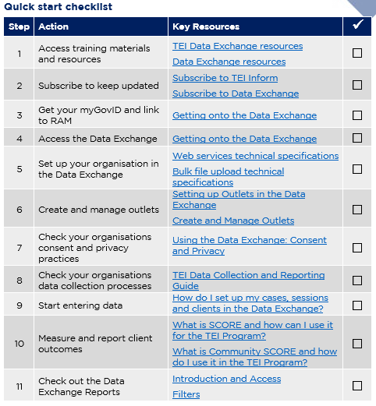
Data Exchange Quick Start Guide
Key resource: Data Exchange Quick Start Guide
This document outlines the 11 key steps you need to follow to access and start using the Data Exchange.
It includes links to key resources for each step.
Notes:
In our previous webinar, we introduced you to this document: the Data Exchange Quick Start Guide. This is a five page document that outlines the 11 key steps you need to follow to access and start using the Data Exchange. It includes links to all the key resources you need to action each step.
And as you can see on the screen, it also includes a check list so you can check off when you’ve completed a step.
In our previous webinar, Introduction to the Data Exchange, we took you through step 1, access training material and resources and step 2, subscribe to keep updated.

Slide 4
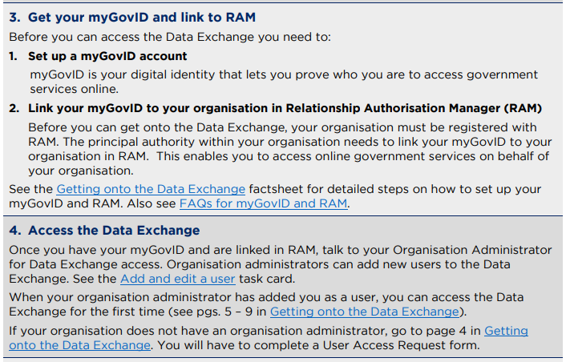
Quick start guide steps 3 and 4
Quickstart guide to the Data Exchange
Notes:
In today’s webinar we’re going to cover the next two steps..
Step 3 takes you through setting up a myGovID account and linking your myGovID to your organisation in RAM (the relationship authorization manager).
Step 4 then takes you through how to access the Data Exchange.

Slide 5
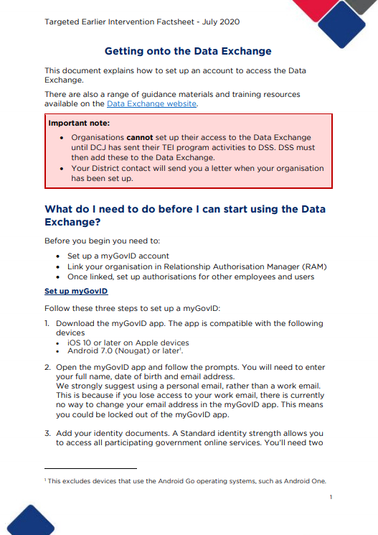
Getting onto the Data Exchange
Key resource: Getting onto the Data Exchange
This document outlines how to set up your MyGovID, link to RAM and access the Data Exchange portal.
Notes:
The first document you need to use is called ‘Getting onto the Data Exchange’. This outlines the entire process you need to follow. Please download the document and follow the steps to obtain your myGovID, link to RAM and access DEX.
I’m going to go through this document now, and we’ll work our way though the key things you need to do, and the key information you need to do it.

Slide 6
Setting up myGovID
Three simple steps:
1. Download the myGovID app
2. Enter your details
3. Add your identity documents
myGovID is an app that you download on your phone.
It is your digital identity – its like the 100 point ID check but on your phone.
It enables you to prove who you are when you need to access government services online.
Notes:
The first step in this document is to set up your myGovID.
For those who don’t already know, myGovID is an app that you download on your phone. It’s kind of like your digital identity – so think about the 100 point identity check you often have to do when you open a new bank account, a get a working with children check. It’s the same thing, but it’s much easier, because you can just do it in an app on your phone.
And the app, enables you to prove your identity when you access the Data Exchange. So each time you log into the Data Exchange, you’ll get a prompt on your phone to enter a 4 digit code, into the app, and this helps prove that you are who you say you are, and you have permission to access the Data Exchange.
So its very similar to when you try to access your bank account online, and you get a text message on your phone, or you get a notification in an app on your phone. It’s the same thing – it’s just that verification to check that you are who you say you are, and you have the authority to access the information you’re about to see.
So setting up your myGovID is probably the simplest part of this whole process. There are just three easy steps you need to follow. 1. You download the app onto your phone. 2. You follow the prompts and enter your details and 3 you add in your identity documents – the same as you would for a 100 point ID check.

Slide 7
Setting up myGovID
1. Download the myGovID app
2. Enter your details
Open the app and follow the prompts.
As it's your personal digital identity, you should set up your myGovID using a personal email address. It should not be a shared or work email address.
3. Add your identity documents
You should add at least two different identity documents to prove who you are.
These could be:
Download the app on your phone from the Apple Store or Google Play store
Enter your full name, date of birth and email address.
Drivers licenses or learners permit
Passport
Birth certificate
Visa (using your foreign passport)
Citizenship certificate
ImmiCar
Medicare card
After entering these details you’ll have a Basic identity strength
Standard identity strength
Notes:
So, this next slide just provides a little bit more detail about each step.
So when you download the app, depending on what kind of phone you have, the app will be in either the Apple Store, or your Google Play store.
Once the app is downloaded, just follow the prompts and enter your information. So you need to enter your full name, your date of birth and your email address.
When you enter your email address, you must use your personal email address. This is because myGovID is personal to you – its your personal digital identity.
If you leave your organisation, for example, and you go and work somewhere else, you’ll still have your myGovID, because its yours, its not your employers. So you need to make sure you use a personal email, and not a work email, or a shared email.
Once you’ve entered that information, you can start to add your identity documents. You need to upload atleast 2 documents, to do this, you can scan them through the app, or you enter the information manually. The app will prompt you to do this.
There are a number of different identity documents you can use. These are all listed on the slide.
One word of advice, if you decide to use your medicare card. It must be the second document you add, it can’t be the first. I don’t know why. That’s just how it works. So if you’re going to use that, make sure you add another document first, like your driver’s license for example.
myGovID has two different identity strengths. So you can see at step 2, just by entering your name, date of birth and address you’ll achieve a basic identity strength. And when you upload your documents you’ll achieve a standard identity strength.
You can access the data exchange with just a basic identity strength. So if there are lots of issues with your identity documents, and no matter what you do it just doesn’t work for you, you can just stick with a basic identity strength. So you don’t have to upload anything if it’s not working.

Slide 8
Setting up myGovID
The full name you enter must match the identity documents you use.
myGovID and myGov are NOT the same thing.
See FAQs for myGovID and RAM for answers to common questions.
See the myGovID Need Help? page for solutions to common issues.
Notes:
So a few more pieces of information that might be useful for you.
When you add your identity documents, the name in them, must match the name you entered in the app. This is because the app is verifying your identity. So everything needs to be the same.
I also want to make the point that myGovID and myGov are NOT the same thing.
myGovID is an app that you download on your phone, to prove who you are when you access government services.
myGov is a platform that you use to actually access government services. So for example, I use myGov to do my tax every year, and my medicare data is all linked in there. But myGovID is completely separate to all of that. It is literally just an app to verify your identity – it doesn’t do anything more than that.
There are two really useful places you can go if you have any questions about myGovID. There is an FAQs document that we put together earlier this year. You can download that from the slide.
You can also go directly to the myGovID website. They have a needs help section that has solutions to common trouble shooting problems. So if you are experiencing issues trying to verify your identity, or you get an error message, please go to the website and hopefully they will have a solution for you.

Slide 9
Link to your organisation in RAM
Relationship Authorisation Manager (RAM) lets you manage who can access online services, like the Data Exchange, on behalf of your organisation.
Before you can access DEX, your organisation must be registered with RAM.
To do this, you must be the principal authority within your organisation.
For instructions see the Relationship Authorisation Manager website
Who is a principal authority?
A person responsible for the organisation. They could be a Trustee, Public officer, Director, Partner etc.
You will need to figure out who this person is in your organisation.
See Principal authority for more information.
Notes:
So, now you’ve got your myGovID. The next thing you need to do is link your organisation in RAM.
So RAM stands for Relationship Authorisation Manager, and it basically lets you control who can access online government services, on behalf of your organisation.
So in your organisation, you might only have 2 staff who need access to the Data Exchange. So RAM lets you say, these are two people who can access DEX. No one else can.
To link your organisation in RAM, you must be a principal authority. A principal authority is someone who is responsible for the organisation, they could a trustee, a director, a partner. You will have to try to figure out who this person is. There is lots of information on the RAM website about principal authorities. You can click the link here for more information if you’re not sure who it is for your organisation.
Once you’ve figured that out, the principal authority can head to the RAM website, you can click this link here, and they can follow the instructions to link the organisation in RAM.
To do this, they must have a myGovID. So if you’ve set up your myGovID, and then you realise that someone else is the principal authority and only they can link the organisation is RAM, they will need to set up a myGovID as well.

Slide 10
Authorise staff to access the Data Exchange
Once your organisation is linked in RAM, the principal authority can authorise staff to access the Data Exchange.
They can set up employees as:
Authorisation administrator: a user who can create and manager authorisations for others
Authorised user: a user who can work on behalf of your organisation
Basic user: a user who can work on behalf of your organisation with a Basic myGovID identity strength
See Set up Authorisations for instructions.
Notes:
So, next step. You’ve found your principal authority, they’ve linked your organisation in RAM, NOW they can start authorizing staff to access the Data Exchange.
The link on this slide, takes you to a webpage with step by step instructions on how to do this.
When the principal authority authorizes staff, they have different options for how they can set staff up. So they could make someone an authorization administrator – so this means that another person can also authorize users. Which might come in handy if your principal authority isn’t around very often.
Or they can just make them an authorized user – so this is just a standard users who can just access specific services.
They can also make someone a basic user. So if someone was struggling with their myGovID and they couldn’t upload their identity documents, the principal authority can just make them a basic user, when they link them in RAM and they’ll still be access the Data Exchange.

Slide 11
Authorise staff to access the Data Exchange
When your principal authority authorises you to access the Data Exchange, you will receive a RAM authorization request via email. This includes an authorization code.
You must accept this authorization within 7 days (otherwise a new request must be issued).
To accept the authorization:
Click the link in the email, and log in with myGovID
Enter the authorization code from the email and click submit
Review the summary of your access – you should see ‘Data Exchange Portal’ under the Department of Social Services.
Tick ‘I understand and accept the declaration’ and click ‘Accept’.
Notes:
When your principal authority authorizes you, you will receive an email with a RAM authorization request. You must accept this authorization within 7 days – if you don’t, you will need to be issued a new request.
You must have a myGovID to accept the authorisation. So the email will include a link to follow, you click on the link and you have to log in using your myGovID – to prove that you are who you say you are.
Then you enter the authorization code from your email and click submit. RAM will show you a summary of your access – you should see Data Exchange Portal, under the Department of Social Services. Tick the box that says I understand and accept the declaration and click accept.
And DONE. You’re linked in RAM.

Slide 12
Access the Data Exchange
Submit user access request form
Complete the form in full.
The information in ‘funding identifier’ box should be a TEI program activity (e.g. TEI Community Connections) or “Targeted Earlier Intervention”. The Data Exchange Helpdesk does not accept alphanumeric codes.
Send it to your manager for approval. They will then send it to DSS.
It can take DSS up to 10 business days to approve the request.
Notes:
So, now it’s finally time to take that final step, and get onto DEX.
The first thing you need to do is complete a user access request form. This form includes information about your organisation, like your ABN, and information about you, you name. email address etc.
There is one field in this form that everyone seems to get tripped up on. And that is the funding identifier. When you complete this form, you need to write in the funding identified box ‘Targeted Earlier Intervention’ or one of your TEI program activities (e.g. TEI Community Connections).
When the form is finished, there is a button down the bottom of it to email it to your manager. This has to be someone else in your own organisation.
Your manager will receive an email that contains a link to access the form and approve it. This URL expires after 7 days. So your manager must approve the form within the 7 days, or the request will need to be resubmitted.
When your manager access the form, there will be a ‘submit form’ button in the email to send the form to the Data Exchange helpdesk.
Once the help desk receive it, there is no expiry on the request and they will process it and approve it. This may take up to 10 business days.
You will receive a notification via email as soon as it has been approved.

Slide 13
Access the Data Exchange
Once the user access request form is complete, you will be your organisations ‘organisation administrator’.
This means you can set up your organisation, add new users, create outlets etc.
The user access request form only needs to be completed once.
All subsequent users can be added to the Data exchange by the organisation administrator. See the add and edit a user task card.
Notes:
Once the form is approved, you will become your organisations ‘organisation administrator’. So this means you can start to set your organisation up and you can add new users.
So instead of every single staff member having to complete the user access request form, you can just add them to DEX yourself – which is soooo much easier.
There is a task card that shows you how to do this – its called add and edit a user. So you can follow the steps in this document to add other staff members to the data exchange.

Slide 14
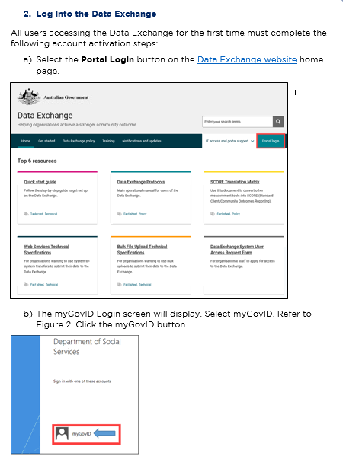
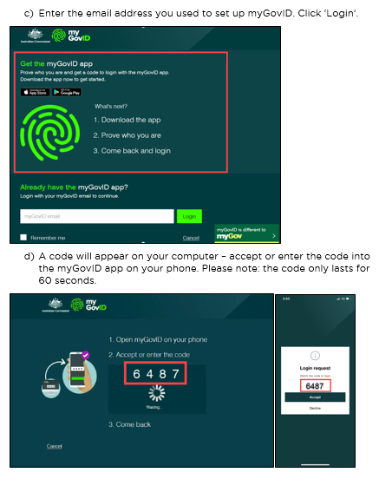
Accessing the Data Exchange
2. Log into the Data Exchange for the first time
- Follow the activation steps in Getting onto the Data Exchange
All users must follow these steps the first time they try to log on to the Data Exchange portal.
Notes:
So when you log onto DEX for the first, there are some specific steps they need to follow.
And this applies to all users. So if you’re the first user, who completed the access request form, or if you’re a subsequent user who was given access by the org. administrator, you all need to follow this process, the first time you log into DEX.
The steps for this are outlined in the document I mentioned earlier: Getting onto the Data Exchange.
You can see some screenshots on the slide there. The document takes you through step by step exactly what you need to, where to click, everything.
So I’m not going to take everyone through this, because hopefully you can just follow those steps and you’ll be all good.

Slide 15
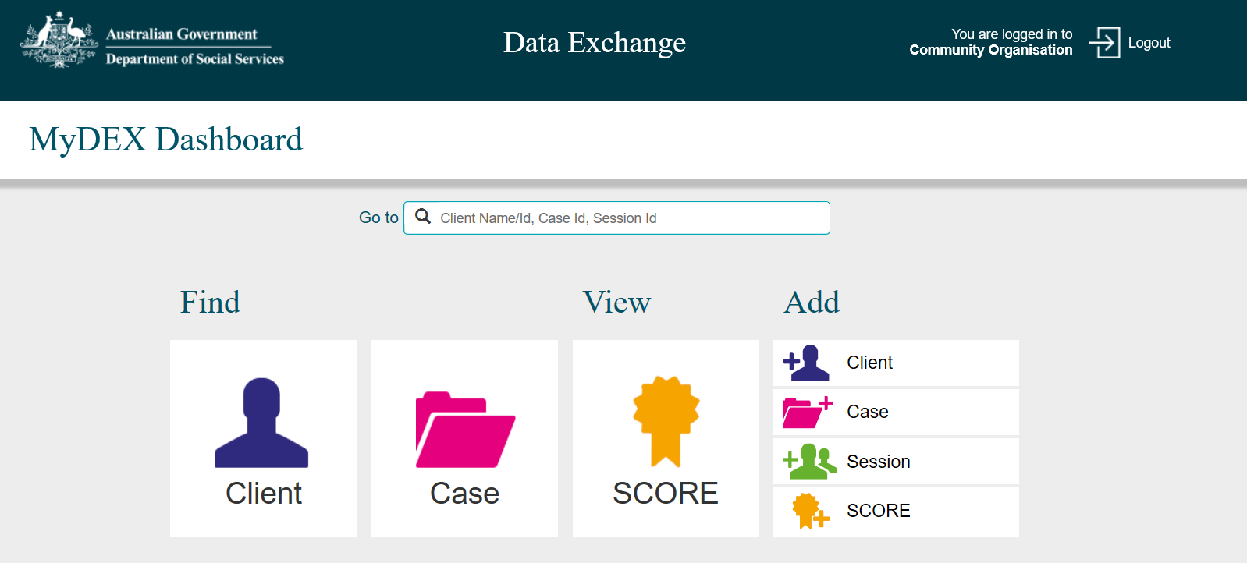
Start using DEX
Notes:
And that’s it! You’re ready to start using DEX.

Slide 16
Key Resources
TEI website
Data Exchange website
Getting on to the Data Exchange
FAQs about myGovID and RAM
FAQs about the Data Exchange
Add and edit a user task card
Notes:
Before we wrap up, I just want to remind everyone of some of the key resources that are available for you about this.
The main document is the ‘Getting onto the Data Exchange’ document.
That goes through all the steps I’ve taken you’ve through today. Its broken everything down into 3 key parts – and you can just work your way through those steps
The other two are both FAQ documents – please take a look at these if you have any questions about what I’ve discussed today. We’ve tried to make sure we’ve included all the questions we’ve been asked about this over the last 6 months. So it will hopefully address any issues you have.
And then on the right, we have the add and edit a user taskcard, for those organisation administrator who are ready to add other users.

Slide 17
Where can I go for help?
Contact | Type of Support
DSS Data Exchange Website | Training resources for the Data Exchange
DSS Helpline: dssdataexchange.helpdesk@dss.gov.au or 1800 020 283 (8.30am – 5.30pm Monday to Friday) | Technical issues with the Data Exchange web platform (NB: not myGovID or RAM)
TEI Website | Training resources tailored to the TEI program
TEI Inbox: tei@facs.nsw.gov.au | TEI specific questions which are unavailable in existing resources
myGovID and RAM support line: 1300 287 539 | Support for issues with myGovID and RAM
myGovID ‘Need help?’ webpage | Support resources for myGovID
RAM ‘Help’ webpage | Support resources for RAM
Notes:
As always, there are all the places you can go for help if needed.
That’s it for today, so thanks everyone for joining us.
Our next webinar is on setting up your organisation and creating outlets in the Data Exchange. So I will hopefully see you there. Thanks again.

