Slide 1
Targeted Earlier Intervention Program
Webinar 10: Community SCORE
Live recording: https://www.youtube.com/watch?v=FPqhc6sdyvw
Notes:
Hi everyone, and welcome to Webinar 10 in our Data Exchange webinar series for the Targeted Earlier Intervention program.
In today’s webinar, we are going to talk about Community SCORE - measuring outcomes for unidentified groups and communities.

Slide 2
Purpose
When should I use Community SCORE?
How do I use Community SCORE?
What is Community SCORE?
In this webinar we discuss:
Notes:
As always, there are three key things today’s webinar will cover.
We’ll talk about what Community SCORE actually is, when to use it, and how to use it.
I’ll go through an overarching process of how to use Community SCORE and I’ll show you some concrete examples, so you can see what it looks like in practice.

Slide 3
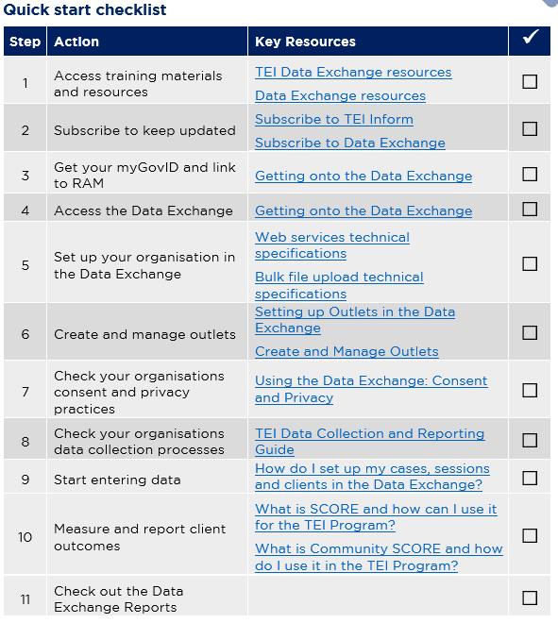
Data Exchange Quick Start Guide
Key resource: Quickstart guide to the Data Exchange
This document outlines the 11 key steps you need to follow to access and start using the Data Exchange.
It includes links to key resources for each step.
Notes:
In our previous webinar’s I introduced everyone to this document: the Data Exchange Quick Start Guide. This is a five page document that outlines the 11 key steps you need to follow to access and start using the Data Exchange. It includes links to all the key resources you need to action each step. And as you can see on the slide it includes this checklist, so you can keep track of where you’re up to.
In each of our webinar’s I’ve been taking everyone through each step in this document.
So as you can see we’ve worked our way through getting onto Data Exchange, and we’ve started entering out data, and now we’re up to Step 10 – measure and report client outcomes.
So, like our last few webinars, we’ve split this step up into two different webinars, because measuring outcomes is quite a mammoth task.

Slide 4
Quick start guide: step 10
Quickstart guide to the Data Exchange
Notes:
So our previous webinar we discussed how to use SCORE for individual clients. And in today’s webinar, we’ll go over how to use Community SCORE to measure and report outcomes for unidentified groups of people.

Slide 5
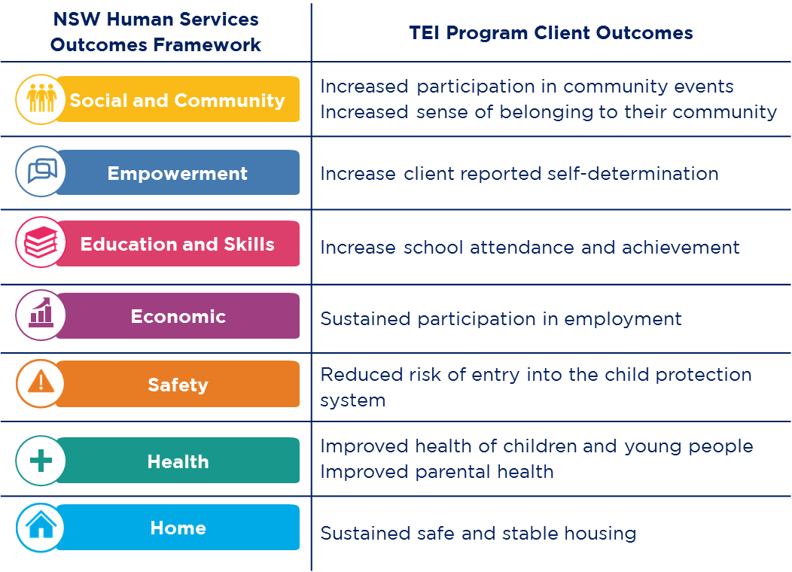
What are client outcomes?
Client outcomes are the changes your service or activities hope to achieve.
They can be for individuals, groups, or communities.
They can be changes in knowledge, attitudes, values, skills and behaviours.
Notes:
So we went through this in our previous webinar, but I’m going to cover it again just in case people haven’t seen it.
What are client outcomes? Client outcomes are the changes your service or activities hope to achieve.
These may be changes in your client’s knowledge, attitudes, values, skills or behaviours. And they could be outcomes for individuals, groups, families, or communities.
There are 9 high-level client outcomes the TEI program is working towards: so for example, increase school attendance and achievement, sustained participation in employment, sustained safe and stable housing.
And we have mapped these outcomes to the NSW Human Services Outcomes Framework: so you can see there are 7 different domains there, that include things like safety, health, home etc.
These are the outcomes that the TEI Program as a whole aims to achieve for children, young people, families and communities in New South Wales.
In your TEI contract, you have identified one of these domains for each of the service types you deliver. So these are the high-level outcomes that every single person here today, is contributing to in some way or another.
In today’s webinar, I’m going to show you how to measure and report these outcomes for the work that you do.

Slide 6
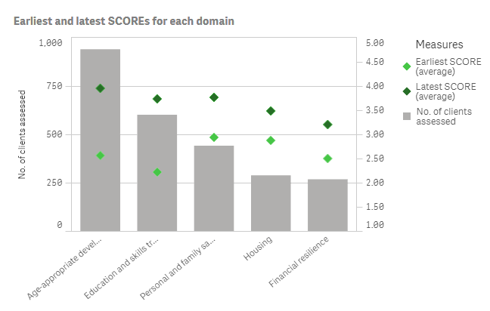
Why is it important to measure outcomes?
Measuring client outcomes can help us understand:
the effectiveness of our services
if our clients are ‘better off’ after receiving a service
We can use this information to:
continuously improve the quality of our services.
evaluate our programs and build the evidence for ‘what works’ for our clients
Notes:
Before, we do that I want to spend a bit of time discussing why it’s important to measure outcomes.
Measuring client outcomes can help us understand the effectiveness of our services and if our clients are better off after receiving a service. Client outcome data shows us if our clients have achieved their goals, or if their circumstances have improved.
We can use this information to improve the services we deliver to ensure our clients receive the right service, at the right time.
We can also use this information to build the local evidence base for what works. We can evaluate our programs and services and identify activities that achieve the best possible outcomes for our clients.
So there is an end-game to all of this data collection and reporting. Please don’t think about it, as some compliance exercise – it’s really about making sure we’re all making a positive difference in our clients lives and we’ve giving them the best service possible to improve their situation.

Slide 7
What is SCORE?
SCORE stands for ‘Standard Client/Community Outcomes Reporting’.
It is an outcomes reporting tool that enables us to report client outcomes and satisfaction.
There are four types of SCORE:
Circumstances SCORE
Goals SCORE
Satisfaction SCORE
Community SCORE
Used for individual clients
Used for groups or communities
Notes:
To measure the effectiveness of the TEI program, we are reporting client outcome data in the Data Exchange. This means we need to use SCORE to report client outcomes.
SCORE is an outcomes reporting tool used in the Data Exchange, it stands for Standard Client/Community Outcomes Reporting.
It allows us to report client and community outcomes and satisfaction.
There are four different types of outcomes measured through SCORE. And last week, I took you through the three for individual clients: so circumstances, goals and satisfaction.
This week, we’re going to tackle community SCORE.

Slide 8
Community SCORE
Community SCORE enables us to report outcomes for groups or communities (i.e. unidentified clients).
In the TEI program, Community SCORE can be used when it is not possible, practical or relevant to record SCOREs for individual clients.
For example:
An information night/session
Community event
One-off occasions of service
Some sector development work
Notes:
So, Community SCORE enables us to report outcomes for groups or communities, so our unidentified clients in the Data Exchange.
In the TEI program, Community SCORE should be used when it is not possible, practical or relevant to record SCOREs for individual clients.
For example:
An information night/session
Community event
One-off occasions of service
Some sector development work

Slide 9
Community SCORE Domains
There are four Community SCORE domains:
Group/community knowledge, skills, attitudes and behaviours:
Have the attitudes, behaviours, skills or knowledge of the client group improved?
Organisational knowledge, skills and practices
Community infrastructure and networks
Are these organisations better able to respond to the needs of their clients/communities as a result?
Social cohesion
Is there greater cohesion and social harmony within the group/community as a result of your activity?
Have the knowledge, skills and/or practices of TEI funded organisations improved?
Are these organisations better able to respond to the needs of their clients/communities as a result?
Have the networks/relationships between TEI-funded organisations improved?
Only for community sector planning and coordination work
Notes:
There are four Community SCORE domains that we can use to measure community outcomes.
The first domain, is group/community knowledge, skills, attitudes and behaviours.
So if you were to use this domain you’d really be interested in measuring if the knowledge, skills, attitudes etc. of the client group have improved.
The second domain is organizational knowledge, skills and practices.
So for this domain, we’re really interested in if the knowledge/skills/practices of TEI-funded organisations have improved.
And if those organisations are better able to respond to the needs of the clients/communities as a result of your work.
The third domain, is community infrastructure and networks.
So this one, we’re interested in if the networks or relationships between TEI-funded organisations have improved?
And if those organisations are better able to respond to the needs of their clients/communities as a result?
The last one, social cohesion.
Its pretty self explanatory. Is there greater cohesion and social harmony within the group/community as a result of your activity?
So, you hopefully already picked up on this. But these two domains in the middle are only really for sector development work.
For organisations that work with other organisations to improve how they respond to community needs.
So they’ll only really be used for community sector planning, or community sector coordination – when you’re working with other community organisations.

Slide 10
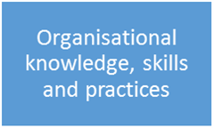
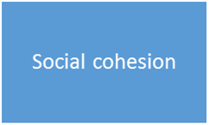
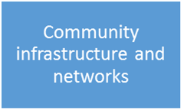
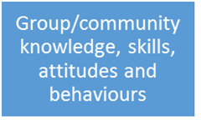
Community SCORE Domains - Examples
Activity Community SCORE domain
Notes:
See examples of screen.

Slide 11
Community SCORE Rating Scale
1. No change
A 5-point rating scale is used to report changes in community outcomes.
To record a Community SCORE, you need to record a rating between 1 and 5 against the relevant domain.
See the Data Exchange Protocols, pg. 38
2. Limited change with emerging engagement
3. Limited change with strong engagement
4. Moderate change
5. Significant change
Notes:
So, community SCORE has a 5-point rating scale.
You can see down the left hand side of the slide – number 1 is no change, then we have limited change with emerging engagement, limited change with strong engagement, moderate change, and significant change.

Slide 12
How to use Community SCORE
Method 1: Post-SCOREs for single sessions
Method 2: Pre- and post-SCOREs across multiple sessions
You can report one Community SCORE for a single session.
For example:
Community events
Information nights or forums
A one-off class or workshop (e.g. workshops held with a different group of people each time)
Report pre- and post-Community SCOREs across multiple sessions.
For example: a series of workshops, forums or information sessions
You can only record Community SCOREs this way, if:
you have the same group of people attend 2 or more sessions
it is not practical or relevant to collect information from individual clients.
Notes:
There are two different methods we can use to collect and report Community SCOREs.
The first method is that you just report 1 Community SCORE for the session.
So you can do this for Community events, information nights or forums, and one-off classes or sessions.
The second method, is to record pre- and post-SCOREs across multiple sessions.
So you could do this for a series of workshops, forums, interagency meetings.
You should only use Method 2 if you have the same group of people attend the sessions, because you want to see if their outcomes have changed.
And if it is not practical or relevant for you to collect personal information from them as individual clients – so they will be recorded as unidentified clients even though they will all be attending multiple sessions.

Slide 13
Method 1: Post-SCOREs for single sessions
Step 1. Identify your Community SCORE domain
Think about the outcomes you are trying to achieve (refer to your contract and program logic).
Step 2. Identify a tool to measure community outcomes
Use SCORE directly
Step 3. Record the outcome in the Data Exchange
Record the SCORE assessment in the Data Exchange.
Pick the domain(s) that is most relevant to your outcome.
See:
Add a SCORE assessment – Task Card
Add a SCORE assessment – Module
Use a survey tool
Observe the group, use your professional judgement
Short survey for clients to complete at the end of the session
Notes:
So I’m going to go through each of those 2 methods in more detail now.
And I’ll show you some concrete examples as well, so you can see how it all kind of comes to together.
So there are 3 key steps you need to follow.
The first one is to identify you Community SCORE domain that you’ll use.
So to do this, you need to think about the outcomes you are trying to achieve – and you can always take a look at you contract or your program logic if you already have one.
And then you need to figure out which of the 4 community SCORE domains is most relevant to your outcome.
Once you’ve done that, you can identify a tool to measure the outcome.
So for this method, we have two options. We can use SCORE directly, as an observation tool, so you can observe the group of people and make a professional judgement about how you think the group is going.
OR we can use a survey tool – so you could develop a short survey at the end of the event or the session to give to your clients to help you understand how they’re going. And then once you’ve implemented that, you need to record it in the Data Exchange.
So now I’m going to take you through some concrete examples to show you what this will look like in practice.

Slide 14
Method 1: Post-SCOREs for single sessions
Example 1. Using SCORE directly at a small community event
An organisation hosts a barbeque for families with children in the local area. They play games where adults and children can mix, e.g. soccer and sack races.
Step 1. Identify your Community SCORE domain
This event aims to increase community connectedness for attendees. The ultimate goal is to increase social cohesion, networks and participation.
Step 2. Identify a tool to measure community outcomes
Step 3. Record the outcome in the Data Exchange
The service provider uses their professional judgement and decides the increased engagement shows a ‘moderate change’. They record this as a 4 on the SCORE scale.
They identify ‘Social cohesion’ as the Community SCORE that is more relevant.
They decide to use SCORE directly and observe how the attendees interact with each other.
At the beginning of the event, they attendees engage in small talk.
By the end of the event, they are mixing well. They have organised a Facebook group and have made plans to meet for coffee and a playdate.
Notes:
So, the first example I want to walk you through is for a small community event.
So in this example, an organisation hosts a bbq for families in the local community. They play games where adults and children can mix, theres lots of fun things happening on the day.
So the first thing they need to do is identity their outcome and the community SCORE domain they’re going to use.
So this event aims to increase community connectedness for the attendees.
So the ultimate goal is to increase social cohesion, networks and participation.
So of the four community SCORE domains we have, ‘social cohesion’ is probably the most relevant.
So that’s what they’re going to use to record their outcome.
Now, they need to figure out how they’re going to measure it. So they have two options – they can use SCORE as an observational tool, or they can develop a survey.
In this example, they decide to use SCORE directly as an observation tool.
And the reason they choose to observe the group, rather than develop a survey, is because this is just a really informal get together. Its just an opportunity for people in their community to connect with others, and have a fun Saturday afternoon. They don’t want to burden people by asking them to complete a short survey. And also, there might be lots of people coming and going throughout the afternoon – so it could be quite hard to actually get people to answer your questions.
So they’re going to watch the group of people, see how people interact and engage with each other, and they might have some small conversations with people about they think things its going.
So at the beginning of the event, they notice that people are just engaging in small talk with each other. Which isn’t a lot of engagement.
But, by the end of the event, everybody seems to be mixing well. They’ve organized a facebook group and they have made plans to meet up for coffee and a playdate. So we can see that there has actually been some really positive engagement here.
So now, all they need to do is record that in DEX.
So they’re going to use their own professional judgement and they need to figure out on that scale of 1-5 where they think the group sits. So in this example, they decide that the increased engagement, the fact that people have made a facebook group, they’ve got future plans to catch up, that shows a ‘moderate change’ in the Social Cohesion domain. So they record this as a 4 on the Community SCORE scale.

Slide 15
Method 1: Post-SCOREs for single sessions
Example 2. Using SCORE directly at a large-scale community event
A group of TEI service providers organise an event to raise public awareness of mental illness. The event has stalls for local services and a series of talks from community members with lived experience of mental illness.
Step 1. Identify your Community SCORE domain
The events aims to increase community knowledge about services and resources available for people with mental illness and carers.
Step 2. Identify a tool to measure community outcomes
Step 3. Record the outcome in the Data Exchange
The services had mixed experiences.
They decide to use SCORE directly.
The service providers identify ‘group/community knowledge, skills, attitudes and behaviours’ as the Community SCORE domain most relevant to this activity.
They decide the best way to assess the event is to debrief with all the services and speakers after it has finished.
They talk about:
How many people came to each stall and what information they were given
How people responded to this information
How many people signed up to receive more information or registered to join a group or activity
How the talks went and if the speakers felt they were successful
Some spoke about community members who were very grateful for the information given to them and who were excited to find out about different services in their community.
Others spoke about community members who were looking for information they couldn’t provide and for specific services that weren’t at the event.
The service providers use the information shared in this discussion to agree on a Community SCORE. They decide to record a ‘3 – limited change with strong engagement’.
Notes:
So our next example is for a large community event.
So in this example, a group of TEI service providers organise an event to raise public awareness of mental illness. The event has stalls for local services and a series of talks from community members with lived experience of mental illness.
So again, the first thing they need to do is identify their outcome and the SCORE domain.
So this event aims to increase community knowledge about services and resources available for people with mental illness and carers.
So they decide that the most relevant domain is ‘group/community knowledge, skills, attitudes and behaviours’ because they’re trying to impact people’s knowledge right, they’re trying to raise awareness.
So now they have to figure out how they’re going to measure that.
And in this example again, they decide to use SCORE directly, and all the service providers who were at the event, and the speakers who presented, will come together at the end of the day to debrief and talk about how they think it went.
So they discuss lots of different things like:
How many people came to each stall and what information they were given
How people responded to this information
How many people signed up to receive more information or registered to join a group or activity
How the talks went and if the speakers felt they were successful
So in this example, at the end of the day, all the service providers come together to have this discussion, and there are a couple of different things that they find.
Some people spoke about community members who were very grateful for the information given to them and who were excited to find out about different services available in their community.
Others spoke about community members who were actually looking for information they couldn’t provide and for specific services that weren’t even at the event.
So there were some mixed experiences, right?
So collectively they decide that on the Community SCORE scale, from 1-5, this is probably indicates that there was limited change. Because there were some people who were very happy, and others who weren’t. So they think they did a pretty average job. So in the Data Exchange, they record that as a 3 on the SCORE scale.

Slide 16
How can we make this information more meaningful?
We encourage service providers to think about more meaningful ways to record outcomes for large-scale community events.
You could survey community members who volunteered to organise the event. Their participation could have empowered them to contribute to local decision-making and improved their sense of belonging.
You could survey community members who spoke at the event. Their participation could have improved their confidence and empowerment.
Notes:
So, before we move on to the next example, there is one little thing that I would like to talk about.
For those organisations who do conduct large scale community events, what I would really like you to start thinking about is how can you record outcomes for these events in more meaningful ways.
So with an event like our previous example, I could imagine that there would be local volunteers who contributed to putting on that event.
And I could imagine as well, that the time they spent doing that work, could have really empowered them. Like maybe after all the planning sessions they were a part of, they really feel like they’re contributing to local decision-making, maybe their sense of belonging to their community has improved.
And these are really tangible outcomes that you could measure.
The same goes for, in the example I had, the people who spoke at the event were all community members with lived experience of mental illness. And again, I could imagine that having that opportunity to address their community and talk about their lived experiences could have a really positive impact on them. It could have increased their confidence, it could have empowered them, it could really make them feel that they have a voice and they’re being listened to by their peers and community.
If you start collecting information from the volunteers who contribute to your events and the people who speak at your event you’re able to tell the bigger story about the impact your having in your community.
So maybe just have a think about how you can start recording these sorts of activities in more meaningful ways, to show the full breadth of the impact you’re having.

Slide 17
Method 1: Post-SCOREs for single sessions
Example 3. Using a survey tool for an information night
A TEI service provider hosts an information session for new parents.
Step 1. Identify your Community SCORE domain
The session aims to inform new parents about support services, activities and resources available in the local community.
Step 2. Identify a tool to measure community outcomes
Step 3. Record the outcome in the Data Exchange
The service provider uses the results of the survey to determine a Community SCORE.
They decide the best way to assess the activity is to conduct a short survey at the end of the session.
The service provider identifies ‘group/community knowledge, skills, attitudes and behaviours’ as the Community SCORE domain most relevant to this activity.
it is not practical or feasible to collect pre- and post-surveys for a large group of people.
if they did collect pre- and post-surveys it is unlikely they would see a change in the participants responses. This is because the information session is a one-off and short event.
This is because:
If the majority of respondents ‘agree or strongly agree’ that they have a better understanding after attending the session, you might record this as a ‘4 - moderate change’.
If only a small number of respondents ‘agree or strongly agree’, you might record this as a ‘2 - limited change with emerging engagement’.
For example:
Notes:
So just one last example for our first method, an organisation hosts an information session for new parents.
So the first thing they need to do is identify their outcome and their SCORE domain.
So the information session aims to inform new parents about support services, activities and resources that are available in the local community.
So of the four community SCORE domains, they identify that ‘group/community knowledge, skills, attitudes and behaviours’ is most relevant. Because they’re trying to improve peoples knowledge, right?
So, now they have to figure out how they’re going to measure that.
In this example, they decide to conduct a short survey. And they’re just going to do it once, at the end of the session.
This is for two reasons:
it is not practical or feasible to collect both pre- and post-surveys for a large group of people.
if they did collect pre- and post-surveys it is unlikely they would see a change in the participants responses. Especially for an information sessions that might only go for one hour.
So they, develop a short little survey, that they can ask everyone to complete at the end of the session.
So I’m just going to skip to the next slide very quickly…
So I’ve got some examples of how you might figure out that SCORE in the last box.
If a majority of respondents said yes, the session was useful, I know more about the services in my community, then maybe they would record that as a 4 on the SCORE scale, for moderate change.
But, if only a small number of respondents said that, then maybe it would be a 2 on the SCORE scale for limited change.
So you have to look at all the results from the survey, tally them all up, and then figure out where you think the majority sits.

Slide 18
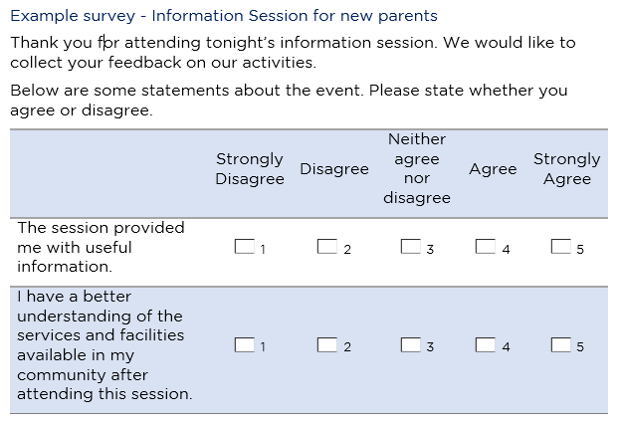
Information session for new parents
Notes:
This is an example of the survey tool they used.
So they hand this to people as they walk in the door, and they ask them to complete it at the end of the session.
So they just have two simple statements:
The session provided me with useful information
I have a better understanding of the services and facilities in my community
So at the end of the info night, they collect these from everyone who completed it, and they use the answers to figure out what their Community SCORE might be.

Slide 19
How to use Community SCORE
Method 1: Post-SCOREs for single sessions
Method 2: Pre- and post-SCOREs across multiple sessions
You can report one Community SCORE for a single session.
For example:
Community events
Information nights or forums
A one-off class or workshop (e.g. workshops held with a different group of people each time)
Report pre- and post-Community SCOREs across multiple sessions.
For example: a series of workshops, forums or information sessions
You can only record Community SCOREs this way, if:
you have the same group of people attend 2 or more sessions
it is not practical or relevant to collect information from individual clients.
Notes:
So that’s in for method 1.
Now we’re going to go through method 2.

Slide 20
Method 2: Pre- and Post-SCOREs for multiple sessions
Step 1. Identify your Community SCORE domain
Think about the outcomes you are trying to achieve (refer to your contract and program logic).
Step 2. Identify a tool to measure community outcomes
Use a survey tool.
Step 3. Record the outcome in the Data Exchange
Record the SCORE assessment in the Data Exchange.
Pick the domain(s) that is more relevant to your activity and client group.
See:
Add a SCORE assessment – Task Card
Add a SCORE assessment – Module
Ask participants to complete the short survey:
at the beginning of the first session
at the end of the last session.
You must ensure the tool is a suitable and accurate measure that can be interpreted consistently.
Reminder: You should only use this method, if:
you have the same group of people attend 2 or more sessions
it is not practical or relevant to collect information from individual
Notes:
The second method, is to record pre- and post-SCOREs across multiple sessions.
So you could do this for a series of workshops, forums, interagency meetings.
You should only use this method if you have the same group of people attend the sessions, because you want to see if their outcomes have changed.
If you have different people attending the sessions, then use Method 1.
So for example, if you run three information sessions on parenting, and you expect a different group of people to attend each time, then use method one. Because that’s a one-off service essentially.
And you can also use this method if it is not practical or relevant for you to collect personal information from individual clients – so they will be recorded as unidentified clients even though they will all be attending the same sessions.
So to implement this method there are 3 key steps you need to follow.
The first one is to identify you Community SCORE domain.
So you do the same thing we already discussed, you need to think about the outcomes you are trying to achieve –take a look at you contract or your program logic if you already have one.
And then try to identify the Community SCORE domain that is most relevant to your outcome.
Once you’ve done that, you then identify how you’re going to measure that outcome.
Our advice for this method is to use a survey tool.
You could do observation if you really wanted to – but I think a survey tool is more appropriate because you’re meeting with the group on at least two separate occasions.
And then again, the last step is to record the outcome in the Data Exchange.
So now I’m going to take you through some concrete examples.

Slide 21
Method 2: Pre and Post-SCOREs for multiple sessions
Example 1. Using a survey tool for interagencies
A TEI service provider hosts a monthly interagency meetings with local service providers.
Step 1. Identify your Community SCORE domain
The interagency aims to:
Step 2. Identify a tool to measure community outcomes
Step 3. Record the outcome in the Data Exchange
The service provider uses the results of the survey to determine a Community SCORE.
They decide to measure outcomes by asking the attendees to complete a survey at the:
The service provider identifies two relevant Community SCORE domains:
For example: In the first survey, the majority of respondents say they ‘disagree’ or ‘neither agree nor disagree’ that they have strong relationships with other organisations. They decide to record this as a ‘2 – limited change with emerging engagement’.
Connect local community organisations with each other
Identify emerging issues in the community and develop solutions
In the second survey, the majority of respondents ‘agree’ that they have strong relationships. They decide to record this as a ‘4 – moderate change’.’
Beginning of the first session
Every 6 months as a follow up
Share information
Organisational knowledge, skills, and practice
Community Infrastructure and networks
Notes:
So, the first example we have is using a survey tool to measure outcomes for interagencies
So in this example, a service provider hosts monthly interagency meetings with local service providers.
So the first thing they need to do is identify their outcomes and the relevant SCORE domains.
The purpose of the interagency, as you can see on the slide, is to
Connect local community organisations with each other
To enable them to share information
And to identify emerging issues in the community and develop solutions
So of the four community SCORE domains, they actually identify two domains that are relevant to the interagency.
So the first one is organizational knowledge, skills and practices – and this is because they’re trying to increase the knowledge of these organisations about issues in the community, about the best way to respond to those, about what other organisations are doing.
The second domain is community infrastructure and networks – and this is because they’re trying to connect local organisations with each other, and facilitate positive relationships between those organisations so they can work together to tackle the issues the local community faces.
So, they’ve got their outcome and they’ve identified their community SCORE domain. Now they have to figure out how they’re going to measure that.
In this example, they decide to conduct a short survey. So the first survey is conducted at the beginning of the first interagency, at the beginning of the year. And then they decide to do a follow up every 6 months, to see how the group is tracking.
So I’m just going to skip to the next slide very quickly…
So, coming back to our steps really quickly.
We’ve conducted the survey, and now we’re ready to record an outcome in the Data Exchange, so step 3.
And again, I’ve got some examples of what this might look like in the last box.
But its really the same as the previous example, you have to look at all the results from the survey, tally them all up, and then figure out where you think the majority sits, on the 5-point SCORE scale.
And hopefully, you’ll be able to see that overtime, your interagency is supporting organisations to engage with one another, to share information, to and respond to community needs.

Slide 22
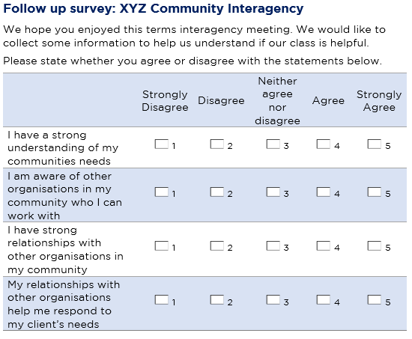
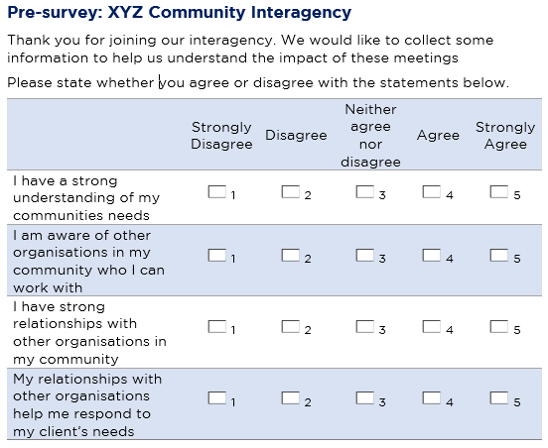
Survey example: XYZ Community Interagency
Organisational knowledge, skills and practices | I have a strong understanding of my communities needs
 | I am aware of other organisations in my community who I can work with
Community Infrastructure and Networks | I have strong relationships with other organisations in my community
 | My relationships with other organisations help me respond to my client’s needs
Notes:
This is an example of the survey they use.
So its quite simple. They have the same questions in the pre-survey and the post-survey, so all of their follow up.
Because they want to see the difference in everyone’s knowledge, their relationships, all that sort of stuff.
So they have four relatively simple statements:
I have a strong understanding of my communities needs
I am aware of other organisations in my community who I can work with
I have strong relationships with other organisations in my community
My relationships with other organisations help me respond to my clients needs
So these statements relate to the Community SCORE domains they identified earlier.
So, you can see in the red box here, the first two statements, will be used to measure outcomes for the domain Organisational knowledge, skills and practices.
And the last two statements, will be used to measure outcomes for the domain Community Infrastructure and Networks.
So they’ll use people’s responses to these questions to determine the community SCORE for those domains.

Slide 23
Method 2: Pre and Post-SCOREs for multiple sessions
Example 3. Using a survey tool for workshops
A TEI service provider hosts a series of workshops to help other organisations use evidence and data. They run 3 workshops with the same group of staff members.
Step 1. Identify your Community SCORE domain
The workshops aim to:
Step 2. Identify a tool to measure community outcomes
Step 3. Record the outcome in the Data Exchange
The service provider uses the results of the survey to determine a Community SCORE.
They decide to assess the workshops by asking attendees to complete a survey at the first and last session.
In the first survey, the majority of staff members say they ‘disagree’ or ‘neither agree nor disagree’ that they use research and data in their everyday decision-making. They record this ‘2 – limited change with emerging engagement’.
improve the staff’s ability to access and use evidence
improve the organisation’s practices so these skills are embedded in their day-to-day work.
The service provider identifies ‘organisational knowledge, skills and practices’ as the Community SCORE domain most relevant to their workshops.
In the second survey, the majority of staff members ‘agree’ that their organisations has embedded evidence-based practices in the way they work. They record this as a ‘4 – moderate change’.
Notes:
So, the second example we have is using a survey tool for sector development workshops.
So in this example, a sector development orgs hosts a series of workshops for other organisations to learn how to use evidence and data in their work.
So they run 3 workshops with the same group of staff members.
So as always the first thing they need to do is identify their outcome and the relevant community SCORE.
The workshops aim to:
improve the staff member’s ability to access and use evidence
improve the organisation’s practices so these skills are embedded in their day-to-day work.
So of the four community SCORE domains, they identify that ‘organisational knowledge, skills and practices’ is most relevant.
So, they’ve got their outcome and they’ve identified their community SCORE domain. Now they have to figure out how they’re going to measure that.
In this example, they decide to conduct a short survey. And they’re going to do this twice, once at the beginning of the first session and then again, at the end of the last session.
So I’m just going to skip to the next slide very quickly…
And again, I’ve got some examples of what this might look like in the last box, and its very similar to the other examples.
So they to look at all the results from the survey, tally them all up, and then figure out where the majority sits, on the 5-point SCORE scale.
For example: In the first survey, the majority of staff members say they ‘disagree’ or ‘neither agree nor disagree’ that they use research and data in their everyday decision-making. They record this ‘2 – limited change with emerging engagement’.
In the second survey, the majority of staff members ‘agree’ that their organisations has embedded evidence-based practices in the way they work. They record this as a ‘4 – moderate change’.

Slide 24
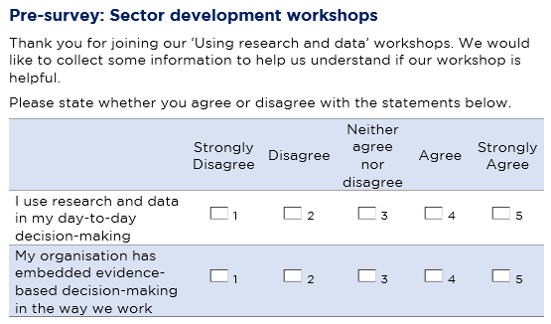
Survey example: sector development workshops
Notes:
This is an example of a survey they could use.
So again, its super simple. They have the same questions in the pre-survey and the post-survey.
Because they want to see the difference in the clients knowledge and skills.
So they have two really clear, simple statements:
I use research and data in my day-to-day decision making
My organisation has embedded evidence-based decision-making in the way we work.
So both statements relate directly to the outcomes they’re trying to achieve as well.
So then they use the results of the survey, to determine the Community SCORE.

Slide 25
TEI Outcomes Matrix template
TEI program client outcomes (identified in program logic and schedule) | Service level outcomes (identified in program logic) | How will this be measured? | When will this be measured? | Who is responsible for measuring this outcome?
List the domain and the TEI program client outcome. Add rows as needed. | List the specific client/community outcomes your activity is working towards. | Identify how these outcomes will be measured. List the questions you will ask and/or the tool you will use. List the SCORE domain the outcome will be recorded in the Data Exchange. | Describe when the outcome will measured. For example, when will you ask clients to complete the survey? | Describe who is responsible for measuring the outcome. For example, will clients complete a survey or will a practitioner observe the client?
Notes:
So last week, I introduced you guys to a resource called the TEI Outcomes Matrix.
So you can see this is just a really simply table that you can use to help you go through the process that I just went through.
So you can document the outcomes you’re working towards, how you’re going to measure those outcomes, the SCORE domain that you’ll use to report the outcome.
And you can also include information about when it will measured and who is responsible for measuring it.

Slide 26
Using Community SCORE – Parenting information session example
TEI program client outcomes (identified in program logic and schedule) | Service level outcomes (identified in program logic) | How will this be measured? | When will this be measured? | Who is responsible for measuring this outcome?
Social and Community Domain Increased participation in community events/increased sense of belonging to the community | Increase parents knowledge of services in their community | Attendees complete a short survey with 2 questions on a 5-point Likert scale: The session provided me with useful information I have a better understanding of the services and facilities available in my community Responses are averaged and a single score is entered directly into Community SCORE: Group/community knowledge, skills, attitudes and behaviours. | At the end of the session. Attendees will be given the survey when they enter, and will be ask to hand back the completed survey as they leave the building. | Leader of the information session asks attendees to complete the short survey.
Notes:
So this is an example we completed earlier – for a parenting information session.
So the first column identifies the outcome domain we’re working in, then we’re got the specific outcome that is the purpose of the information session: so we’re trying to increase parents knowledge of service in their community.
Then the third column, how will this be measured, includes the survey questions that will be used.
And the SCORE domain that it will be recorded in:
So you can see it says, attendees complete a short survey with 2 questions on a 5-point Likert scale:
The session provided me with useful information
I have a better understanding of the services and facilities available in my community
Responses are averaged and a single score is entered directly into Community SCORE: Group/community knowledge, skills, attitudes and behaviours.
Then the next column, when will this be measured, gives us some information about when the survey will be conducted.
So it says, at the end of the session. Attendees will be given the survey when they enter, and will be ask to hand back the completed survey as they leave the building.
And then our last column, who is responsible for measuring the outcome. And it just says, leader of the information sessions asks attendees to complete the short survey.
So you can see we’ve got a really clear and simple plan of attack for measuring outcomes for the information session.
So you can use this resource to help you go through the process we just went through, of identifying your outcome and the SCORE domain and then figuring out how its going to measured and implemented.

Slide 27
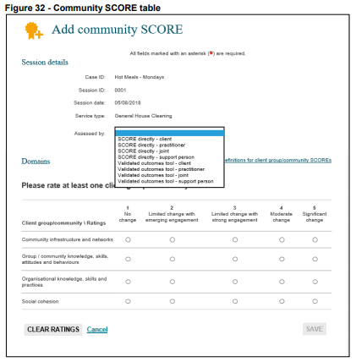
How do I record SCORE?
Record each SCORE assessment in the Data Exchange.
Add a Community case and session
Add a SCORE assessment – Module
Add a SCORE assessment – Task Card
Important:
Only record a SCORE in the domains relevant to your activity. You do not need to record a SCORE in every domain.
DO NOT RECORD COMMUNITY SCORES FOR SESSIONS WITH 0 UNIDENTIFIED CLIENTS
Notes:
Ok, now we’re up to the final bit to actually record the Community SCORE in the Data Exchange.
Ok, so for those of you who are using the web-based portal, these three resources walk you through how to enter the Community SCORE.
So the Community SCORE is entered at the session level – so after you’ve created a session, you will have the opportunity to ‘add a Community SCORE’.
Then you just need to select who conducted the assessment.
For Community SCORE we’re probably always going to choose SCORE directly – I’m not aware of any validated instruments that measure this kind of stuff.
So you just select who conducted the assessment.
And then down here in the little matrix, you’ll just select what the actual SCORE was.
So, its super important to remember, you do not need to record a SCORE for every domain. Just the domain that is most relevant to your activity.
These domains are quite disparate from one another, so its probably going to very rare that you would use all four of them.
When we think back at all the examples I went through today, in almost every example there was only one relevant domain.
It was only the example for interagencies, where I used two domains.
So please, think very critically about the work you’re doing, and the immediate outcomes you’re trying to achieve, and try to identify the domains that are most relevant to you’re activity.
You do not need to record an outcome for every domain.
Another super important thing to remember, is that you should only record Community SCORE for sessions with unidentified clients.
If all of your clients are individual clients who have a client record in DEX, then you should be using Circumstance and Goals SCORE to measure their outcomes. Not Community SCORE.

Slide 28
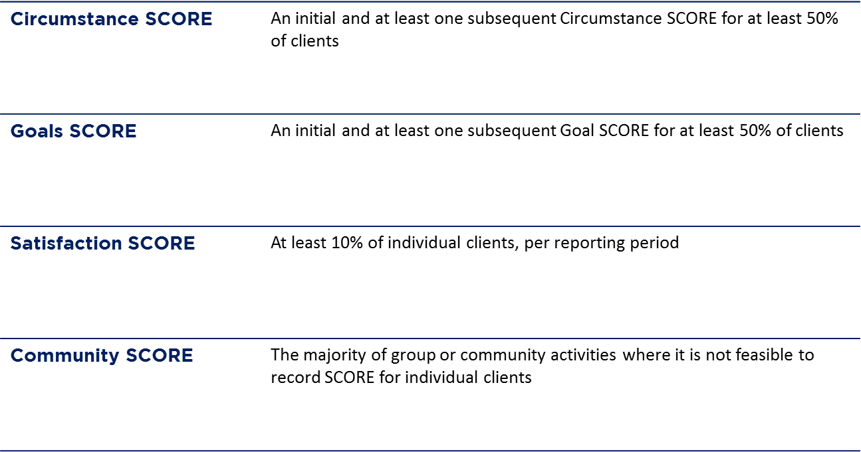
How many clients do I need to report SCORE for?
Notes:
Ok, so one of the common questions we also get is how many clients do you need to report SCOREs for.
This is a little bit tricky for Community SCORE, because as you should all now know, we only use Community SCORE for unidentified groups.
So, as a general rule of thumb, you should record a Community SCORE for the majority of the group or community activities where its not possible to record SCORE for individual clients.
So this means, for every session you’ve conducted, where you have recorded a number of unidentified clients, you should record a Community SCORE for the majority of those sessions, so at least half of them.

Slide 29
Key Resources
TEI website:
What is Community Score and how do I use it for the TEI Program?
TEI outcomes matrix template
What is SCORE and how can I use it for the TEI Program?
TEI Guide to Developing Surveys
DSS Website:
Community Outcomes (SCORE) Fact sheet
Data Exchange Protocols
How to use SCORE with clients
SCORE translation matrix
Add a SCORE assessment – Module
Add a SCORE assessment – Task Card
View and edit a SCORE assessment – Task Care
Notes:
Here are all of the resources, I’ve shown you today.
On the left, we have the documents that we in DCJ have developed. The first resource, ‘What is Community SCORE?’ goes through the methods and steps I took your through today. So please download that document and work your way through it.
The outcomes matrix is also here – so please download that resource. We’ve heard from lots of organisations that they’ve found it really useful to work through how they’re going to measure client outcomes.
And on the right, are all the resources DSS have developed, including the taskcards and learning modules to actually enter the Community SCORE into the web-based portal.

Slide 30
Where can I go for help?
Contact | Type of Support
DSS Data Exchange Website | Training resources for the Data Exchange
DSS Helpline: dssdataexchange.helpdesk@dss.gov.au or 1800 020 283 (8.30am – 5.30pm Monday to Friday) | Technical issues with the Data Exchange web platform (NB: not myGovID or RAM)
TEI Website | Training resources tailored to the TEI program
TEI Inbox: tei@facs.nsw.gov.au | TEI specific questions which are unavailable in existing resources
myGovID and RAM support line: 1300 287 539 | Support for issues with myGovID and RAM
myGovID ‘Need help?’ webpage | Support resources for myGovID
RAM ‘Help’ webpage | Support resources for RAM
Notes:
And as always. here are all the places you can go for help if needed.
Thanks everyone.

