Slide 1
Targeted Earlier Intervention Program
Webinar 1: Introduction to the Data Exchange
Living recording: https://www.youtube.com/watch?v=hGN1xuFqgXs
Notes:
Hi everyone, and welcome to the Data Exchange webinar series, for the Targeted Earlier Intervention Program.
This is the first webinar, in a series of 12 – to help you understand how to access, use and make the most out of the Data Exchange.
Today’s webinar is a really easy one – where I’m just going to introduce everyone to the Data Exchange.

Slide 2
Purpose
In this webinar we discuss:
What the Data Exchange is and why we’re using it
Subscribe to our newsletter
Where to find key resources and seek help
Notes:
There are three key things we’ll cover.
We’ll talk about what the Data Exchange is and why we’re using it.
We’ll take you through where to find useful resources and where to go for help.
And then I’ll also talk about the newsletters you can sign up to to continue to receive useful information about the program.

Slide 3
What is the Data Exchange?
The Data Exchange is a data reporting platform.
It is hosted by the Department of Social Services.
In the TEI program, we are using the Data Exchange to report information about the services we deliver, our clients and the outcomes they achieve.
Using the Data Exchange enables us to:
Clearly understanding who our clients are
Track client pathways in the service system
Demonstrate the impact of our services on client and community outcomes
Notes:
The Data Exchange is a data reporting platform. In the TEI program, we are using the data exchange to report information about the services we deliver, our clients and the outcomes they achieve.
Using the Data Exchange will better enable us to clearly understand who are clients are, we can track client pathways through the service system and we can also use the data we report to demonstrate the impact of our services on client and community outcomes.

Slide 4
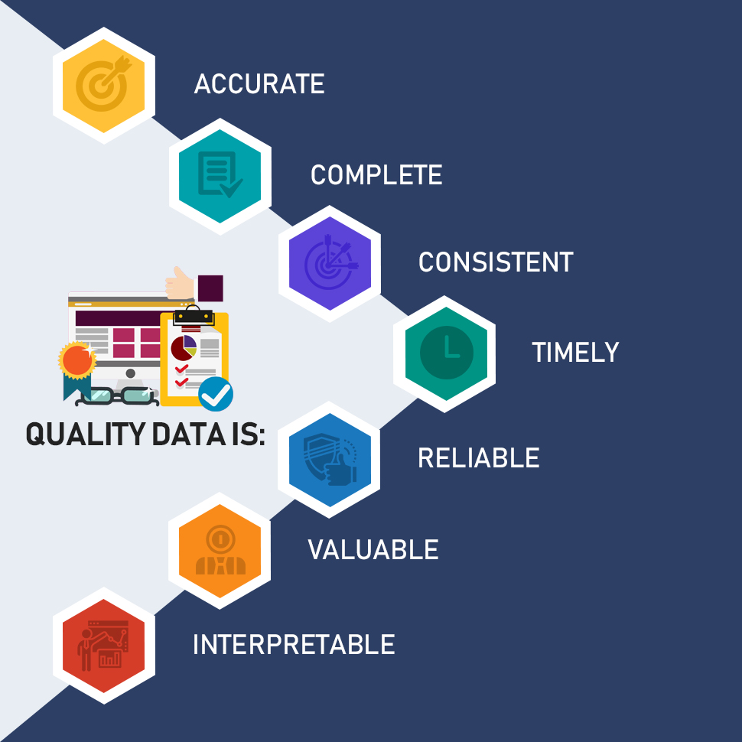
Why do we need high-quality data?
Our ultimate goal is to clearly understand our client’s needs, in real time, so we can make sure people get the right support at the right time.
High-quality data helps us understand what works and what we can do better to achieve greater outcomes for our clients and communities.
It can be a powerful tool for planning, decision-making, evaluation and advocacy.
Notes:
Our ultimate goal is to have a high-quality data set that clearly tells us who are clients are and what their needs are. So we can use this information to make sure the right people, get the right support at the right time.
The data we report into the Data Exchange is going to help us understand what works for our clients and what we can do better to achieve greater outcomes for them and for their communities.

Slide 5
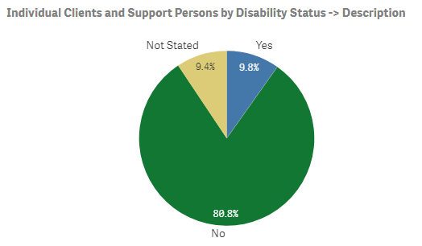
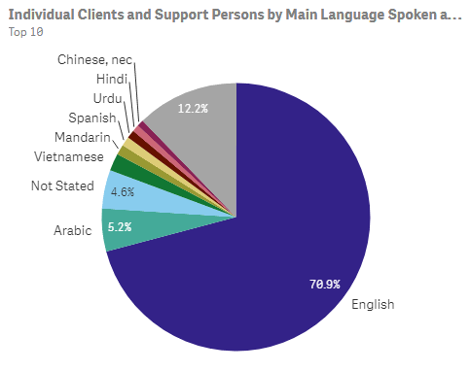
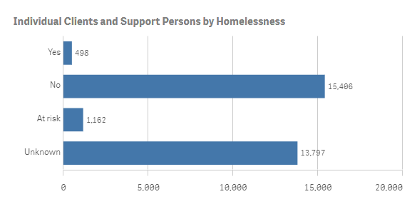
Client demographic data in the Data Exchange reports
Notes:
Over the coming weeks, we’ll talk more and more about all the different ways we can use the Data Exchange and how useful it’s going to be for our program, but I just to show you really quickly some of the information that you’ll be able to see when you start reporting.
So the graphs you can see on the slide, show some of the key demographic information service providers have already reported for the TEI program.
When you start entering your data, and you access your reports, you’ll be able to this same information about your own clients. You’ll have age breakdowns of clients, you’ll be able to see how many are homeless or at risk of homelessness, what disabilities people have, what languages people speak. And we can use this information to make sure we’re addressing our clients’ needs in the best possible way and that they’re receiving the right service for them.

Slide 6
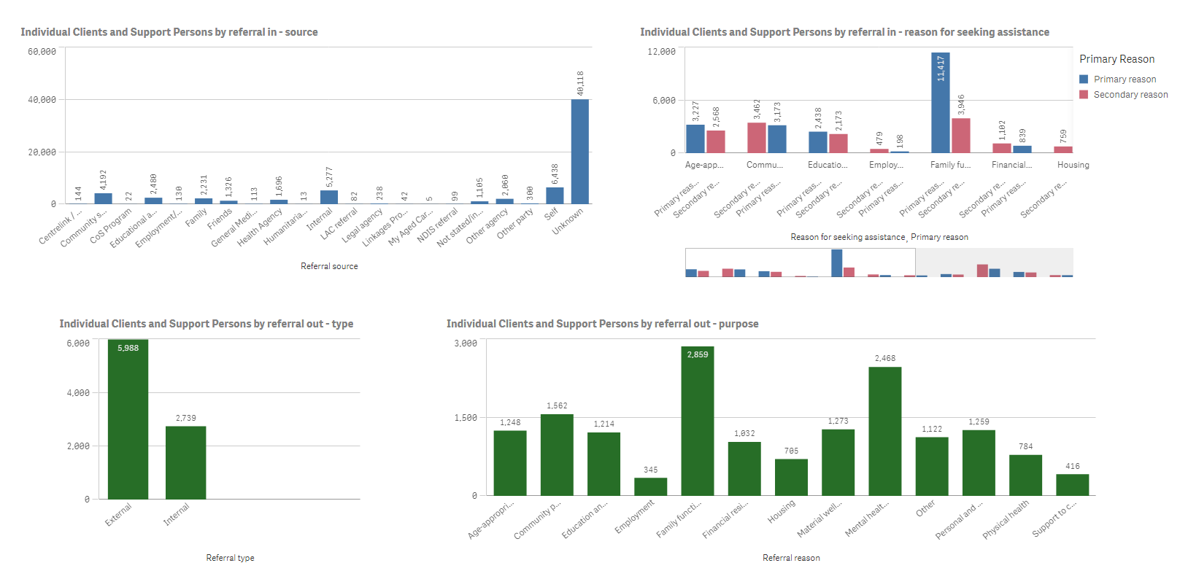
Referral data in the Data Exchange reports
Notes:
This next slide is some of the information about referrals that has already been recorded. So we can also start to see how clients are coming into contact with TEI services – some are being referred by health agencies, by educational agencies, there are lots of internal referrals and lots of self-referrals as well. And we can also see the reasons why people are coming to our services – which is obviously really useful information that can help us ensure clients get the service that is right for them.
So already we are starting to see really useful information about how are clients are navigating the service system and what their needs are. And this is only going to become more and more useful as we collect more data.

Slide 7
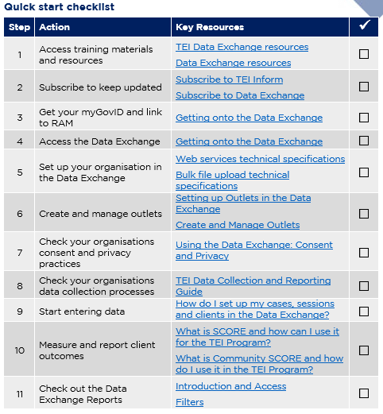
Data Exchange Quick Start Guide
Key resource: Data Exchange Quick Start Guide
This document outlines the 11 key steps you need to follow to access and start using the Data Exchange.
It includes links to key resources for each step.
Notes:
So many of you will be using the Data Exchange for the first time. Like anything new, it will at times seem quite overwhelming and difficult. And there quite a bit of work that needs to be done, to make sure we’re collecting the right information and that we’re reporting it correctly.
We have tried to simplify the process for you in a document called the data exchange quick start guide.
This is a five page document that outlines 11 key steps you need to follow to access and start using the Data Exchange.
It includes links to all the key resources you need to complete each step.
And, as you can see on the slide, it include a check list. So you can keep track of what step you’re up to, and hopefully feel some sense of accomplishment as you begin to navigate the Data Exchange.

Slide 8
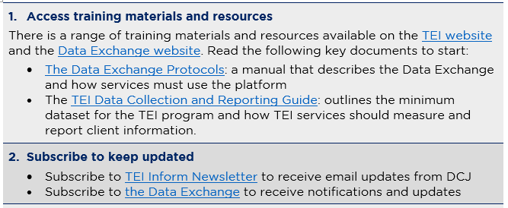
Quick Start Guide – Steps 1 and 2
Quickstart guide to the Data Exchange
Notes:
The first two steps in this guide are to access training materials and resources and to subscribe to relevant newsletters.
I’m going to take you through these steps now.

Slide 9
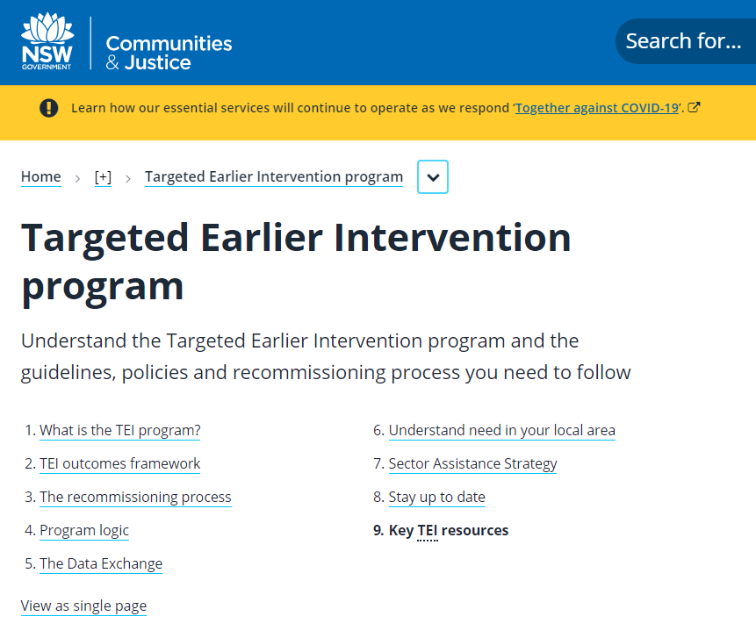
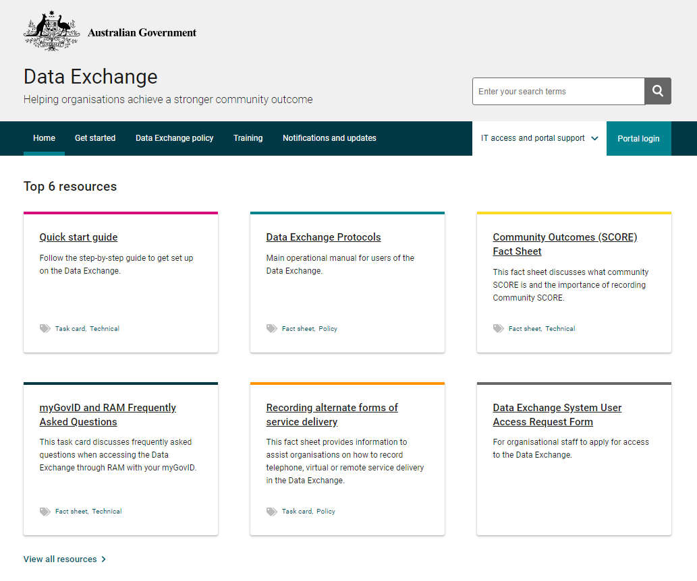
TEI Website
Data Exchange website
Notes:
So in regards to accessing resources – there are two key websites you will need to be familiar with.
There is the TEI website – which is the website hosted by DCJ and this has all of the resources about the Targeted Earlier Intervention program.
There is also the Data Exchange website – so that website is hosted by the Commonwealth Department of Social Services, they are the ones who managed the Data Exchange. And that website includes all the resources you need to actually use and navigate the DEX portal.
So what we’re going to do now, I’m going to take you to the TEI website and we’re going to spend some time exploring that.
LIVE VIEW OF WEBSITES:
As you can see here, there are 9 different pages you can go to, to find different information about the TEI program.
Page number 5, the Data Exchange is where you can find all of the resources we’ve developed to help you get onto and start using DEX.
In the How do I get started? section, there are lots of useful documents.
The first is the quick start guide I just showed you.
Then there are 3 resources about getting onto the Data Exchange. These documents outline the process you need to follow to get your myGovID, to link yourself in RAM and finally, to log into the Data Exchange platform. We’ll talk more about this process later.
There are also two frequently asked questions documents about myGovID and RAM and the Data Exchange. These includes answers to lots of common questions.
The next section includes 3 very important documents that all service providers should read.
The first, is the Data Exchange Protocols. This is basically a manual for using the Data Exchange. I strongly encourage everyone to read this document – it describes the different elements of the Data Exchange, includes definitions and explanations of key concepts. It is quite a long document, but it is a really good introduction and overview of everything you need to know about DEX.
The second, is the program specific guidance for state agencies in the Data Exchange. So lots of different organisations use DEX, for different government departments, for different programs, this document provides information about using DEX that is specific to the TEI program.
The third document has been developed by DCJ, and this is a resource that outlines how the TEI program is using the Data Exchange. It covers what data needs to be collected, how we’ll measure outcomes, and general rules and guidance for data collection and reporting. Again, I strongly encourage you to read this document. It provides an overview of all the information you need about using DEX for the TEI program. And it links you to other useful resources we’ve developed.
Then if we scroll down a little further into the ‘How will we help you?’ section, there are even more resources to help you with different stages of reporting.
There is a resource to help you with setting up outlets.
There is a document about setting up cases and sessions.
There are two resources that talk about the information you need to collect from clients and record in the Data Exchange.
There are 4 different resources about measuring and reporting outcomes, so using SCORE in the Data Exchange.
And we even have a resource that talks about your consent and privacy obligations for using DEX.
This may seem overwhelming, but please don’t stress. My advice would be to just download the quick start guide, and work your way through those steps, and it will tell you when you use each of these resources.
Now, I’m just going to scroll back up the top, and go to page 8 – stay up to date. This is where you can subscribe to the TEI newsletter. We send out updates pretty regularly, about whats happening the TEI program, changes are occurring, new support or resources that are available, anything we think is useful to the sector.
So please subscribe to the TEI newsletter so you can receive this updates.
You can see here also, that we have a catalogue of all the old newsletters that have been sent. So you also come here if you’ve missed anything in the page.
Now, I also want to show you the key TEI resources page. So if we just scroll back up to the top and click on number 9.
This page includes all of the key resources that have been developed for the entire TEI program. We have information about contracts, program logics, there are more documents about privacy, all of the Data Exchange resources are here also, and the documents about measuring outcomes.
We have local data packs, that include data about each LGA across all of NSW.
And we have resources specifically for sector development organisations.
So please, if you’re ever looking for information about anything to do with the TEI program, please come straight to our website. Bookmark so you can find it easily, whatever you have to do, just remember to always come here first, because if you’ve got an issue or a question you need answered, chances are you can find the answer here.
Now I want to show you the Data Exchange website.
When you finally get access to the Data Exchange, this is where you’ll go to log into the web-based portal.
But it is also where you can find more useful resources.
What I usually do when I’m looking for something, is I got down here, to where it says ‘view all resources’, and you’ll be taken to a page where you can browse all of the resources DSS have developed.
They have lots of different types of resources, you can see in the filters here, they’ve got fact sheets, learning modules, task cards and webinars.
The task cards are very useful – they include screenshots and step-by-step instructions on how to use different parts of the Data Exchange.
So if I click on this document, add a case, and then I just click on the image on the right, we can see screenshots of what the portal looks like, and the document walks you through exactly what you need to do to create a case.
And there are lots of resources like this, if I just click on that filter, there are all the different task cards they have. And there is one for everything you could think of. Adding a case, adding a client, adding a score assessment, adding a session.
They also have learning modules that take you through the same thing. If I just change this to learning module, you can see there are 18 different learning modules, and these all videos that show a live version of someone creating a case, or creating a session. And they explain where to click and what information to enter.
When you’re ready to start using the Data Exchange, I strongly recommend you come to this website to look at the taskcards and the learning modules to learn how to use the web-based platform.
If we scroll back up to the top, I’m just going to click on this Notifications and Updates button.
DSS also a have a newsletter specifically for the Data Exchange. This normally includes reminders that reporting period might be ending, it’ll tell you about updates or changes to the system, updates to the reports, anything that you might need to know about using the Data Exchange platform.
So again, I strongly recommend you sign up to this newsletter to make sure you’re getting all the information you need.
Now I’m just going to go back to our powerpoint slides.

Slide 10
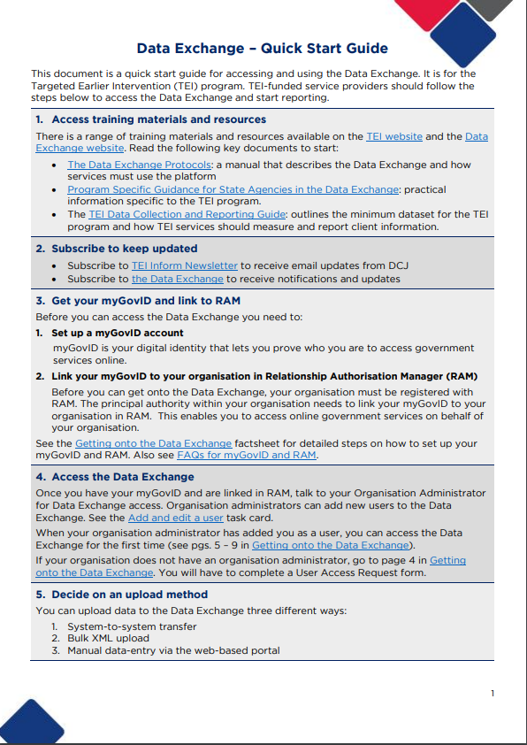
Key Resources
Notes:
So I just want to reiterate that these are the key documents that you really need to take a look at.
So the Data Exchange protocols, the TEI data collection and reporting guide, and the data exchange quick start guide.
So for those of you ho haven’t started reporting yet, or who are a little bit lost in using the data exchange, please take a look at these documents and they’ll hopefully provide you with the information you need to get started and help wrap your head around it.

Slide 11
Where can I go for help?
Contact | Type of Support
DSS Data Exchange Website | Training resources for the Data Exchange
DSS Helpline: dssdataexchange.helpdesk@dss.gov.au or 1800 020 283 (8.30am – 5.30pm Monday to Friday) | Technical issues with the Data Exchange web platform (NB: not myGovID or RAM)
TEI Website | Training resources tailored to the TEI program
TEI Inbox: tei@facs.nsw.gov.au | TEI specific questions which are unavailable in existing resources
myGovID and RAM support line: 1300 287 539 | Support for issues with myGovID and RAM
myGovID ‘Need help?’ webpage | Support resources for myGovID
RAM ‘Help’ webpage | Support resources for RAM
Notes:
This is an overview of all the different places you can go to for help.
There is the Data Exchange website I just went through. And if you ever have any technical problems using the platform you can always call the DSS helpline.
There is also the TEI website, like I also just went through. You can also contact DCJ staff through the TEI mailbox. This is checked daily by our Central office staff.
And for those of you who are yet to get onto to the Data Exchange, you can also visit the MyGovID and RAM websites for assistance, or you can call their support line.

Slide 12
Subscribe to relevant newsletters
TEI Inform
Data Exchange Newsletter
Notes:
I did already show you this on the websites, but I’ve included the hyperlinks here as well, just to make it easier for you.
So when you download the slides for the webinar, you can go straight to the TEI and Data Exchange websites and you can subscribe to our newsletters.
This is really important, because this is the best way for you to hear about things that are happening in the sector, to get updates, to be invited to more webinars or forums.
And as you start using the Data Exchange, the newsletter is really important because it will tell you about planned updates or outages that might impact your data entry.

Slide 13
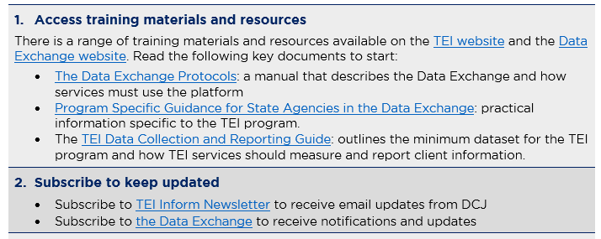
Quick Start Guide – Steps 1 and 2
Quickstart guide to the Data Exchange
Notes:
I’m just going to show this slide quickly again to wrap up.
So these are the first two steps in the Quick Start Guide to the Data Exchange.
I strongly encourage you to hop onto both of those websites, download these documents to help you get started.

Slide 14
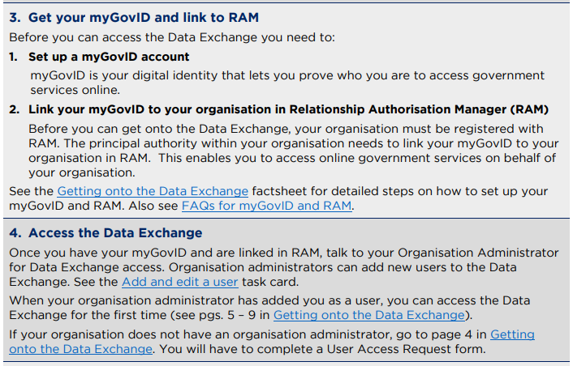
Next webinar
Notes:
In our next webinar, we’re going to talk the next two steps – which are to get your myGovID and RAM and access the Data Exchange.

