Slide 1
Targeted Earlier Intervention Program
Webinar 9: Measuring outcomes - SCORE for Individual Clients
Live webinar: https://www.youtube.com/watch?v=HDzLq7hXpJw
Notes:
Hi everyone, and welcome to Webinar 9 our Data Exchange webinar series for the Targeted Earlier Intervention program.
In today’s webinar, we are going to talk about measuring outcomes for individual clients.

Slide 2
Purpose
What is SCORE?
How do I use SCORE to measure and report client outcomes?
What are client outcomes?
In this webinar we discuss:
Notes:
As always, there are three key things today’s webinar will cover.
We’re going to talk about anything and everything about measuring and reporting individual client outcomes.
First we’ll talk about what client outcomes actually are, and why we need to measure them.
Then we’re going to talk about SCORE. What it is and why we need to use it.
And most importantly, we’re talk about how to use SCORE to measure and report client outcomes.
I’m going to go through an overarching process to do this, and I’ll also show you some concrete examples, so you can see what it looks like in practice.

Slide 3
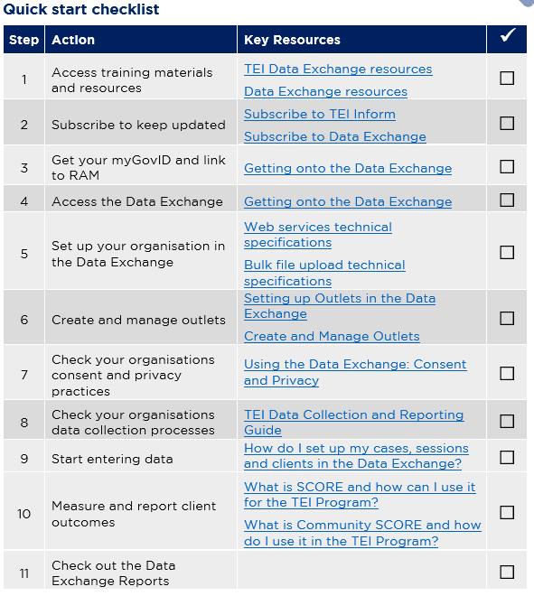
Data Exchange Quick Start Guide
Key resource: Quickstart guide to the Data Exchange
This document outlines the 11 key steps you need to follow to access and start using the Data Exchange.
It includes links to key resources for each step.

Slide 4
Quick start guide: step 10
Quickstart guide to the Data Exchange
Notes:
In our previous webinar’s I introduced everyone to this document: the Data Exchange Quick Start Guide. This is a five page document that outlines the 11 key steps you need to follow to access and start using the Data Exchange. It includes links to all the key resources you need to action each step. And as you can see on the slide it includes this checklist, so you can keep track of where you’re up to.
In each of our webinar’s I’ve been taking everyone through each step in this document.
So as you can see we’ve worked our way through getting onto Data Exchange, and we’ve started entering out data, and now we’re up to Step 10 – measure and report client outcomes.
So, like our last few webinars, we’ve split this step up into two different webinars, because measuring outcomes is quite a mammoth task.

Slide 5
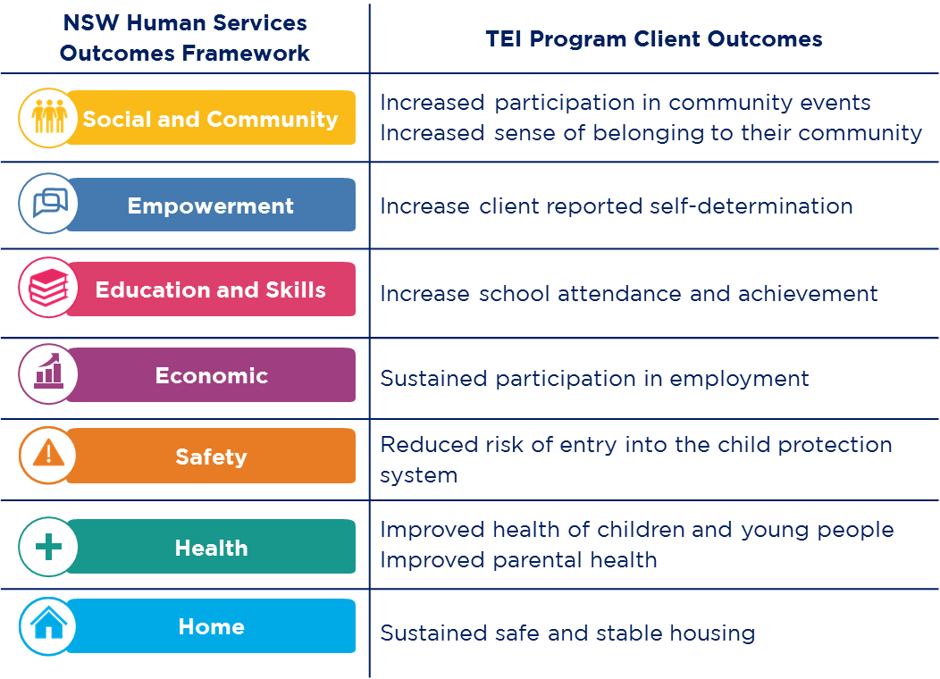
What are client outcomes?
Client outcomes are the changes your service or activities hope to achieve.
They can be for individuals, groups, families or communities.
They can be changes in knowledge, attitudes, values, skills and behaviours.
Notes:
So, what are client outcomes? Client outcomes are the changes your service or activities hope to achieve.
These may be changes in your client’s knowledge, attitudes, values, skills or behaviours. And they could be outcomes for individuals, groups, families, or communities.
There are 9 high-level client outcomes the TEI program is working towards: so for example, increase school attendance and achievement, sustained participation in employment, sustained safe and stable housing.
And we have mapped these outcomes to the NSW Human Services Outcomes Framework: so you can see there are 7 different domains there, which include things like safety, health, home etc.
These are the outcomes that the TEI Program as a whole aims to achieve for children, young people, families and communities in New South Wales.
In your TEI contract, you have identified one of these domains for each of the service types you deliver. So these are the high-level outcomes that every single person here today, is contributing to in some way or another.
In today’s webinar, I’m going to show you how to measure and report these outcomes for the work that you do on the ground with clients.

Slide 6
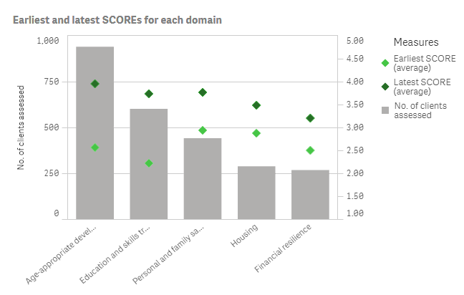
Why is it important to measure outcomes?
Measuring client outcomes can help us understand:
the effectiveness of our services
if our clients are ‘better off’ after receiving a service
We can use this information to:
continuously improve the quality of our services.
evaluate our programs and build the evidence for ‘what works’ for our clients
Notes:
Before, we do that I want to spend a bit of time discussing why it’s important to measure outcomes.
Measuring client outcomes can help us understand the effectiveness of our services and if our clients are better off after receiving a service. Client outcome data shows us if our clients have achieved their goals, or if their circumstances have improved.
We can use this information to improve the services we deliver to ensure our clients receive the right service, at the right time.
We can also use this information to build the local evidence base for what works. We can evaluate our programs and services and identify activities that achieve the best possible outcomes for our clients.
So there is an end-game to all of this data collection and reporting. Please don’t think about it, as some compliance exercise – it’s really about making sure we’re all making a positive difference in our clients lives and we’ve giving them the best service possible to improve their situation.

Slide 7
What is SCORE?
SCORE stands for ‘Standard Client/Community Outcomes Reporting’.
It is an outcomes reporting tool that enables us to report client outcomes and satisfaction.
There are four types of SCORE:
Circumstances SCORE
Goals SCORE
Satisfaction SCORE
Community SCORE
Used for individual clients
Used for groups or communities
Notes:
So, in order for us to reports outcomes we are going to use this thing called SCORE.
So, SCORE is an outcomes reporting tool used in the Data Exchange, it stands for Standard Client/Community Outcomes Reporting.
It allows us to report client and community outcomes and satisfaction.
So you can see on the slide, there are four different types of outcomes measured through SCORE.
Circumstances, goals, and satisfaction SCOREs – these are used to measure outcomes for individual clients. So the individual people who have their own client record in the Data Exchange.
Community SCORE is used for large groups or communities. So when it’s not possible to get information from all the people who attend your community event, for example, you can use Community SCORE to report outcomes.

Slide 8
Reporting outcomes for individual clients vs. unidentified groups
Individual clients | Unidentified group clients
Individual people who receives a service you deliver that is expected to lead to a measurable outcome. An individual person who has a client record in the Data Exchange. Some examples: Playgroups Counselling Parenting programs Home visits/Case management Mens/Womens/Youth/Parenting groups School program | A group of people who receive a service and no identifying information has been collected from them. Unidentified groups are recorded if it is not practical or possible to collect individual client information. Some examples: A community event A one-off information session Interagency meeting
What SCORE should you use? Circumstances SCORE Goals SCORE Satisfaction SCORE | What SCORE should you use? Community SCORE
Notes:
I just want to talk about this in a little bit more detail, because I know some people have been getting confused about which SCORE they can use in specific circumstances.
So in the Data Exchange, there are two different types of clients we can report.
There are individual clients – so this is any person who participates in an activity you deliver, you’ve collected personal information from them, and you’ve created a client record for them in the Data Exchange.
So we’ve got some examples on the slide there, so you will most likely have individual clients for things like playgroups, counselling, parenting programs, home visits or case management, group activities, like a youth group, or a parenting group, school programs. It’s really going to be any activity, where you expect to see your clients more than once.
And you can use SCORE to measure the outcomes of these clients.
So the type of SCORE you will use are Circumstances, Goals and Satisfaction. And I’m going to take you through how to do that a little bit later on.
The other type of clients we can record in DEX are unidentified group clients. So this is a large group of people who receive a service, and it’s not practical or necessary to collect individual client information from them. So instead, you just record the number of people who participated in the activity. So you can do this for things like a community event, a one-off information session, interagency, etc.
So when you just record the number of people who participate in an activity, it’s obviously not going to be possible to measure outcomes for those individual people. So what you can do instead, is you can use Community SCORE to measure an outcome for the group.

Slide 9
Reporting outcomes for individual clients vs. unidentified groups
Individual clients | Unidentified group clients
Individual people who receives a service you deliver that is expected to lead to a measurable outcome. An individual person who has a client record in the Data Exchange. Some examples: Playgroups Counselling Parenting programs Home visits/Case management Mens/Womens/Youth/Parenting groups School program | A group of people who receive a service and no identifying information has been collected from them. Unidentified groups are recorded if it is not practical or possible to collect individual client information. Some examples: A community event A one-off information session Interagency meeting
What SCORE should you use? Circumstances SCORE Goals SCORE Satisfaction SCORE | What SCORE should you use? Community SCORE
We are NOT discussing Community SCORE today.
Notes:
So I am not going to discuss Community SCORE in any more detail today. We’re going to spend an entire hour talking about that next week. Today we’re going to focus on reporting outcomes for individual clients. If you have questions about Community SCORE, please post them in the chat and we’ll try to address them next week.
But just know that the focus of today’s session is going to be on measuring outcomes for individual clients. So now I’ve going to take everyone through the three different types of SCORE that we can use to report outcomes for our individual clients.

Slide 10
Circumstances SCORE
Used to report changes in individual client’s circumstances
Uses a 5-point rating scale:
very poor – poor – moderate – good – very good
11 Domains:
Physical health
Mental health, wellbeing and self-care
Personal and family safety
Age-appropriate development
Community participation and networks
Family functioning
Do not report outcomes for every domain. Choose the domains that are most relevant to the service you deliver.
Financial resilience
Employment
Education and skills training
Material wellbeing and necessities
Housing
Notes:
So the first type of SCORE is called Circumstance SCORE.
The name of it, is quite on the nose, in the sense that it is used to report changes in client’s circumstances.
So there are 11 different domains that can be used to capture these changes. You can report changes in their physical health, their mental health, family functioning, their employment situation, or their housing status. Anything that these 11 domains cover.
You do NOT need to report outcomes for every single domain. You just need to pick the domains that are most relevant to the service you deliver.
So say for example, you deliver a playgroup – you might report an outcome for the child in the age appropriate development domain.
And you might report an outcome for the parent in the community participation domain.
But you wouldn’t report outcomes in domains like financial resilience, or material wellbeing, or housing, because you’re playgroup isn’t actually addressing those needs. So you just need to focus on the domains that are most relevant to your activity.
So in order to report a Circumstance SCORE there is a five-point rating scale that we use. So you can say if a client’s mental health, for example, is very poor – poor- moderate – good OR – very good.

Slide 11
Goals SCORE
Used to report an individual client’s progress in achieving specific goals
Uses a 5-point rating scale:
very poor – poor – moderate – good – very good
6 Domains:
Knowledge and access to information
Skills
Behaviours
Empowerment, choice and control to make own decisions
Engagement with support services
Impact of immediate crisis
Do not report outcomes for every domain. Only use the domains that are relevant to your clients needs and the service they receive.
Notes:
The next type of SCORE is Goals SCORE.
We can use Goals SCORE to report if our clients are achieving their goals.
So there are 6 different domains we can use. So we can report if a client has improved their knowledge, skills or behaviors. You can report if a client is more empowered, if they have engaged with relevant services, and you can even report about the impact of an immediate crisis.
So again, you do NOT need to report outcomes for every single domain. You just need to pick the domains that are most relevant to the service you deliver.
And Goals SCORE also has a five-point rating scale that we use. So you can say if someone's behavior, for example, is very poor – poor- moderate – good OR – very good.

Slide 12
Satisfaction SCORE
Used to report if an individual client is satisfied with the service they received.
Uses a 5-point rating scale:
Disagree – tend to disagree – neither – tend to agree – Agree
3 Domains:
The service listened to me and understood my issues
I am satisfied with the services I have received
I am better able to deal with the issues I sought help with
Notes:
The last type of SCORE we can use for individual clients, is Satisfaction. So this very obviously, enables us to report if a client is satisfied with the service they received. So there are three domains:
The services listened to me and understood my issues
I am satisfied with the services I have received
I am better able to deal with the issues I sought help with
You can ask clients all three of these questions, or just one or two. It’s up to you.
And this also uses a 5-point rating scale – that ranges from disagree to agree. So clients will just say where they sit on the 5-point scale in relation to those questions.

Slide 13
Using SCORE to report outcomes
Circumstances SCORE
Physical health
Financial resilience
Goals SCORE
Knowledge and access to information
Satisfaction SCORE
The service listened to me and understood my issues
I am satisfied with the services I have received
I am better able to deal with the issues I sought help with
Skills
Behaviours
Empowerment, choice and control to make own decisions
Engagement with support services
Impact of immediate crisis
Mental health, wellbeing and self-care
Personal and family safety
Age-appropriate development
Community participation and networks
Family functioning
Employment
Education and skills training
Material wellbeing and necessities
Housing
Only choose domains that are directly relevant to the service you delivered. Use any combination of these domains to report the impact of your service.
Use 1, 2 or 3 of these domains to report client satisfaction
Notes:
So, quick little recap.
There are three different types of SCORE. For circumstance and goals SCORE, you just need to pick the domains that are most relevant to the service you have provided. And you can use any combination of circumstance and goals SCORE together to report the impact of your service.
So say for example, you have someone come to your center, and they’re experiencing domestic violence. You might use the domain personal and family safety to report how safe they feel.
And then you might also use the domain, impact of immediate crisis to report how that crisis is impacting them, and if it lessens over time. And then for satisfaction, you can ask clients to answer 1, 2 or all three of these statements. It’s entirely up to you.

Slide 14
How to use SCORE
Step 1. Identify your client outcomes
Step 2. Identify your SCORE domains
Step 3. Select a tool to measure your client outcomes
Step 4. Decide how to make an assessment
Step 5. Decide when to make an assessment
Step 6. Record client outcomes in the Data Exchange
Notes:
So what we’re going to now, is we’re going to go through this process to actually use SCORE.
As you can see there are 6 key steps that we’ve identified
So the first step, is to identify your client outcomes. You can’t measure anything until you know exactly what it is that you’re trying to achieve. And then once you’ve figured that out, there are 5 more steps we need to follow, that take us all the way up to recording our outcome in the Data Exchange.
I’m going to go through each step in this process, and explain what it means and how to do it.
And then I’m going to go through some concrete examples, so show you what this process looks like in practice.

Slide 15
Step 1. Identify your client outcomes
HSOF Domain
TEI Program Client Outcome
What is the purpose of your activity?
What change do you expect to see in your clients?
Identify:
NSW Human Services Outcomes Framework domain(s)
TEI Program Client outcome(s)
Service level outcome
The outcomes you identify will depend on the specific activity you deliver.
Specific client outcome
Social and Community
Education and Skills
Safety
Increase sense of belonging to their community
Increase school attendance and achievement
Reduced risk of entry into the child protection system
Increased community connection
Increased confidence when attending job interviews
Children are safe with their families
Notes:
Ok, so the first thing you need to do is identify your client outcomes.
You need to think about the purpose of your activity – what change do you expect to see in your clients? What goals do you want them to achieve? What difference is your service going to make?
When you do this you should identify three specific things:
The first, is the NSW human services outcomes framework domain. So you can see on the slide, there are 7 domains to choose from, you need to identify the domains that are most relevant to your specific activity. You might just pick one domain, or there could be 2 or 3 of them. It is going to depend on the activity you deliver.
Once you’ve done that, you need to identify the TEI program client outcomes – this is going to be really easy, because once you’ve identified you’re domain, you can already see what the outcome is.
What we can also see is that these outcomes are quite broad, they’re pretty high-level, right?
So, the next thing you need to do, is you need to come up with a very specific outcome for your group of clients that your service can directly achieve. This is called your service level outcome.
So if you run a 12 week program, with a group of parents, what kind of things do you expect those parents to do be able to do at the end of your program?
If you run some workshops in a school with year 6 students, what kind changes do you expect to see in those kids at the end of the term?

Slide 16
Step 1. Identify your client outcomes
HSOF Domain
TEI Program Client Outcome
What is the purpose of your activity?
What change do you expect to see in your clients?
Identify:
NSW Human Services Outcomes Framework domain(s)
TEI Program Client outcome(s)
Service level outcome
The outcomes you identify will depend on the specific activity you deliver.
After school art program with kids
Interview skills workshops
Family-capacity building program
Service level outcome
Social and Community
Empowerment
Safety
Increase sense of belonging to their community
Increase school attendance and achievement
Reduced risk of entry into the child protection system
Increased connection to community
Increased confidence when attending job interviews
Children are safe with their families
Notes:
So here are three different examples, so show you what we mean. Say for example, you run an after school art program with Aboriginal school children. The purpose of it, might be to connect those kids with their culture and ensure they feel part of their community.
So the most relevant HSOF domain, is probably social and community. Then we’ve got our TEI outcome – which is increase sense of belonging to their community and then we’ve got an outcome that is specific to the activity which is to increase connection to community. So you can see how we’re really drilling down the key purpose of the activity. And hopefully, at the end of the art program, you’ll be able to see that those kids are more connected to their community.
Ah, another example might be for an in-home family capacity building program for families with children at risk of abuse and neglect. So the aim of this program could be to support parents and carers to keep their children safe, ultimately. So, the HSOF domain, is very likely going to be safety. Then you can see we’ve got our TEI outcome – which is reduce risk of entry into the child protection system, and then our specific outcome is that children are safe with their families. So again, we’re really drilling down the key purpose of the program.
Now, please bear in mind, that these are just examples. When you do this for your own work, you might find that there are 2 or 3 domains, that are relevant to the work you’re doing, and you might end up with 2 or 3 specific client outcomes. That’s more than ok. Just so long as the outcomes are directly related to your activity.
So, once you’ve identified you’re outcomes, you can move onto step 2.

Slide 17
Step 2. Identify your SCORE domains
Circumstances SCORE
Physical health
Financial resilience
Goals SCORE
Knowledge and access to information
Skills
Behaviours
Empowerment, choice and control to make own decisions
Engagement with support services
Impact of immediate crisis
Mental health, wellbeing and self-care
Personal and family safety
Age-appropriate development
Community participation and networks
Family functioning
Employment
Education and skills training
Material wellbeing and necessities
Housing
Only choose domains that are directly relevant to the service you delivered. Use any combination of these domains to report the impact of your service.
Notes:
So, in step 2, we need to identify which SCORE domains we will use to report those outcomes.
So we need to go back to our list of circumstance and goals SCORE domains, and figure out which ones are most relevant to our activities. For some activities this will be really obvious, for others it will not be.
So we’ve developed this table, to help people out.

Slide 18
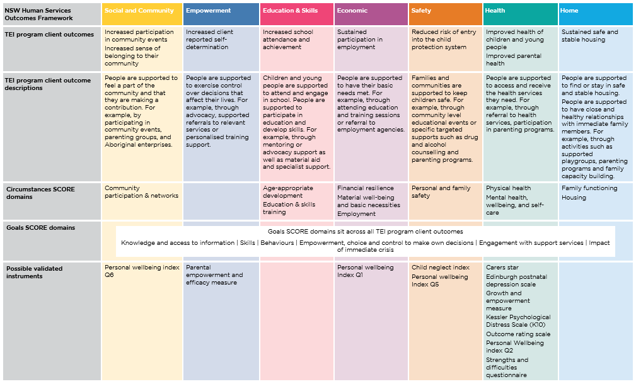
Step 2. Identify your SCORE domains
To report client outcomes in the Data Exchange, we need to map our outcomes to SCORE.
This table helps us do that.
See What is SCORE and how can I use it for the TEI Program?
Notes:
So, you can use the information in this table, figure out which SCORE domain is most relevant to you.
To start, let’s just take a look at the first three rows in the table.
So at the top, you can see the 7 HSOF domains across the top of the table. Then, we can see the TEI program client outcomes, and they all sit under the relevant domain.
The next row, Row 3 includes a short description for each outcome. It describes each TEI client outcome in more detail to help you understand if this outcome is relevant to your service.
For example, in the education and skills domain, the TEI client outcome is “increased school attendance and achievement”.
The description for this outcome states: “children and young people are supported to attend and engage school”. However, in TEI we don’t just support children and young people to achieve education-related goals.
So the description also says “people are supported to participate in education and develop skills.” This means this outcome is relevant to all people, children, young people and adults, who are trying to increase their education and skills in some way. So please take a look at those descriptions if you’re ever a bit stuck trying to figure out what domain to use.
Underneath that description there are the Circumstance domains. So we have mapped the Circumstance domains, to the TEI outcomes to help you figure out which domain you should use to report outcomes in the Data exchange.
So, you can see in the social and community column, there is the circumstance domain, community participation and networks. This means, if an outcome you’re trying to achieve, falls into the social and community domain, then you’ll most likely use the ‘community participation and networks’ domain to record it in SCORE.
In the education column, we can see there are two Circumstance domains that are relevant: Age-appropriate development and education and skills training.
If your outcome sits in the education and skills column, you might use one of these SCORE domains to report it.
The next row, looks at the Goal SCORE domains. Now these are a little trickier. As we can see if our table, the 6 Goal SCORE domains actually sit across all of the TEI program client outcomes.
So this means, once you’ve identified your outcomes, you should look at each Goals SCORE, and see if it’s relevant to your activity.
The last row shows some of the validated tools you can use to measure your client outcomes. But, we’ll go through this in more detail later.

Slide 19
Step 2. Identify your SCORE domains
HSOF Domain
TEI Program Client Outcome
After school art program with kids
Interview skills workshops
Family-capacity building program
Service level outcome
Social and Community
Empowerment
Safety
SCORE DOMAINS
Increase sense of belonging to their community
Increase client reported self-determination
Reduced risk of entry into the child protection system
Increased connection to community
Increased confidence when attending job interviews
Children are safe with their families
Circumstance SCORE: Community Participation and Networks
Goals SCORE: Empowerment
Circumstance SCORE: Personal and Family Safety
Notes:
So, to continue building on our previous example. I’ve added some more information to this image.
So we identified earlier, that our art program for kids, is focused on increasing connection to community. So the most relevant SCORE domain for this is the Circumstance domain: community participation and networks.
The example, in the middle is for interview skills workshops. So one of the outcomes for these workshops could be to increase client’s confidence when attending job interviews. And you can see the most relevant domain is the empowerment domain. So the most relevant SCORE domain for this, is going to be the Goals domain empowerment.
And then for our last example, were we’re trying to make sure kids are safe, the most relevant domain is probably personal and family safety. And that’s it, for the step 2.
So some of you might be thinking, ok this is all well and good, but how do I remember all this? How do I keep track of what outcomes we’re achieving and what domains we’re using, and how do I make sure that everyone in my organization is reporting the same way?

Slide 20
How do I keep track of all this?
The TEI Outcomes Matrix
TEI program client outcomes | Service level outcomes | How will this be measured? | When will this be measured? | Who is responsible for measuring this outcome?
List the HSOF domain and the TEI program client outcome. Add rows as needed. | List the specific client/community outcomes your activity is working towards. | Identify how these outcomes will be measured. List the questions you will ask and/or the tool you will use. List the SCORE domain the outcome will be recorded under in the Data Exchange. | Describe when the outcome will measured. For example, when will you ask clients to complete the survey? | Describe who is responsible for measuring the outcome. For example, will clients complete a survey or will a practitioner observe the client?
Social and Community - Increase sense of belonging to their community | Increased connection to community | Circumstances SCORE: Community participation and networks
See Outcomes Matrix
Notes:
Well, we have a solution for. And it is the TEI Outcomes Matrix.
You can use this document to list the client outcomes your service is working towards. So there is a column for the TEI outcome, and then your service level outcome. And then you can also include the SCORE domains you’ll use the report the outcomes.
I’ll show you what a completed version of this looks like, as we go through all the other steps. But I wanted to show you this now, you can see that there is a method to our madness – and that we’re working towards this end goal of having a plan to measure and report our clients outcomes.
So you’ve can see I’ve already filled in the first two columns – with the outcomes we’re working towards. And in the third column, I’ve put the SCORE domain we’ll use. There is some information we need to include here, but we’ll come back to this later.

Slide 21
How to use SCORE
Step 1. Identify your client outcomes
Step 2. Identify your SCORE domains
Step 3. Select a tool to measure your client outcomes
Step 4. Decide how to make an assessment
Step 5. Decide when to make an assessment
Step 6. Record client outcomes in the Data Exchange
Notes:
Ok, so step 1 and 2 are done. Now our next step, is to figure out how we’re actually going to measure the client outcome. What tool are we going to use? What questions will ask? All those sorts of things.

Slide 22
Step 3. Select a tool to measure your client outcomes
Use SCORE directly
Use the matrix in the Data Exchange protocols
Use a validated tool in the SCORE translation matrix
Use a validated tool and translate the client’s result into SCORE (see SCORE Translation Matrix).
Use your own tool or another instrument
Use the TEI guide to developing surveys to develop your own tool
Use a tool your organisation has already developed
Use the How to use SCORE with clients survey
Notes:
So there are a number of different options that we have to choose from, when it comes to picking how you will measure your outcomes.
You can use SCORE directly, you can use a validated tool, or you can use your own tool.
So I’m going to take you through, each of these options now, in as much detail as possible.

Slide 23
Step 3. Select a tool to measure your client outcomes
Use SCORE directly
Use the matrix in the Data Exchange protocols
Use a validated tool in the SCORE translation matrix
Use a validated tool and translate the client’s result into SCORE (see SCORE Translation Matrix).
Use your own tool or another instrument
Use the TEI guide to developing surveys to develop your own tool
Use a tool your organisation has already developed
Use the How to use SCORE with clients survey
Notes:
First, I’m going to take you through using SCORE directly – which arguably in the easiest option.

Slide 24
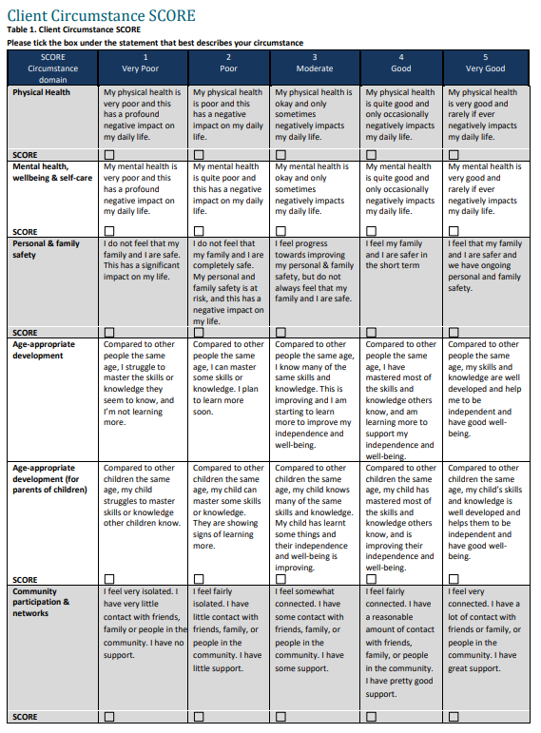
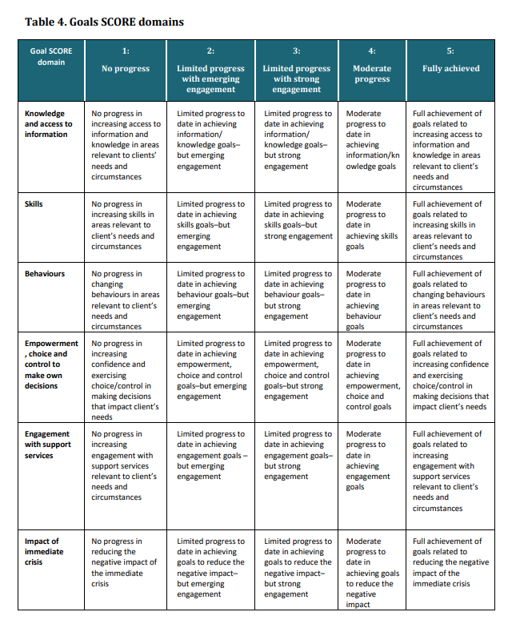
Use SCORE directly
Example of matrix in Data Exchange protocols
How to use SCORE with clients
Survey instrument
Practitioner assessment
Notes:
So, there are two different ways you can use SCORE directly.
The first is to use SCORE as a survey that clients can complete.
So there is a document that DSS have developed called ‘How to use SCORE with clients’. You can see the hyperlink to the document and a screen shot of what some of it looks on the screen.
This resources includes statements for every SCORE domain. What you can see on the screen are just some of the circumstance domains, but when you download this resource it includes tables like this for all of the circumstance domains, all of the goal domains and the satisfaction domains as well.
The second option is to use SCORE to conduct a practitioner assessment.
So you can use your own professional judgement, to observe the client, to talk to them, to see how they’re going. And you will make a judgement call about where they fit on the five point scale.

Slide 25
Use SCORE directly: a survey
Example of matrix in Data Exchange protocols
How to use SCORE with clients
After school art program with kids
Only ask clients the statements that are relevant to the activity they participated in. You can ask more than 1, but it must be directly related to the service.
You can change/simply these.
Increased connection to community
Circumstance SCORE: Community Participation and Networks
Interview skills workshops
Increased confidence when attending job interviews
Goals SCORE: Empowerment
Notes:
So if we think back to the examples I gave before, you could use the SCORE survey to help you measure these outcomes.
So for our school program, the outcome was increased community connection, the SCORE domain was ‘community participation and networks’.
And then this is a screenshot of the SCORE survey for the community participation and networks domain.
So you would just ask your clients to read through the five categories and pick the option that best describes them and their situation.
The second example, we’ve got is for the interview skills workshop. So our outcome was increased confidence when attending job interviews, and we decided we would use the Goals SCORE: Empowerment. And then, there is the screenshot for the SCORE survey for the empowerment domain.
So again, you would just ask your clients to read through this and select the option that best suits them – you can see there are little check boxes for the client to complete.
So, I know these descriptions are quite long, some of them are a bit dense and might be difficult for clients to easily understand them.
So, if you wanted to, you could simplify these to better suit your clients. And to make it easier for them to complete.
So, again, the examples I’ve taken you through are just really basic ones. If you needed to, you might end up asking clients about 2 or 3 different domains. You’re more than welcome to do that, but just remember you only need to include the domains that are relevant to the activity.

Slide 26
Use SCORE directly: practitioner assessment
SCORE Matrix in Data Exchange protocols
After school art program with kids
Engage with and talk to the client about the activity and how they’re going. Use your professional judgement to decide where they fit on the 5-point scale.
Focus on the domains that are most relevant to your activity.
Increased connection to community
Circumstance SCORE: Community Participation and Networks
Interview skills workshops
Increased confidence when attending job interviews
Goals SCORE: Empowerment
Notes:
So, the other option, like I mentioned before, is to conduct a practitioner assessment.
So this is very similar to what I just went through, but instead of asking the client to complete the survey, you as a practitioner use your professional judgement to determine where they sit on the scale.
So you can do this a number of different ways, depending on the activity, you can observe the client, see how they interact with people, how they engage with the activity, you can have a conversation with them, and talk about how they’re going, what’s improved, what hasn’t, and then you can use this scale to figure out where they sit from 1-5.

Slide 27
Step 3. Select a tool to measure your client outcomes
Use SCORE directly
Use the matrix in the Data Exchange protocols
Use a validated tool in the SCORE translation matrix
Use a validated tool and translate the client’s result into SCORE (see SCORE Translation Matrix).
Use your own tool or another instrument
Use the TEI guide to developing surveys to develop your own tool
Use a tool your organisation has already developed
Use the How to use SCORE with clients survey
Notes:
So, our next option is to use a validated tool.

Slide 28
Use a validated tool
DSS have translated 11 existing validated tool into SCORE.
Child Neglect Index (CNI)
Carers Star (CS)
Growth Empowerment Measure (GEM)
Edinburgh Postnatal Depression Scale (EPDS)
Kessler Psychological Distress Scale (K10)
Outcome Rating Scale (ORS)
Parenting, Empowerment and Efficacy Measure (PEEM)
Personal Wellbeing Index (PWI)
Sessions Rating Scale (SRS)
Strengths and Difficulties Questionnaire (SDQ)
If any instrument is relevant to your outcome(s) and suitable for your clients we encourage you to use it.
You can use the SCORE Translation Matrix to translate the client’s result into SCORE.
Notes:
So, for those who don’t know, a validated tool is a survey, or an instrument of some sort, that is recognised by the academic research community as a valid way to ‘measure what it is supposed to measure’. So it’s a tool that has gone through a very rigorous process to determine its validity, sensitivity, and reliability.
So, DSS have taken 11 existing validated tools, and they have translated them into SCORE.
So, you can see the list of tools on the slide – and the little icon indicates the type of outcomes that they measures.
So for example, the Child Neglect Index can be used to measure outcomes in the Safety domain. The Personal Wellbeing Index can be used to measure outcomes in the Safety domain, the Social and Community domain, the Economic domain AND the health domain.
So, if you wanted to, instead of using SCORE directly, you could use one of these instruments to measure outcomes for your clients.

Slide 29
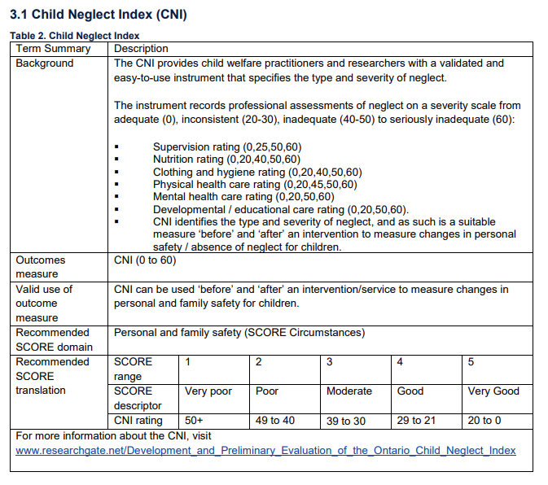
Use a validated tool
Example of how to translate a tool into SCORE: Child Neglect Index (CNI)
Use the CNI to conduct a professional assessment of neglect
Translate the result into SCORE
See SCORE Translation Matrix
Notes:
So I’m going to go through one quick example to show you how this works.
So this is a screen shot from this document, SCORE translation matrix.
And for this example, I’m going to take you through the child neglect index.
So what you would need to do, is download the Child Neglect Index, so you’ve got a copy of that tool.
And then you would use it to assess the client. So the child neglect index, uses a rating scale from 0 and 60. Where 0 is adequate, the child’s basic needs are being fulfilled and 60 means seriously inadequate. – So the child’s needs are not being met in any way.
So, you use the child neglect index, you figure out where they sit on that scale from 0 – 60.
Then, you take the result of that assessment, and you translate it into SCORE.
So the bottom part of this table tells you what domain to use. So you can see the recommended SCORE domain is personal and family safety. So that’s the domain we’ll use to record the SCORE.
And then it shows you how to translate the result of the Child Neglect Index into SCORE. So if the result is 0, you would record that as a 5 in SCORE.
If the result was anything over 50, you would record it as a 1.

Slide 30
Use a validated tool
DSS have translated 11 existing validated tool into SCORE.
Child Neglect Index (CNI)
Carers Star (CS)
Growth Empowerment Measure (GEM)
Edinburgh Postnatal Depression Scale (EPDS)
Kessler Psychological Distress Scale (K10)
Outcome Rating Scale (ORS)
Parenting, Empowerment and Efficacy Measure (PEEM)
Personal Wellbeing Index (PWI)
Sessions Rating Scale (SRS)
Strengths and Difficulties Questionnaire (SDQ)
If any instrument is relevant to your outcome(s) and suitable for your clients we encourage you to use it.
You can use the SCORE Translation Matrix to translate the client’s result into SCORE.
Notes:
So this document, the SCORE translation matrix, has tables like this for all of the validated tools in this list.
So you can use any of those tools to measure outcomes, and then you can look up the little translation table to figure out how to report it in SCORE.
If you decide to use one of these tools, you need make sure you follow the advice on how to use and implement it.
You have to implement it, exactly as it’s been designed, otherwise it’s not validated anymore.
If you want to use a validated tool that’s not in this list…

Slide 31
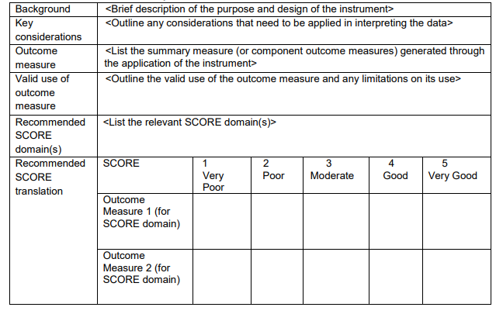
Use another validated instrument
You can use a validated instrument not listed above.
There is a blank template in the SCORE Translation Matrix
Complete this template to translate your instrument to SCORE.
This will help ensure reporting is consistent within your organisation.
Notes:
You can also do that. So, use another validated instrument.
So, in the SCORE translation matrix, there is a blank template you can use to translate other instruments.
So your organization might use a validated tool that is not on the list I showed you, or you might have your own tool that you’ve been using for ages and it works for you.
You can continue to use them, and if you want to, you could complete this little template, to translate your own tool into SCORE.
This will help ensure that everyone in your organization is reporting outcomes consistently.

Slide 32
Step 3. Select a tool to measure your client outcomes
Use SCORE directly
Use the matrix in the Data Exchange protocols
Use a validated tool in the SCORE translation matrix
Use a validated tool and translate the client’s result into SCORE (see SCORE Translation Matrix).
Use your own tool or another instrument
Use the TEI guide to developing surveys to develop your own tool
Use a tool your organisation has already developed
Use the How to use SCORE with clients survey
Notes:
Ok so our last option, is to use your own tool.
So for those of you who have never measured outcomes before you can design your own survey from scratch – I’ve seen lots of organisations do this.
You’re more than welcome to come up with your own survey questions to measure client’s outcomes.
Or there might be a tool that you’ve been using for years, and you just want to continue to use that. So you can do that too.

Slide 33
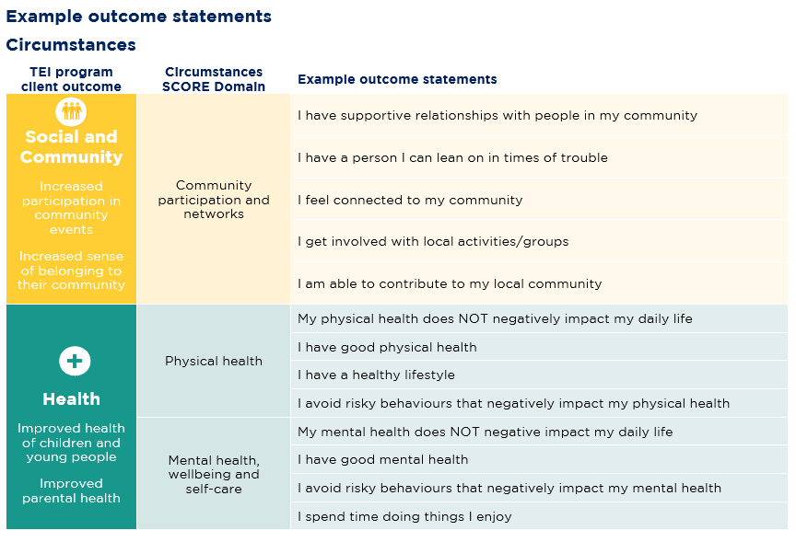
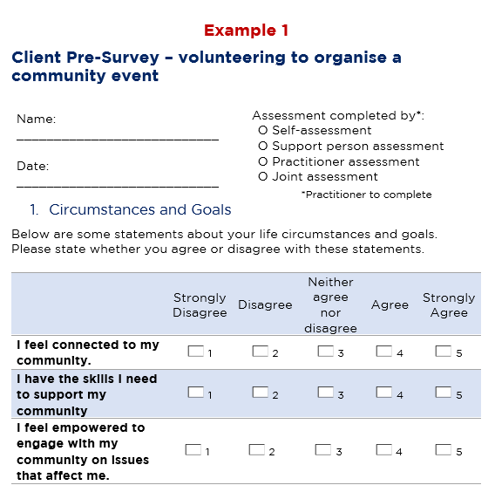
Use your own tool
You can develop your own tool to measure client outcomes.
If you use your own tool, you must ensure it is a suitable and accurate measure that can be interpreted consistently.
See our TEI guide to developing surveys
This document includes:
A template to develop pre- and post-test surveys
Examples of survey questions (outcome statements)
A check list to ensure your questions are suitable and will measure the outcomes you want
Examples of pre- and post-surveys
1. Volunteers organising a community event
2. Employment skills workshops
Notes:
For those of you who want to develop your own surveys, and how may have never done this before, we have a developed a guide to help you.
So this is called the TEI guide to developing surveys.
This document includes:
a template you can use to develop your own surveys
Examples of survey questions you can use to measure client outcomes
A check list to ensure your questions are suitable and will measure the outcomes you want
Examples of surveys to show you what a final one looks like.
So I’ll take you through some of the cool stuff in here, in a second. Before I do, I just want to make the point that using this tool isn’t compulsory. DCJ developed this resource to support providers to develop their own instrument if they cannot use a validated tool because there are none that are relevant to or if you don’t want to use SCORE directly because it’s too convoluted and your clients don’t like.

Slide 34
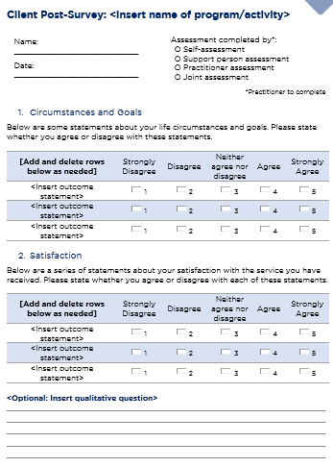
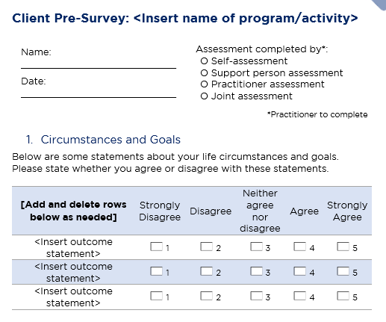
TEI Guide to Developing Surveys: Templates
TEI guide to developing surveys
Notes:
So, this is what the templates look like.
There are no questions in them, they’re just blank, and so you can add in your own.
And you can see that we’ve got two templates – one for the pre-survey and one for the post-survey.
So I’ll discuss this in more detail in a minute, but to measure outcomes we need to ask clients the same question twice – once at the beginning of service delivery and again at the end. To see if there is a change in their response. We’ve got templates for both of those surveys and the post-survey includes satisfaction so you can make sure you ask about that at the end of service delivery.
So in order to populate these templates, we’ve come up with some examples of questions, or outcomes statements, whatever you want to call them.

Slide 35
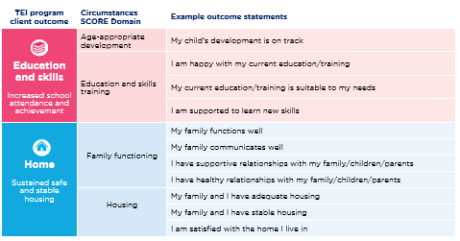
TEI Guide to developing surveys: outcome statements
TEI guide to developing surveys
Notes:
So these are just some screenshots from the guide.
We’ve got statements for the 7 domains of the outcomes framework, and you can see we also grouped them by the SCORE domains.
So, if we look at the health domain of the outcomes framework, there are to SCORE domains, one physical health and one’s mental health. And then you can see we’ve got statement for each of them. And they’re really simple – I have good physical health, I have a healthy lifestyle.
And, you might not be able to see it very well but we’ve done the same thing for the Goals SCORE domains.
So we’ve got a few statements for each domain.
So, if you do want to use these, you can just cut and paste them into the templates, and war-la you’ll have your own little survey all ready to go.
Now, you do not HAVE to use these. You can come up with your own statements, you can use these as inspiration, you can do whatever is that you want to do with them, so long as they’re clear and simple and they will be very easy for clients to understand.

Slide 36
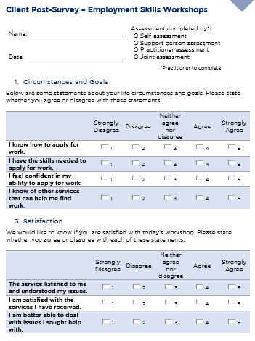
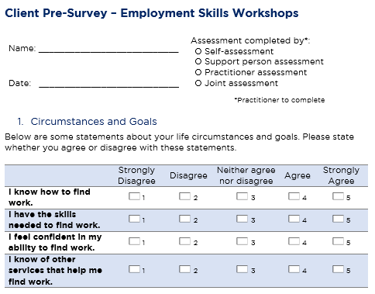
TEI Guide to develop surveys - example
Goals SCORE: Knowledge | I know how to find work
Goals SCORE: Skills | I have the skills needed to find work
Goals SCORE: Empowerment, choice & control to make own decisions | I am confident in my ability to find work
Goals SCORE: Engagement with relevant services | I know of other services I can engage to help me find work
Notes:
So I just want to show you what this will look like in practice.
So this is an example of a survey that could be used for employment skills workshops.
So in our pre-survey we’ve got 4 simple questions: I know how to find work. I have the skills I need to find work. I feel confident in my ability to find work. I know of other services that can help me find work.
Now, our post survey is exactly the same. We need to ask exactly the same questions, to see if there is a change in the client’s response – cos that’s what's going to tell us if they’re achieving their outcomes.
The only things we’ve added to the post survey, are the client satisfaction questions.
And then this red table down the bottom, just shows how these would align with SCORE.
So the statement, I know how to find work, would go in the Goals SCORE domain, knowledge.
And you can see the rest below.
So, that’s one way that we’re trying to help you to develop your own surveys.

Slide 37
Use SCORE directly: a survey
Example of matrix in Data Exchange protocols
After school art program with kids
I feel connected to my community | Strongly Disagree | Disagree | Neither | Agree | Strongly agree
Increased connection to community
Circumstance SCORE: Community Participation and Networks
Notes:
So, I just want to go back to our example, that was for the after school art program for kids.
The purpose of the activity is to increase community connection – so if you wanted to, you could do something as simple as this, and just have one statement, that simply says ‘I feel connected to my community’. And that’s it, you ask the students to answer the question at the beginning of the term and again at the end, and you’ve done.
Measuring outcomes does not need to be overly complicated, or over engineered.
I think the best advice I can give you, is to do the bear minimum.

Slide 38
How do I keep track of all this?
The TEI Outcomes Matrix
TEI program client outcomes | Service level outcomes | How will this be measured? | When will this be measured? | Who is responsible for measuring this outcome?
List the HSOF domain and the TEI program client outcome. Add rows as needed. | List the specific client/community outcomes your activity is working towards. | Identify how these outcomes will be measured. List the questions you will ask and/or the tool you will use. List the SCORE domain the outcome will be recorded under in the Data Exchange. | Describe when the outcome will measured. For example, when will you ask clients to complete the survey? | Describe who is responsible for measuring the outcome. For example, will clients complete a survey or will a practitioner observe the client?
Social and Community - Increase sense of belonging to their community | Increased connection to community | Attendees answer question on a 5-point scale: I feel connected to my community Result is entered directly into Circumstances SCORE: Community participation and networks
See Outcomes Matrix
Notes:
So, now we can update our outcomes matrix.
So we’d already filled out the first two columns – we know what TEI outcome we’re contributing to, we know the service level outcome is to increase community connection.
And now we know that we‘re just going to ask the students the respond to one simple statement – and we know what domain we’ll record that under.

Slide 39
How to use SCORE
Step 1. Identify your client outcomes
Step 2. Identify your SCORE domains
Step 3. Select a tool to measure your client outcomes
Step 4. Decide how to make an assessment
Step 5. Decide when to make an assessment
Step 6. Record client outcomes in the Data Exchange
Notes:
Ok, so that is step three done and dusted. Thankfully, all that’s left is the super easy stuff.
So our next step is to decide how to make an assessment – that probably sounds a bit weird but I’ll explain to you what that means.

Slide 40
Step 4. Decide how to make the assessment
Step 4. Decide how to make the assessment
Client self-assessment: a client completes survey or tool on their own
Support person: a support person completes the survey or tool on behalf of or with the client
Practitioner/worker assessment: use your professional judgement to conduct the assessment
Joint assessment: client and practitioner work together to conduct the assessment
If you use a validated instrument, you should follow the instructions on how to use that tool.
For example, the Child Neglect Index should be completed by a practitioner. The K10 and PWI are self-assessment tools that should be completed by the client.
See the SCORE Translation Matrix for information on how to administer each validated instrument.
For other tools and instruments, you should use your professional judgement to determine what is appropriate and will work best for your client.
Notes:
So once you’ve decided what tool you’re going to use to measure outcomes, then you need to figure out what the best way is to administer that tool.
So, the first one is a client self-assessment – so this means the client completes the survey on their own. You just give them a piece of paper or an iPad, they fill it out and they give it back to.
Another option, is a support person could complete the survey on their behalf. So if you work with a client with severe disability, a carer could complete the tool for them.
You as a practitioner could conduct the assessment yourself.
Or, you could conduct a joint assessment – so you could work with the client to help them complete the survey. Or you could work with the support person to complete the survey.
The approach you take is going to depend 100% on your client and what support they need.
I’m sure there are lots of people you work with, who are more than capable of filling out a short survey on their own, but I’m sure there will also be people who need some support from you or from their carer to do this. So please take whatever approach best suits your client on the day you’re working with them.
The only exception to this, is if you use a validated instrument.
If you use a validated instrument, you should follow the instructions on how to use that tool. For example, the Child Neglect Index should be completed by a practitioner. The K10 and PWI are self-assessment tools that should be completed by the client.
So if you are using a validated instrument, you need to make sure you’re following the instructions on how to implement it.

Slide 41
How do I keep track of all this?
The TEI Outcomes Matrix
TEI program client outcomes | Service level outcomes | How will this be measured? | When will this be measured? | Who is responsible for measuring this outcome?
List the HSOF domain and the TEI program client outcome. Add rows as needed. | List the specific client/community outcomes your activity is working towards. | Identify how these outcomes will be measured. List the questions you will ask and/or the tool you will use. List the SCORE domain the outcome will be recorded under in the Data Exchange. | Describe when the outcome will measured. For example, when will you ask clients to complete the survey? | Describe who is responsible for measuring the outcome. For example, will clients complete a survey or will a practitioner observe the client?
Social and Community - Increase sense of belonging to their community | Increased connection to community | Attendees answer question on a 5-point scale: I feel connected to my community Result is entered directly into Circumstances SCORE: Community participation and networks |  | Group leader will ask students to complete the survey (self-assessment). Group leader will provider additional help to students who need it (joint-assessment).
Notes:
So that brings us back to our outcomes matrix.
So we’re ready to fill in another column, and this is a little bit out of order, but you can see the last column that’s title who is responsible for measuring this outcome?
So basically we want you to describe how your tool will be implemented.
So I’ve just written hear, in our example for the school program, – the group leader will ask students to complete the survey themselves. So that’s going to be a self-assessment.
And then I’ve also written Additional support can be given to students who need it. So there might be some joint-assessments that are conducted – depending on the needs of the students.

Slide 42
How to use SCORE
Step 1. Identify your client outcomes
Step 2. Identify your SCORE domains
Step 3. Select a tool to measure your client outcomes
Step 4. Decide how to make an assessment
Step 5. Decide when to make an assessment
Step 6. Record client outcomes in the Data Exchange
Notes:
Ok, so moving onto step 5. Now we need to decide WHEN to make the assessment.
So this is another easy one – that hopefully won’t take too much time.

Slide 43
Step 5. Decide when to make the assessment
Step 5. Decide when to make the assessment
To measure client outcomes you should conduct at least two assessments:
1. At the beginning of service delivery
2.Towards the end of service delivery
Satisfaction only needs to be collected once – at the end of service delivery.
Important Considerations:
You may need to build a relationship with your client before they feel comfortable answering personal questions.
If your service is long-term/ongoing you could consider conducting regular assessments to monitor your client’s progress.
Clients can unexpectedly leave services. Take this into consideration when conducting your assessments.
Services won’t be penalised if they’re unable to collect follow up SCOREs because a client left.
Notes:
So, to measure client outcomes, you should conduct at least two assessments:
1. at the beginning of service delivery
2. at the end of service delivery
This is because you need at least two assessments to see the difference your service has made in a client’s situation
You should conduct your first SCORE assessment at the very beginning of service delivery, ideally the first time you meet with a client. However, we know that this may not always be possible. You may have to build a connection with your client for them to feel comfortable. In these circumstances, you should conduct the first assessment at the most appropriate time after service delivery has started.
The second SCORE assessment will ideally be conducted at the end of service delivery – so on your last session with the client. However, we also know that this may not always be possible because clients can unexpectedly leave services. You should take this into consideration when deciding when to conduct your assessments.
So for example, if you’re running a 12 week program and there are few people who you think might drop out, (1) do whatever you can to keep them in the program, but (2) you could also do a follow up assessment with them a bit earlier, instead of waiting till the end.
So I know that for a lot of you, you don’t necessarily deliver, clear cut 12 week programs and that for a lot of the services you provide, there is no clear beginning or end, because you just see clients ongoingly, the support you provide is quite ad hoc, and it really just depends on the client and if they need your help at a particular point in time.
What I would recommend you do in those situations, is pick a time frame that you think is appropriate to check in with the client and to do an assessment.
Maybe you do it on a monthly basis, maybe you do it once every three months, maybe you just do it every second time you see the client, or every time you see them, if you only see them a few times a year.
So what you could do, is when you meet with the client, check their client record in DEX, look at what support they received previously, and what SCOREs were recorded.
And have a conversation with them to see if their situation has improved or if it’s gotten worse. Maybe last time they spoke to you, they needed help finding accommodation, so you helped them do that, they’ve been in this great place for 3 months, so you can record that as an outcome, their housing situation has improved and you helped them get there. But now, they’re going through a really hard time because they’ve lost their job. So you could also record that, that they’ve got a poor employment outcome. So you might spend some time with them doing up their resume, helping them do some job searches. And then you might not see them again for 3 months. But the next time you see them, you can check in to see how the job search is going. Do you see what I mean? So you’ll have to kind of take, this long-term approach, where you’re constantly following up with clients about the last thing they came to you for, to see if anything has changed.
And this kind of goes for any long-term service. So say for example, you deliver counselling. There could be some clients who you’ve been seeing for years. Maybe they come to you once a month, maybe its weekly. And again, there might not be any clear end in sight because the client might continuously need those counselling sessions. So again, you should just pick a regular time frame to assess the client – you could do it monthly, every 3 months, twice a year. Whatever you think is appropriate.
And you can use this information to track their progress, to see if they’re improving. Do you need to try something different, do they need some additional support?
Just be careful not to burden your client with too many surveys – nobody likes completely surveys. So just try to make sure the time frames you pick are appropriate.
Satisfaction information only needs to be recorded once: at the end of service delivery. However, as clients can unexpectedly leave a service, it might be a good idea to collect satisfaction information more frequently. You should do what is most practical for your service and client group.

Slide 44
How do I keep track of all this?
The TEI Outcomes Matrix
TEI program client outcomes | Service level outcomes | How will this be measured? | When will this be measured? | Who is responsible for measuring this outcome?
List the HSOF domain and the TEI program client outcome. Add rows as needed. | List the specific client/community outcomes your activity is working towards. | Identify how these outcomes will be measured. List the questions you will ask and/or the tool you will use. List the SCORE domain the outcome will be recorded under in the Data Exchange. | Describe when the outcome will measured. For example, when will you ask clients to complete the survey? | Describe who is responsible for measuring the outcome. For example, will clients complete a survey or will a practitioner observe the client?
Social and Community - Increase sense of belonging to their community | Increased connection to community | Attendees answer question on a 5-point scale: I feel connected to my community Result is entered directly into Circumstances SCORE: Community participation and networks | First week of program Last week of program | Group leader will ask students to complete the survey (self-assessment). Group leader will provider additional help to students who need it (joint-assessment).
Notes:
So, in the example we’ve been working through for the after school program, this is an easy one because most school programs only run for a term. So they have a clear beginning and end date.
So I’ve just filled in our last column – when will this be measured to say the first week of the program and the last week of the program. Easy as pie.
So now we have a really clear plan that tells us what outcomes we’re measuring and how we’re going to measure them.
So you could hopefully give this document to any staff member in your organization and they could know exactly what they need to do when they deliver a specific activity.

Slide 45
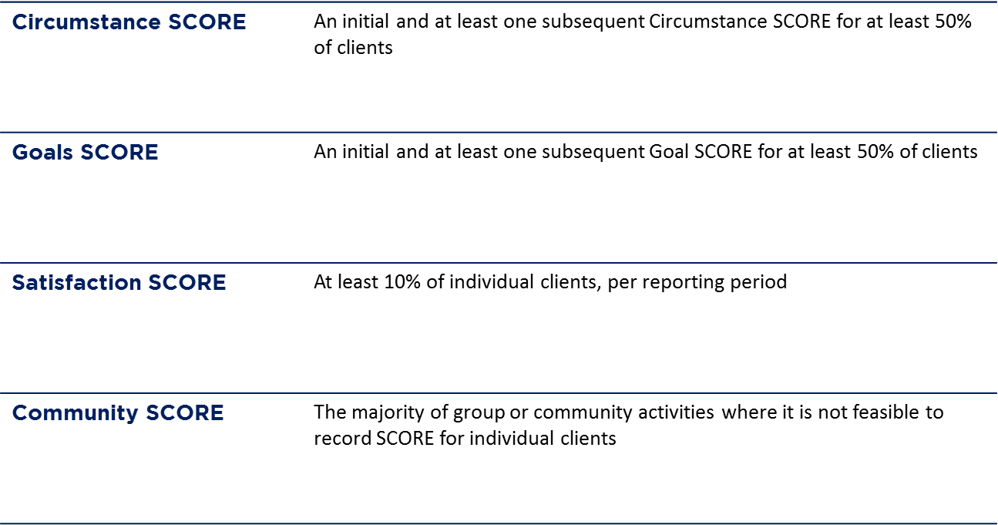
How many clients do I need to report SCORE for?
Notes:
A question we get asked a lot is how many clients to you need to report a SCORE for. The table on the slide shows the proportion of clients we expect to you to collect the different types of SCORE for. So for Circumstance SCORE – you should try to record SCOREs for 50% of your individual clients, Goals SCORE is also 50%, and Satisfaction score is 10%.
So these percentages are quite low – because we’ve tried to account for all potential issues you could have collecting follow up SCOREs.
So my advice would actually be to try to collect SCOREs from almost all of your individual clients, because when you start to factor in clients who drop out of programs, who never come back to your sessions, who miss the last few sessions, clients who didn’t fill out a survey correctly – all the potential issues you could have with data collection – you’ll hopefully still be able to obtain SCOREs from at least 50% of your individual client’s.

Slide 46
How to use SCORE
Step 1. Identify your client outcomes
Step 2. Identify your SCORE domains
Step 3. Select a tool to measure your client outcomes
Step 4. Decide how to make an assessment
Step 5. Decide when to make an assessment
Step 6. Record client outcomes in the Data Exchange
Notes:
So our lucky last step – is to record the client outcomes in the Data Exchange.

Slide 47
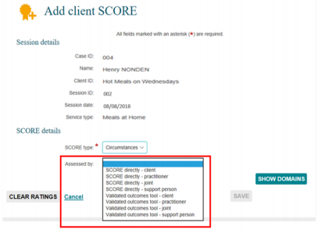
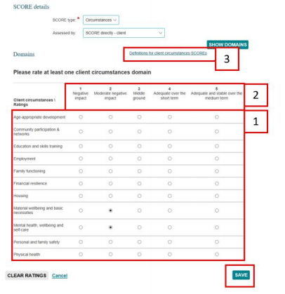
Step 6. Record client outcomes in the Data Exchange
There are a few different ways to record a SCORE. See:
Add a SCORE assessment – Module
Add a SCORE assessment – Task Card
Notes:
So, there are two resources you can use to help you do this.
You can see the hyperlinks on the screen, there is a learning module and task card that both take you through the process.
These are screen shots of the pages where you need to enter the SCORE.
So you can see the client’s details up here.
Then you’ve got the SCORE type – so this is where you say if the SCORE is Circumstances, Goals or Satisfaction.
Then you need to say how the SCORE was assessed.
So if you used SCORE directly or a validated tool, and who did the assessment.
If you’ve used your own tool – you should select SCORE directly. I don’t know why, that’s just what DSS have instructed us to do. You should only select validated tool, if you’re actually using a validated tool, like the PWI for example.
And then, once you’ve done that, you need to record the actual SCORE.
So you use find the relevant domain, and then select if it the SCORE was a 1, 2, 3, 4 or 5 on the scale.

Slide 48
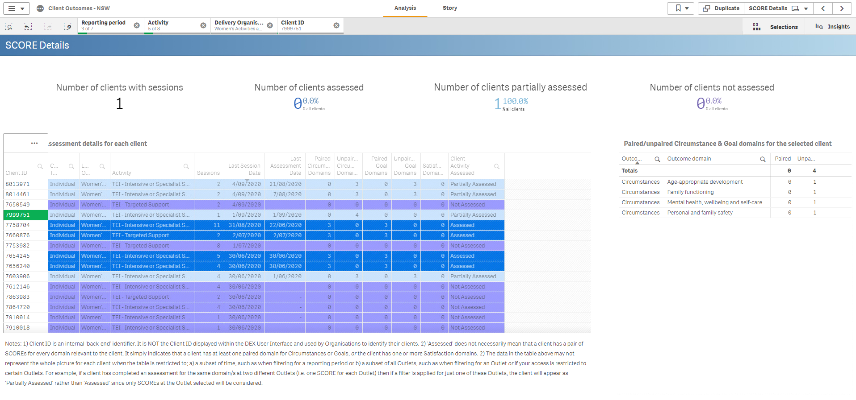
Step 6. Record client outcomes in the Data Exchange
Important:
SCOREs are only paired when the following information matches:
Client ID
Program Activity
Service type
Outcome Type (Circumstances or Goals)
Outcome Domain (e.g. Physical health)
Use the Client Outcomes report to see which clients need post-SCOREs
Service Provider X
Notes:
So, a quick point I want to make.
When we record SCOREs in DEX, the pre- and the post-SCORE will only be paired if these key pieces of information match.
So obviously, it needs to be for the same client. But it also needs to be for the same program activity and service type. And then the outcome type and outcome domain also need to match.
So all of those pieces of information need to be the same in order for SCOREs to be paired.
I wouldn’t stress about this too much, because from what I’ve seen everyone is doing this perfectly anyway.
But I just thought I’d point it out.
And if you ever come across some issues with reporting outcomes, please check out the Client Outcome Report.
This includes really useful information that tells you which clients have had SCORE assessment, and if they’ve been paired.
So you can keep track of who might need a follow up assessment.

Slide 49
Key Resources
TEI website:
What is SCORE and how can I use it for the TEI Program?
TEI Guide to Developing Surveys
TEI outcomes matrix template
DSS Website:
Data Exchange Protocols
How to use SCORE with clients
SCORE translation matrix
Add a SCORE assessment – Module
Add a SCORE assessment – Task Card
View and edit a SCORE assessment – Task Care
Notes:
Here are all of the resources, I’ve shown you today.
On the left, we have the documents that we in DCJ have developed. The first resource, ‘What is SCORE and how can I use it?’ goes through the six steps I took your through today. So please download that document and work your way through it.
The TEI guide to developing surveys is here. And so is the outcomes matrix.
And on the right, are all the resources DSS have developed, including the task card and learning module to actually use the web-based platform.

Slide 50
Where can I go for help?
Contact | Type of Support
DSS Data Exchange Website | Training resources for the Data Exchange
DSS Helpline: dssdataexchange.helpdesk@dss.gov.au or 1800 020 283 (8.30am – 5.30pm Monday to Friday) | Technical issues with the Data Exchange web platform (NB: not myGovID or RAM)
TEI Website | Training resources tailored to the TEI program
TEI Inbox: tei@facs.nsw.gov.au | TEI specific questions which are unavailable in existing resources
myGovID and RAM support line: 1300 287 539 | Support for issues with myGovID and RAM
myGovID ‘Need help?’ webpage | Support resources for myGovID
RAM ‘Help’ webpage | Support resources for RAM
Notes:
And as always. Here are all the places you can go for help if needed.
Thanks everyone

