Slide 1
Targeted Earlier Intervention Program
Webinar 7: Creating cases, sessions and clients for the Wellbeing and Safety stream
Live recording: https://www.youtube.com/watch?v=FTw7se9Occg
Notes:
Hi everyone, and welcome to Webinar 7 of our Data Exchange webinar series for the Targeted Earlier Intervention program.
In today’s webinar, we are going to talk about creating cases, sessions and clients for activities in the Wellbeing and Safety stream.
If you haven’t already, please make sure you watch Webinar number 5 before you continue with this webinar. Webinar 5 lays the ground work for a lot of the content I’ll go through today. So please watch that one before you continue watching this.

Slide 2
Purpose
In this webinar we discuss:
How to set up cases and sessions in the Wellbeing and Safety stream
When to record individual clients and unidentified groups
Notes:
So there are two key things this webinar discusses:
I’ll take you through a number of different examples of activities in the wellbeing and safety stream, and we’ll talk about how to set up your cases and sessions for those activities and we’ll also talk about when to record individual clients and when it’s ok to just record an unidentified group.

Slide 3
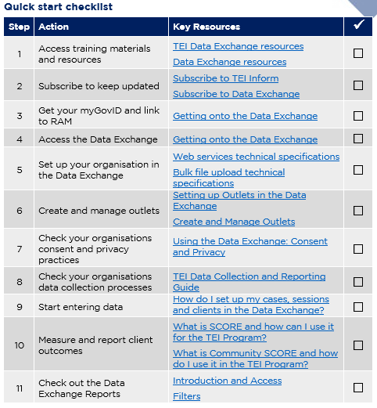
Data Exchange Quick Start Guide
Key resource: Quickstart guide to the Data Exchange
This document outlines the 11 key steps you need to follow to access and start using the Data Exchange.
It includes links to key resources for each step.
Notes:
So, as always in our previous webinar’s I introduced everyone to this document: the Data Exchange Quick Start Guide. This is a five page document that outlines the 11 key steps you need to follow to access and start using the Data Exchange. It includes links to all the key resources you need to action each step. And as you can see on the slide it includes this checklist, so you can keep track of where you’re up to.
In each of our webinar’s I’ve been taking everyone through each step in this document. So we’ve accessed training materials, we’ve subscribed to the newsletters, created our outlets and looked into the consent and privacy documents.

Slide 4
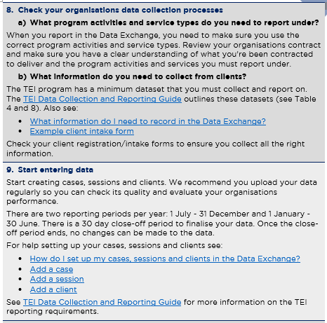
Quick start guide: step 8 and 9
Quickstart guide to the Data Exchange
Notes:
In today’s webinar, just like the previous two webinar, we’re going to continue working on steps 8 and 9. But we’re focusing specifically on the wellbeing and safety stream.

Slide 5
Cases, sessions and clients
Cases
Cases are ‘container’s. Cases store information about program activities and outlets.
Sessions
Sessions are individual episodes of service.
Clients
An individual or group who receives a service as part of a funded activity that is expected to lead to a measureable outcome.
Outlets
Location of service delivery
Clients are attached to the case and to the session.
Outlet
Case
Session
Session
Individual Clients
Individual Clients
Individual Clients
Notes:
So to get started, I just want to do a quick recap of some of the things we learnt in the previous webinars.
So by this stage you should all know what an outlet is – it is the location a service is delivered in. Outlets are the first thing you need to create before you can start reporting.
Once your outlets are set up, then you can start creating cases. So cases store information about program activities and outlets, and as you can see in the diagram, they link relevant sessions together, which then link clients together. So they’re kind of like a container for a specific activity that you deliver.
So once you’ve created your case, you can then start to create sessions. Sessions are individual episodes of service – so every time you meet with an individual client, a family or a group, you will create a session to show that you delivered a specific activity, on a specific day, to a specific person or group of people.
And then the last layer of data entry, are our clients. So you can attach clients to a case – to say these are the people who will be participating in this activity. And then you also need to attach clients to specific sessions – to show who participated in a specific session.
And as we discussed last week, you can also record a number of unidentified clients at the case level and at the session level.

Slide 6
Recording playgroups (or similar group activities)
Outlet
Atown Playgroup
Outlet
Btown Playgroup
Case ID: Atown Outreach Playgroups
Outlet: Atown Playgroup
Program Activity: Targeted Support
Case ID: Btown Outreach Playgroups
Outlet: Btown Playgroup
Program Activity: Targeted Support
Session ID: Mum and Bubs Playgroup November - 1
Session date: 18/11/19
Service type: Supported playgroup
Session ID: Mum and Bubs Playgroup November - 2
Session date: 25/11/19
Service type: Supported playgroup
Session ID: Mum and Bubs Playgroup November - 1
Session date: 19/11/19
Service type: Supported playgroup
Session ID: Mum and Bubs Playgroup November - 2
Session date: 26/11/19
Service type: Supported playgroup
Notes:
So, now we’re going to go through some common activities that are conducted in the wellbeing and safety stream, and we’ll talk about how to report those activities in the Data Exchange.
So how many cases to create, how many sessions to create and if you should have individual clients or unidentified clients.
The first example we have is for two playgroups.
So this organisation runs two playgroups, one in Atown and the other is in Btown. So they’ve got an outlet for each playgroup, beucase they in two different locations.
Then they have a case for each playgroup. Then underneath that they will create a session for each time the playgroup meets.
Clients for playgroups will most likely be individual clients. So they will attach individual clients to the relevant sessions they attend.
You can basically record any group activity this way – you just create a case for the group and then create sessions everytime the group meets.

Slide 7
Recording playgroups (or similar group activities)
Outlet
The Community Centre
Case ID: Playgroups
Outlet: XX Community Centre
Program Activity: Targeted Support
Session ID: Under 1’s Playgroup November - 1
Session date: 18/11/19
Service type: Supported playgroup
Session ID: Under 1’s Playgroup November - 2
Session date: 25/11/19
Service type: Supported playgroup
Session ID: Dads Playgroup November - 1
Session date: 19/11/19
Service type: Supported playgroup
Session ID: Dads Playgroup November - 2
Session date: 26/11/19
Service type: Supported playgroup
Notes:
The next example we have is also for a playgroup. But in this example they only have one outlet because all their playgroups are run in the same location.
So in this example, they run a playgroup specifically for 0-1years, and then they run a playgroup just for dads.
So they’ve create one case for all their playgroups, and they create a session every time a playgroup is hosted.

Slide 8
Recording group parenting program (or similar)
Outlet
The Community Centre
Other service types that could be set up the same way:
Group based education and skills training
Peer support groups
Self-help group
Case ID: 1-2-3 Magic
Outlet: The Community Centre
Program Activity: Targeted Support
Session ID: 1-2-3 Magic August - 1
Session date: 18/08/19
Service type: Parenting program
Session ID: 1-2-3 Magic August 2
Session date: 25/08/19
Service type: Parenting program
Session ID: 1-2-3 Magic September 1
Session date: 9/09/19
Service type: Parenting program
Notes:
Our next example is for a group parenting program.
So they’ve created one case for the program – and again they just create a session everytime the group meets.
Again, for an activity like this we would expect that clients are individual clients – so you would just attach the individual clients to the relevant sessions they attend.
And again, you could apply this same logic to any sort of group activity were the same group of people is meeting on more than one occasion.

Slide 9
Recording one-on-one parenting program (or similar)
Outlet
The Family Centre
Case ID: Engaging Adolescents Family 1
Outlet: The Family Centre
Program Activity: Targeted Support
Case ID: Engaging Adolescents Family 2
Outlet: The Family Centre
Program Activity: Targeted Support
Case ID: Engaging Adolescents Family 3
Outlet: The Family Centre
Program Activity: Targeted Support
Case ID: Engaging Adolescents Family 4
Outlet: The Family Centre
Program Activity: Targeted Support
Session ID: Session 1 - Nov Session date: 25/11/19
Service type: Parenting Program
Session ID: Session 1 - Aug Session date: 06/08/19
Service type: Parenting Program
Session ID: Session 1 - Aug Session date: 07/08/19
Service type: Parenting Program
Session ID: Session 1 - Nov Session date: 25/11/19
Service type: Parenting Program
Session ID: Session 2 - Nov
Session date: 30/11/19
Service type: Parenting Program
Session ID: Session 2 - Sep Session date: 06/09/19
Service type: Parenting Program
Session ID: Session 2 - Dec Session date: 01/12/19
Service type: Parenting Program
Other service types that could be set up the same way:
counselling
any individualized activities
Session ID: Session 3 - Dec Session date: 07/12/19
Service type: Parenting Program
Notes:
Ok, so our next example is slightly more complicated. This is also for a parenting program – but its being delivered one-on-one.
So one way you could record this, would be to create a case for each family who participates in the program. So you can see in the case ID’s we’ve got Engaging Adolescents (because that’s the name of the program) and then we’ve got Family 1, Family 2, etc. etc.
And every time you meet with a particular family, you would add a session to their case.
For an activity like this we would expect that clients are individual clients – so you would just attach the individual clients to the relevant sessions they attend.
This same kind of logic could be applied to any sort of individualized activity – like counselling, or case management or something like that.

Slide 10
Recording case management
Outlet
The Family Centre
Case ID: Case Management Family 1
Outlet: The Family Centre
Program Activity: Targeted Support
Case ID: Case Management Family 2
Outlet: The Family Centre
Program Activity: Targeted Support
Case ID: Case Management Family 3
Outlet: The Family Centre
Program Activity: Targeted Support
Case ID: Case Management Family 4
Outlet: The Family Centre
Program Activity: Targeted Support
Session ID: Session 1 - Nov Session date: 25/11/19
Service type: Intake/Assessment
Session ID: Session 1 - Aug Session date: 06/08/19
Service type: Intake/assessment
Session ID: Session 1 - Aug Session date: 07/08/19
Service type: Intake/assessment
Session ID: Session 1 - Nov Session date: 25/11/19
Service type: Intake/assessment
Session ID: Session 2 - Nov
Session date: 30/11/19
Service type: Family capacity building
Session ID: Session 2 - Sep Session date: 06/09/19
Service type: Family Capacity building
Session ID: Session 2 - Dec Session date: 08/08/19
Service type: Material aid
You can record different service types at the Session level to capture the kind of work you do with the client(s)
Session ID: Session 3 - Dec Session date: 14/08/19
Service type: Family Capacity building
Notes:
Our next example is actually case management.
So you can see it’s been set up the same as the previous example – we’ve got 1 case per family.
A session is created every time you meet with the family and you would attach individual clients to the sessions they attend.
Now, we know that in case management it’s likely that you’ll provide a range of different services. So when you create your sessions you can pick different service types to capture the kind of work you did with the family.
So if we look at the green column the first session was intake and assessment. The second was material aid and the third was family capacity building.
If you do this, you need to make sure the service types align with that is in your TEI contract.

Slide 11
Recording case management
Outlet
The Family Centre
Case ID: Engaging Adolescents Family 1
Outlet: The Family Centre
Program Activity: Targeted Support
Case ID: Engaging Adolescents Family 2
Outlet: The Family Centre
Program Activity: Targeted Support
Case ID: Engaging Adolescents Family 3
Outlet: The Family Centre
Program Activity: Targeted Support
However, you can only select service types under your chosen Program Activity.
See the TEI Program Specifications for descriptions of each service type.
You should only select service types you have been contracted to deliver.
Session ID: Session 1 - Nov Session date: 25/11/19
Service type: Intake/Assessment
Session ID: Session 1 - Aug Session date: 06/08/19
Service type: Intake/assessment
Session ID: Session 1 - Aug Session date: 07/08/19
Service type: Intake/assessment
Session ID: Session 2 - Nov
Session date: 30/11/19
Service type: Family capacity building
Session ID: Session 2 - Sep Session date: 06/09/19
Service type: Family Capacity building
Session ID: Session 2 - Dec Session date: 01/12/19
Service type: Material aid
Session ID: Session 3 - Dec Session date: 07/12/19
Service type: Family Capacity building
Notes:
And if I just skip to the next slide, one important thing to remember, is that you can only select service types that sit under your chosen program activity. So in this example, the program activity is targeted support. This means, when you create your sessions you’ll only be able to pick service types that sit under targeted support.
If you want to know more about what service types sit under what program program activities, there is a document on the TEI website, called the TEI program specifications, this includes a list of all the program activities and the service types and it has descriptions of each service type – so can check that to which service types are available
But also please make sure you only pick the service type that you have been contracted to deliver. Anything you report in DEX needs to align with your contract – so please make sure you check it.

Slide 12
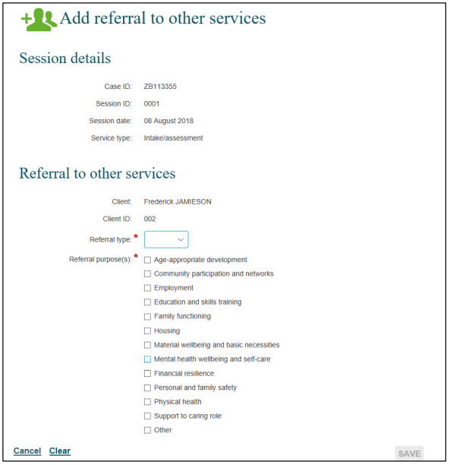
Recording referrals for individual clients
Referrals out – recorded at Session level. See Add a session.
Option 1
Record referrals in existing sessions and record really useful information about the purpose of the referral
Notes:
Ok. So the next example we have to go through is recording referrals.
So in the wellbeing and safety stream, the overwhelming majority of your clients will be individual clients. So this means you can record a referral in an existing session.
So basically what happens is once you’ve created a session and you’ve attached your clients to it, you can record any referrals that occurred with that session.
So you just select the relevant client. And you’ll be taken to a screen that looks like this – the image of the slide – and they you just need to select if the referral type – if it was internal or external, and the reason for the referral. And you can select multiple options.
So you would do this if, after a playgroup you’re talking to one of the parents and you find out they’ve just lost their job, you might refer them to some employment workshops your organisation runs. So you could capture that referral here.
Same goes for if, you’re running a parenting program, and you realise one particular family needs more support, maybe mum has some mental health issues, maybe there is some domestic violence going on – whatever referral you make in a particular session – you can record that here.
Recording referrals this way, can only be done for individual clients – so client who actually have a client record in the Data exchange.
I really encourage every to use this mechanism in DEX to record referrals because it gives you really valuable information about how clients are engaging in the service system.

Slide 13
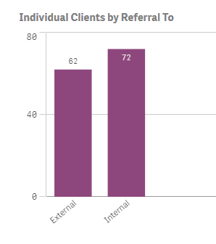
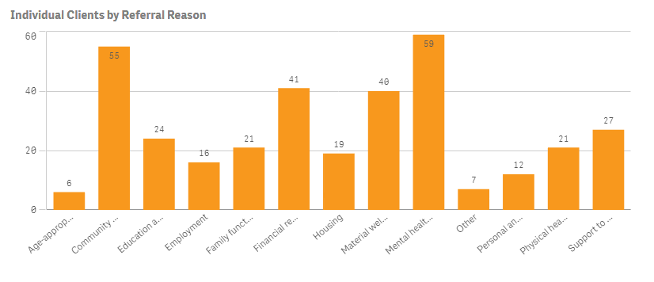
Recording referrals for individual clients
Recording referrals for individual clients this way means you can better understand their needs and how you’re service can work with them to ensure they’re getting the right support at the right time
Notes:
On this next slide, this is an example of some of the data you’ll be able to see once you start recording referrals this way. So you can see how many referrals were internal or external and you can see the reason for that referral.
And we can use this information to improve our service delivery. So let’s say for example, you find out that there are lots of internal referrals in your organisation for mental health reasons, maybe that means there should be something extra you do at intake to make sure you’re picking up on that issues as early as possible.
Or if there are lots of external referrals for a particular issue, that might present an opportunity to engage with other services in your local community, to provide a community-level response to the issue.

Slide 14
Recording info/advice/referral for Program Activities 4 and 5
Option 2
Outlet
Case ID: Engaging Adolescents Family 3
Outlet: The Family Centre
Program Activity: Targeted Support
Family Centre
In a ‘case management’ context, you can create a new session specifically for info/advice/referral.
Record the type of referral and purpose as well.
Session ID: Session 1 - Aug Session date: 07/08/19
Service type: Intake/assessment
Session ID: Session 2 - Dec Session date: 01/12/19
Service type: Info/advice/referral
We only recommend doing this for an assisted referral or if A LOT of time and effort has gone into the referral (at least 30 mins).
Session ID: Session 3 - Dec Session date: 07/12/19
Service type: Family Capacity building
Notes:
There is another option for recording referrals, where you can create a new sessions specifically for the referral.
This is most likely only going to occur within a case management context or when you’re conducted an assisted referral.
So you can create a session specifically for the info/advice/referral – attach the relevant clients to it. And then you can record the type of referral and the reason for the referral as well.

Slide 15
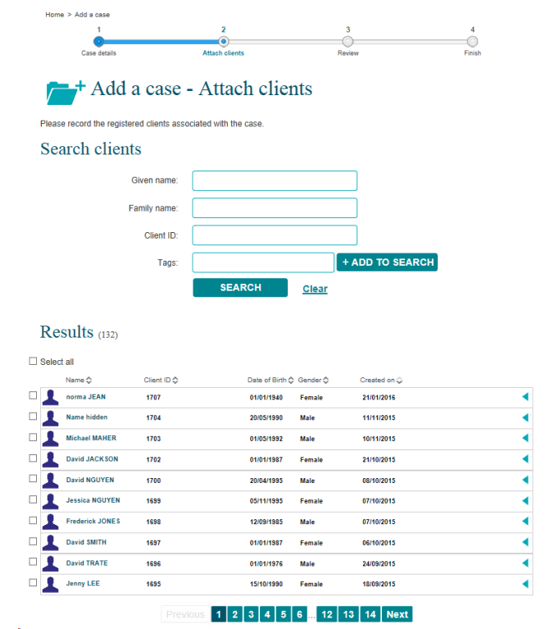
What to do when one client receives multiple services
All individual clients should only have one client record in the Data Exchange.
When you create a new case, all client records will appear for you to ‘attach’ to your case.
If a client accesses multiple services provided by your organisation, they are just attached to the relevant cases.
Your organisation should come up with a process/system to make sure duplicate client records are not created.
Notes:
So one question that we get asked all the time, is what to do when a client receives multiple services. So what happens when a mother attends your weekly playgroup, shes also participating in a parenting program, and some group counselling sessions. How do you record all of that?
Well, this is actually very simple.
All individual clients will have a client record in the Data exchange – and they only need one client record. So once they’re in the system, that’s it, you don’t need to enter them again.
Then, all you need to do, is when you create a new case and session for a different activity – you just need to attach the clients who participated in those activities.
So when the mum attends the playgroup, shes attached to those sessions. When she goes to the parenting program, shes attached to those sessions, and when she goes to the group counselling, shes attached to those sessions.
The only tricky thing, is that your organisation will need to come up with a way to ensure you don’t duplicate client records.
So before you add a client to the system, you should check the list of existing client records to make sure your clients doesn’t already have a record.

Slide 16
How many individual clients do I need to record?
TEI Program Activity | % of individual clients to be recorded:
1. Community connections | 25% of clients or more should be recorded as individual clients in each reporting period.
2. Community centres | 50% of clients or more should be recorded as individual clients in each reporting period.
3. Community support | 50% of clients or more should be recorded as individual clients in each reporting period.
4. Targeted support | 100% of clients should be recorded as individual clients in each reporting period.
5. Intensive or specialist support | 100% of clients should be recorded as individual clients in each reporting period.
There may be circumstances where it is not possible to collect personal information from clients, e.g. clients who have experienced trauma and abuse.
In necessary, you can record these clients as unidentified.
As you build a rapport with your clients and earn their trust, you could possibly collect their personal information at a later date.
You can also de-identify these clients (see slide 21).
Notes:
So, I’ve showed you this table in the last two webinars. But I do want to go over it again quickly.
In the wellbeing and safety stream, there are 2 program activities. For those program activities, we do expect that 100% of clients will be individual clients. So, there won’t be any unidentified groups.
However, we know this won’t always be possible. We know that for some of the clients you work with, it won’t actually be possible to collect demographic information from them. Some of them will even refuse to give you their name.
So, if absolutely necessary, you can record those clients as unidentified clients.
What you could also do, is you could create a client record for them, in the Data Exchange, and over time, as you build a rapport with them, and you earn their trust, you can start to populate their client record to include all the necessary demographic information.
But also remember, that you can deidentify clients in the Data Exchange.

Slide 17
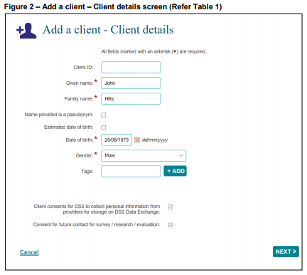
What happens when a client doesn’t consent
Untick this box
The clients name and address will not be stored in the Data Exchange
Keep a record of the ‘Client ID’ so you continue to add the client to relevant cases and sessions
The client will still be counted in your data set
See the Add a client taskcard and the Add a client video
Notes:
So if a client doesn’t want their personal information stored in DEX, you just need to make sure you untick the consent box. And their name and address won’t be stored.
You can also give them a pseudonym – so they can use a fake name if they want to.
If they don’t want to give their actual date of birth – you can just provide an estimate.
So there are lots of things you can do, to help make clients feel a little more comfortable about disclosing information about themselves to you.

Slide 18
Resources
TEI Resources
DSS Resources
The TEI Data Collection and Reporting Guide
How to set up cases, sessions and clients in DEX?
What information do I need to record in the Data Exchange?
Taskcards
Add a case
Add a session
Add a client
Recording alternate forms of service deliver
Learning modules
Add a case
Add a session
Add a client
Notes:
Here are all the key resources I mentioned today.
On the left are the resources we, DCJ, have developed. Please download these and have a read. They include countless examples of how to record information in DEX and what to record. More examples than what I took you through today – so if you even need any help figuring out how to organise your cases and sessions – please take a look at the examples in these resources.
We update these documents all the time as well – so if you ever get stuck please hope onto our website and have a look.
On the right are all the resources DSS have developed – these walk you through how to navigate the Data Exchange platform.

Slide 19
Where can I go for help?
Contact | Type of Support
DSS Data Exchange Website | Training resources for the Data Exchange
DSS Helpline: dssdataexchange.helpdesk@dss.gov.au or 1800 020 283 (8.30am – 5.30pm Monday to Friday) | Technical issues with the Data Exchange web platform (NB: not myGovID or RAM)
TEI Website | Training resources tailored to the TEI program
TEI Inbox: tei@facs.nsw.gov.au | TEI specific questions which are unavailable in existing resources
myGovID and RAM support line: 1300 287 539 | Support for issues with myGovID and RAM
myGovID ‘Need help?’ webpage | Support resources for myGovID
RAM ‘Help’ webpage | Support resources for RAM
Notes:
And as always here are all the places you can go for help if needed.
Thanks everyone.

