Slide 1
Targeted Earlier Intervention Program
Webinar 5: Creating cases, sessions and clients
Live recording:
https://www.youtube.com/watch?v=t2edLP30BAI
Notes:
Hi everyone, and welcome to webinar 5 our Data Exchange webinar series for the Targeted Earlier Intervention program.
In today’s webinar, we are going to talk about data collection and reporting.

Slide 2
Purpose
What cases and sessions are
What information you need to collect from clients
The difference between individual clients and unidentified groups
In this webinar we discuss:
How they fit in with outlets
Notes:
As always, there are three key topics we’ll discuss.
First, I’m going to introduce you to some of the DEX jargon about cases and sessions. We’ll talk about what these actually are, and how we use them to report our activities in the Data Exchange.
Then we’ll talk about the different kinds of clients we can report in the data exchange, and when you should have individual clients or unidentified groups of clients.
And last, but not least, we’ll discuss what information you need to collect from clients.

Slide 3
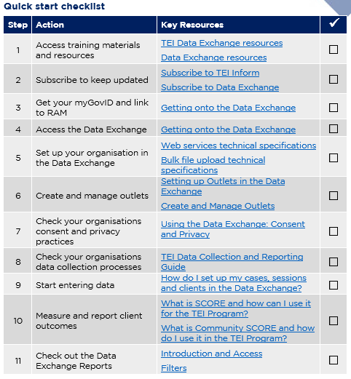
Data Exchange Quick Start Guide
Key resource: Quickstart guide to the Data Exchange
This document outlines the 11 key steps you need to follow to access and start using the Data Exchange.
It includes links to key resources for each step.
Notes:
So, as always in our previous webinar’s I introduced everyone to this document: the Data Exchange Quick Start Guide. This is a five page document that outlines the 11 key steps you need to follow to access and start using the Data Exchange. It includes links to all the key resources you need to action each step. And as you can see on the slide it includes this checklist, so you can keep track of where you’re up to.
In each of our webinar’s I’ve been taking everyone through each step in this document. So we’ve accessed training materials, we’ve subscribed to the newsletters, created our outlets and looked into the consent and privacy documents.

Slide 4
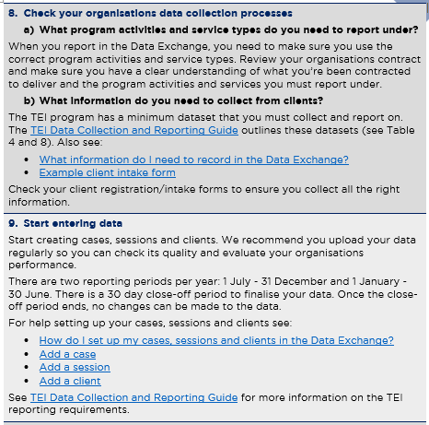
Quick start guide: step 8 and 9
Quickstart guide to the Data Exchange
Notes:
In today’s webinar we’re going to cover two steps: step 8 and step 9.
Step 8 takes you through what information you need to collect from your clients to report in the Data Exchange. So in the TEI program there is a minimum dataset that we expect all organisations to try to collect, so I’ll take you through that dataset and hopefully give you a really good understanding of what information you need and when to collect it.
Step 9, is where things get really exciting, we can finally start talking about reporting, about actually entering. So in this step I’ll take you through how to set up cases, sessions and clients. And I’ll give you a number of different examples to help you figure out how to do this for your specific activities.

Slide 5
Cases, sessions and clients
Cases
Cases are ‘container’s. Cases store information about program activities and outlets.
Sessions
Sessions are individual episodes of service.
Clients
An individual who receives a service as part of a funded activity that is expected to lead to a measureable outcome.
Outlets
Location of service delivery
Clients are attached to the case and to the session.
Outlet
Case
Session
Session
Individual Clients
Individual Clients
Individual Clients
Notes:
So to get started, I want to cover off a lot of the jargon that the Data Exchange uses.
So in there data exchange, there are 4 key things that we need to create, in order to report our on activities and clients.
So the first one, are outlets. So that’s the location a service is delivered in. I’m not going to talk about outlets now, because I went over them in a lot of detail in one of our previous webinars. So if you don’t know what outlets are, and your organisation hasn’t created these yet, please see the previous webinar on setting up your organisation and creating outlets.
Once your outlets are ready to go, then you can start creating cases. So cases store information about program activities and outlets, and as you can see in the diagram, they link relevant sessions together, which then link clients together. So they’re kind of like a container for a specific activity that you deliver.
So once you’ve created your case, you can then start to create sessions. So sessions are individual episodes of service – so every time you meet with an individual client, a family or a group, you will create a session to show that you delivered a specific activity, on a specific day, to a specific person or group of people.
And then are last layer of data entry, are our clients. So you can attach clients to a case – to say these are the people who will be participating in this activity. And then you also need to attach clients to specific sessions – to show who participated in a specific session.

Slide 6
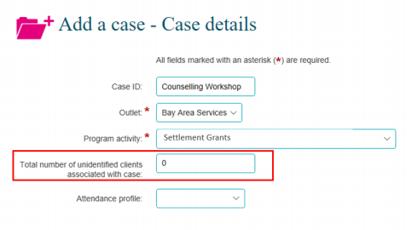
What is a case?
Cases act as containers.
They link client and session data to outlets and program activities.
When you set up a case in the Data Exchange, you need to provide this information:
Notes:
So, now I’m going to go through each of those key components, in a lot more detailed.
So when you create a case in the Data Exchange, this is what the portal will look like.
So the first thing you need to do is create a Case ID. This can be anything you want. The only people who see the Case ID are the staff in your organisation. So you should name your cases something that will make sense to you and your colleagues. But, make sure you don’t include an identifying information about your clients.
If you want you can leave this blank, and the Data Exchange will generate a caseID for you.
The next thing you need to do is pick your outlet. This is a dropdown menu – and a list will appear with the outlets for your organisation. So you just need to pick the outlet, the location that your activity was delivered in.
The next field is program activity. This is also a drop down menu. And it will display the program activities that have been assigned to the outlet you chose. So these two are connected to each other. From the drop down menu you need to choose the relevant program activity.
The next field is the total number of unidentified clients associated with the case. In this field you can record how many unidentified clients may attend your session. This can be used to record large group activities where it’s not possible to identify all attendees, a community event, for example. If the case relates to clients who you can identify leave this field at 0. We’ll talk more about unidentified clients later on.
The last field is the attendance profile – this describes the relationship between people in a case. So it could be a couple, a family, or people who live together. It could also be a community event or a group of peers. This is a drop down menu, so you just select the option that best describe the people who will participate in your sessions.

Slide 7
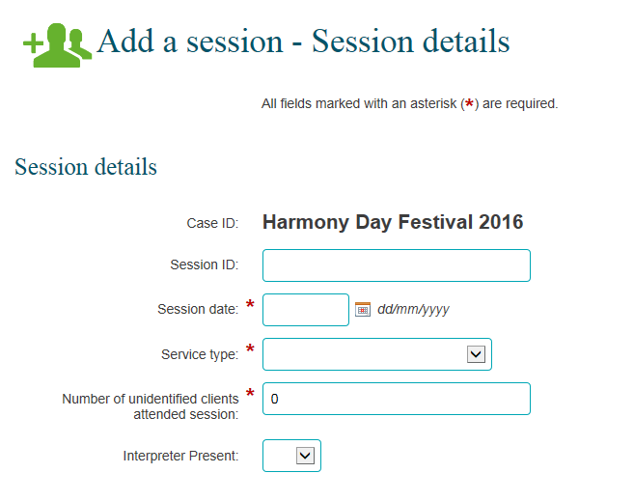
What is a session?
A session is an individual episode of service.
Sessions are stored within cases.
A session records what service was delivered (service type) on a particular date.
Once a session is created, you can attach individual clients to it to show what activities they received.
Notes:
Ok, so now we can move onto sessions.
So as I mentioned earlier, sessions are stored within cases, and they represent individual episodes of service.
When you create a session in the Data Exchange, the portal will look like this:
The first piece of information you can see if the Case ID. So that’s the name of the case that this session sits under.
The first field that you need to complete is the Session ID. So similar to the Case ID this can be anything you want. You should name your sessions something that will make sense to you and your colleagues.
The next field is the session date – this is the actual date that the activity occurred on. When you create sessions, create them before they have occurred. You can only create them on the actual day or for a past date. This is to prevent people from creating sessions that they don’t end up using.
Once you’ve entered the date, you need to select a service type. This is a drop-down menu. You’ll be shown the service types that sit under the program activity you selected when you created your case. You need to choose the service from this list. When you do this, you need to make sure the service type matches what is in your organisations contract. Don’t just pick a random service type – it has to align with what you’ve been contracted to deliver.
The next field is the number of unidentified clients who attended the session. So, this field will only appear if you entered a number of unidentified clients when you created your case. So at the case level, you need to enter the anticipated number of unidentified clients, and then at the session level, you need to enter the actual number of unidentified clients.
It’s also important to know that the maximum number you can enter here, is the number you recorded in the case. So if more people attended an event than you anticipated, you need to go back to the case and increase the number before you add your session.
The next field is service setting – this tells us more information about the location the service was provided in. As you can see, it is a drop down menu and there are 9 different options for you to choose from that describe the setting of your service. It includes things like your organisations office, a client’s residence, online or over the phone, a community venue – the list goes on.
And then the last field is whether or not an interpreter was present - this is just a simple yes or no. In the TEI program we don’t have to complete this field, but if you think it’s relevant to your service and its information that you want to capture, you can do that.

Slide 8
How do cases, sessions and outlets work together in practice?
Outlet
The Hub
Case ID: Naidoc Event
Outlet: The Hub
Program Activity: Community Connection
No. of unidentified clients: 60
Case ID: Mum and Bubs Playgroup
Outlet: The Hub
Program Activity: Targeted Support
Session ID: Naidoc community event August 2019
Session date: 08/07/19
Service type: Community Engagement
No. of unidentified clients: 48
Session ID: Mum and Bubs Playgroup November - 1
Session date: 18/11/19
Service type: Supported playgroup
Session ID: Mum and Bubs Playgroup November - 2
Session date: 25/11/19
Service type: Supported playgroup
Notes:
So now that everyone has a basic understanding of what cases and sessions are, I’m going to run through some concrete examples to show you how this works in practice.
So, on the slide you can see now, we have an example of an organisation who has conducted two different activities.
On the left hand side, in the red, they’ve created a case for a Naidoc event. The outlet for this event is the Hub. And the Program Activity is Community Connection. Because this is a community event they’ve also recorded how many unidentified clients they think will attend – which is 60.
They’ve then created one session for the event – they included the date and the program activity which is community engagement.
And then they’ve also recorded the number of unidentified clients who attended – which was 48.
On the right hand side, in the blue, we can see they’ve created another case – this one is for their playgroup. So this activity is also conducted in the Hub – so that’s the outlet they’ve selected. And their program activity is Targeted Support.
Now, they’ve created two sessions. One for each playgroup they’ve conducted so far. So the first playgroup was on the 18th of November and the 2nd playgroup was on the 25th of November.
They haven’t recorded how many unidentified clients attended – because all the clients for this activity are identified.

Slide 9
How do cases, sessions, and outlets work together in practice?
Outlet
Atown Playgroup
Outlet
Btown Playgroup
Case ID: Atown Outreach Playgroups
Outlet: Atown Playgroup
Program Activity: Targeted Support
Case ID: Btown Outreach Playgroups
Outlet: Btown Playgroup
Program Activity: Targeted Support
Session ID: Mum and Bubs Playgroup November - 1
Session date: 18/11/19
Service type: Supported playgroup
Session ID: Mum and Bubs Playgroup November - 2
Session date: 25/11/19
Service type: Supported playgroup
Session ID: Mum and Bubs Playgroup November - 1
Session date: 19/11/19
Service type: Supported playgroup
Session ID: Mum and Bubs Playgroup November - 2
Session date: 26/11/19
Service type: Supported playgroup
Notes:
The next example I want to show you, is also for a playgroup. But in this example, they’ve got two outlets, because the playgroups are conducted in different locations.
So they have an outlet for each playgroup. Which means they need a case for each playgroup – and then they create their sessions underneath that.

Slide 10
How do cases, sessions and outlets work together in practice?
Outlet
The Family Centre
Case ID: Case Management Family 1
Outlet: The Family Centre
Program Activity: Targeted Support
Case ID: Case Management Family 2
Outlet: The Family Centre
Program Activity: Targeted Support
Case ID: Case Management Family 3
Outlet: The Family Centre
Program Activity: Targeted Support
Case ID: Case Management Family 4
Outlet: The Family Centre
Program Activity: Targeted Support
Session ID: Home visit 1 - Nov Session date: 25/11/19
Service type: Family capacity building
Session ID: Home visit 1 - Aug Session date: 06/08/19
Service type: Family capacity building
Session ID: Home visit 1 - Aug Session date: 07/08/19
Service type: Family capacity building
Session ID: Home visit 1 - Nov Session date: 25/11/19
Service type: Family capacity building
Session ID: Home visit 2 - Nov
Session date: 30/11/19
Service type: Family capacity building
Session ID: Home visit 2 - Sep Session date: 06/09/19
Service type: Family capacity building
Session ID: Home visit 2 - Dec Session date: 01/12/19
Service type: Family capacity building
Session ID: Home visit 3 - Dec Session date: 07/12/19
Service type: Family capacity building
Notes:
The next example I have is a bit more complicated. For services where you are working with the same person or the same family over an extended period of time, you can create a case for that family or individual.
So for example you deliver counselling, or if you do case management, where you work with a family over an extended period of time, you can create a case for each family. So in the example of the slide, this organisation has set up their outlet called the Family Centre. And they’ve created 4 cases, one for each of the families they work with. And then they just create a session every time they meet with the family.
This can be a really useful way to manage a client’s ‘case’. After you’ve been working with them for a while, you can just look up their case in the data exchange and see exactly what activities they’ve participated in, when, and what outcomes they’re achieving.

Slide 11
No. of unidentified clients at the case level
The number of unidentified clients recorded in a case must be the number of UNIQUE people you expect to the sessions.
E.g. You run three information sessions for parents. You expect the same group of parents to attend all 3 sessions. The no. of unidentified clients is 20.
E.g. You run three information sessions for parents. You expect a different groups of 20 parents to attend each session. The no. of unidentified clients is 60.
Outlet
X Public School
Case ID: Parent information sessions
Outlet: X Public School
Program Activity: Community Support
No. of unidentified clients: ???
Session ID: Info session August - 1
Session date: 18/08/19
Service type: Info/Advice/Referral
No. of unidentified clients: 20
Session ID: Info session August 2
Session date: 23/08/19
Service type: Info/Advice/Referral
No. of unidentified clients: 18
Session ID: Info session August 3
Session date: 30/08/19
Service type: Info/Advice/Referral
No. of unidentified clients: 17
Notes:
One last thing I want to discuss about setting up cases and sessions, is no. of unidentified clients you might record at the case level.
So, one of the really important things you always need to remember, is that this number should be the number of UNIQUE people you expect to attend your sessions.
So if we look at this example on the slide. We’ve a case set up for some parent information sessions that are held at the local public school.
Now, the number of unidentified clients you record would depend on if the people who attend your info sessions are the same group of parents for all three sessions, or if it’s a different group each time.
If it’s the same group of people who attend all three sessions – then the number of unidentified clients for the case would be 20. Because 20 different, or UNIQUE, people are participating in your sessions.
If it’s a different group of people for each session – then the number of unidentified clients for the case would be 60. Because all up, 60 different, or UNIQUE people would have attended a session.
So this number acts as a bit of a safeguard to help us understand how many unique unidentified clients you worked with. So it’s really important that you get this right – otherwise your reporting will be off.

Slide 12
Cases, sessions and clients
Cases
Cases are ‘container’s. Cases store information about program activities and outlets.
Sessions
Sessions are individual episodes of service.
Clients
An individual who receives a service as part of a funded activity that is expected to lead to a measureable outcome.
Outlets
Location of service delivery
Clients are attached to the case and to the session.
Outlet
Case
Session
Session
Individual Clients
Individual Clients
Individual Clients
How do I set up my cases, sessions and clients?
Notes:
They are all the examples I have for you today – but please don’t fret. There are 3 more webinars on our website that go through different examples of how to set up cases and sessions. One webinar is targeted at the Community Strengthening stream, another is for wellbeing and safety, and the third one is focused on sector coordination and planning.
You can also check out the document on the screen – how do I set up my cases, sessions and clients. That includes a number of different examples that walk through how to report different activities.

Slide 13
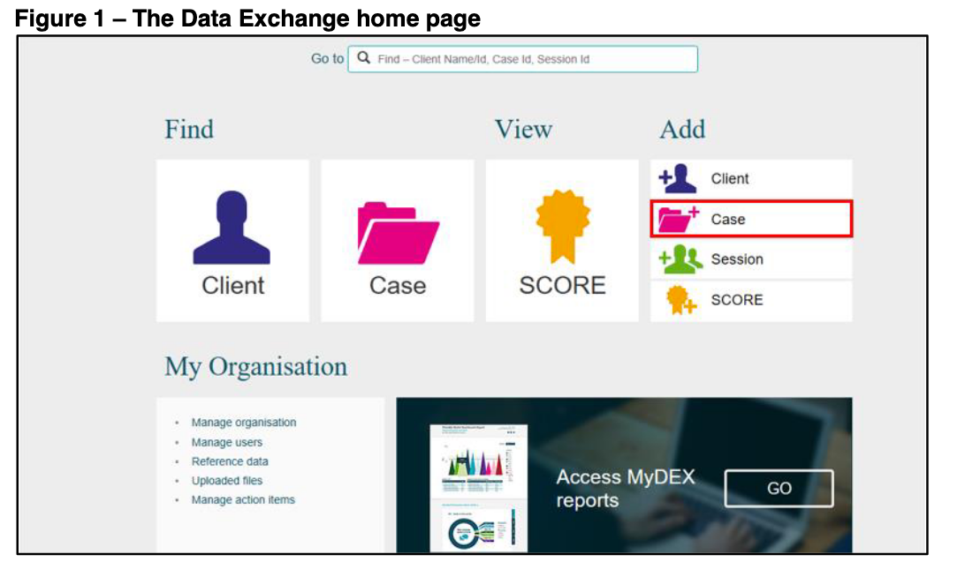
How do I create cases and sessions?
See the taskcards:
Add a case
Add a session
There are also learning modules:
Add a case
Add a session
Add a Community case and session
Notes:
When you’re ready to start creating your cases and sessions in the Data Exchange, there are lots of different resources you can go to for help. There are two taskcards – so these are documents that take you through the process step by step and there are also e-learning modules where you can actually watch some navigate the Data Exchange portal.
So if you ever need any help please see these documents and modules.

Slide 14
Who is a client?
A client is:
An individual who receives a service as part of a funded activity that is expected to lead to a measureable outcome.
Clients can be individuals or groups.
Individual clients | Unidentified group clients
Individual people who receive a service under the TEI program that is expected to lead to a measureable outcome. An individual person who has/will have a client record created in the Data Exchange. | A group of people who have received a service under the TEI program. No identifying information is collected from these clients.
Notes:
What we’re going to do now, is talk a little bit more about clients – who your clients actually are and when you should have individual clients or unidentified clients.
In the TEI program, a client is a person who receives a service that is expected to leave to a measurable outcome. So this means, it is someone who participates in an activity that you deliver, and you expect to see a change in that clients skills or behavior, or their circumstances, because of the activity you have delivered.
So in the Data Exchange, there are two different types of clients you can report.
There are individual clients – so this is any individual person who participates in an activity you deliver, you will collect personal and demographic information from them, and you will also create a client record for them in the Data Exchange.
The other type of clients we can record in DEX are unidentified group clients. So this is a large group of people who receive a service, and it’s not practical or necessary to collect individual client information from them. So instead, you just record the number of people who participated in the activity.

Slide 15
Reporting individual clients vs. unidentified groups
Individual clients | Unidentified group clients
You should try to report individual client data when it is practical and possible. Some examples: Playgroups Counselling Parenting programs Home visits/Case management Mens/Womens/Youth/Parenting groups School program Individual clients can be attached to both Cases and Sessions | Unidentified groups are recorded if it is not practical or possible to collect individual client information. Some examples: A community event A one-off information session Info/advice/referral in a community centre Interagency meeting Cases record the anticipated number of unidentified clients. Sessions record the actual number of unidentified clients. These fields should NOT be used to bulk report services to individuals or groups.
You can report a combination of individual clients and unidentified group clients.
Notes:
Here are some examples of when you might have individual clients, compared to unidentified groups.
So you will most likely have individual clients for things like playgroups, counselling, parenting programs, home visits or case management, group activities, like a youth group, or a parenting group, school programs. It’s really gonna be any activity, where you expect to see your clients more than once.
Unidentified group clients can be used for one-off occasions for service delivery – so when its highly unlikely you’ll see the same client, or the same group of people again. So you could use this for things like community events, maybe a large one-off information session, for information and advice, so when someone just calls up your community centre or just pops in for 10 minutes to ask some questions. For all those fleeting interactions.
You can also record unidentified group clients when it’s not really necessary to collect personal information from people – so we know a lot of TEI funded organisation facilitate interagency meetings, where you work with the staff members of other organisations. For an activity like that, it might not be necessary to collect personal and demographic information from people, so you could just record the people who attend the meetings as an unidentified group.

Slide 16
Reporting individual clients and unidentified clients
 | Example 1: Community Event |  | Example 2: Interagency coordination |  | Example 3: Family therapy
Case | Case ID: NAIDOC Event Outlet: Hyde Park Program Activity: Community Connection No. of unidentified clients: 300 |  | Case ID: Interagency meetings Outlet: Sydney City Community Centre Program Activity: Community Connection No. of unidentified clients: 5 |  | Case ID: FT Family 1 Outlet: The Family Centre Program Activity: Intensive or Specialist Support
Session | Session ID: NAIDOC event August 2019 Session date: 12/07/19 Service type: Community Engagement No. of unidentified clients: 250 |  | Session ID: Interagency August 2019 Session date: 08/07/19 Service type: Community sector coordination No. of unidentified clients: 2 |  | Session ID: Therapy Session 1 - Aug Session date: 08/07/19 Service type: Family capacity building
Individual Clients |  |  | 8 individual clients |  | 2 individual clients
How do I set up my cases, sessions and clients?
Notes:
To illustrate this a little bit better, here are some examples to show you when you might have individual clients and when it’s ok to have an unidentified group.
So the first example, on the far left is for a community event. They expect that 300 people will attend this event – so it’s not really going to be possible to go around to every single person there are ask them to answer a series of questions about themselves. So they can just record the number of identified clients and you can see they’ve done that at both the case and session level.
Example 2 is for a series of interagency meetings.
Now this is an interesting example, because here they’ve actually recording a combination of individual clients and unidentified clients. So we can see at the case, they thought 5 people would be unidentified. At the session, there are actually only 2 unidentified clients, and there 8 individual clients.
And then in our last example, for family therapy, there are no unidentified and there are 2 individual clients. This is because this a really intensive services. You will most definitely see those clients on numerous occasions and it’s really important to have key demographic information about them so you can meet their needs in the best possible way.
Like I mentioned before, there are 3 more webinars that all discuss setting up cases, sessions and clients where we go through a lot more examples like this to help you figure out what you need to do for your specific activities.
You can also check out the document on the screen – how do I set up my cases, sessions and clients. That includes a number of different examples as well that walks through how to report different activities in DEX and when you should have individual clients or unidentified clients.

Slide 17
How many individual clients do I need to record?
TEI Program Activity | % of individual clients to be recorded:
1. Community connections | 25% of clients or more should be recorded as individual clients in each reporting period.
2. Community centres | 50% of clients or more should be recorded as individual clients in each reporting period.
3. Community support | 50% of clients or more should be recorded as individual clients in each reporting period.
4. Targeted support | 100% of clients should be recorded as individual clients in each reporting period.
5. Intensive or specialist support | 100% of clients should be recorded as individual clients in each reporting period.
Notes:
As a general rule of thumb, you could also use the information in this table to help you determine if your clients can be recorded as an unidentified group, or if they should be individual clients.
As you can see, the % of individual clients that we expect you to report, varies for different program activities. So for community connections, only about 25% of your clients need to be individual clients. This is because the type of work that is conducted at the program activity is most likely to be with large groups of people, or with a group that you may not see again.
It goes up to 50% for community centres and community support. And then for targeted support and intensive or specialist support, 100% of you clients should be individual clients.
Please note, this is just a guide. We understand that there are many situations where it may not be possible for organisations to meet these percentages, and that’s more than ok. Just so long as you are trying to record individual clients where it is actually possibly.

Slide 18
The TEI Minimum Dataset
What information do I need to record in the Data Exchange?
Service Delivery Information | Client Demographics and Need | Client Outcomes and Satisfaction** | Community Outcomes**
Cases: Case ID Outlet* (location) Program activity* Total number of unidentified clients associated with the case (estimate) Attendance profile** Clients attached to the case | For individual clients only: Client ID Given name* Family name* Name provided is pseudonym Date of birth* Estimated DOB Gender* Residential address* Country of birth* Main language spoken at home* Aboriginal and Torres Strait Islander identification* Disability, impairment or condition* Consent to store personal information in the Data Exchange* Consent to participate in research, surveys and evaluation* Homelessness indicator** Household composition** Referral source** Reasons for seeking assistance** Referral type** Referral purpose** | For individual clients only: One or more Circumstances SCORE domains for at least 50% of clients AND/OR One or more Goals SCORE domains for at least 50% of clients AND One or more Satisfaction SCORE domains for at least 10% of individual clients, per reporting period | For unidentified groups only: One or more Community SCORE domains for majority of community or group activities Note: Community SCORE is recorded at the session level.
Sessions: Session ID Session date* Service type* Total number of unidentified clients attended session Client/support persons attended
*These are part of the Data Exchange’s priority requirements. For cases and sessions, it is mandatory that we provide this information. For individual clients, it is mandatory that we ask clients these questions. **These are part of the Data Exchange Partnership Approach. In the TEI Program we ask that, when relevant, services record this additional data.
We talk about this other webinars on SCORE.
Notes:
So, what I want to talk about now, is the TEI minimum dataset, so this is all the information you need to report in the Data Exchange.
The table you can see on the screen now is a summary of all that information. This table is available in a document called ‘What information do I need to record in the Data Exchange?’.
The Case level and session level information we went through earlier and we can ignore the client outcomes stuff for now, there are two webinars that talk solely about SCORE. So when you’re reading to talk about outcomes you can watch them.
For the moment, we’re going to focus on client demographics and need column. This is the information you need to try to collect from your individual clients.
As you can see it is a pretty comprehensive list – its includes the age, their address, if they have a disability, if they identify as Aboriginal or Torres Strait Islander, if they speak a language other than English, if they homeless, etc. etc.
All of the items with a red asterisk are mandatory. So that means that for your cases and sessions – you must fill out those data fields. For the client demographics tho – it just means that we must ask clients these questions. We can never force a client to provide this information – but as a TEI funded organisation its mandatory for you to ask, for you to try to obtain that information.
The items with the two black asterisk are part of the Partnership approach. So in the TEI program, we ask that you also collect this info, because it can give you really useful information about your clients needs.

Slide 19
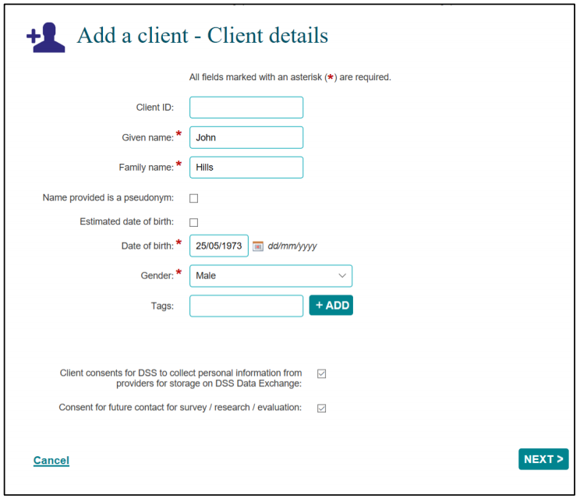
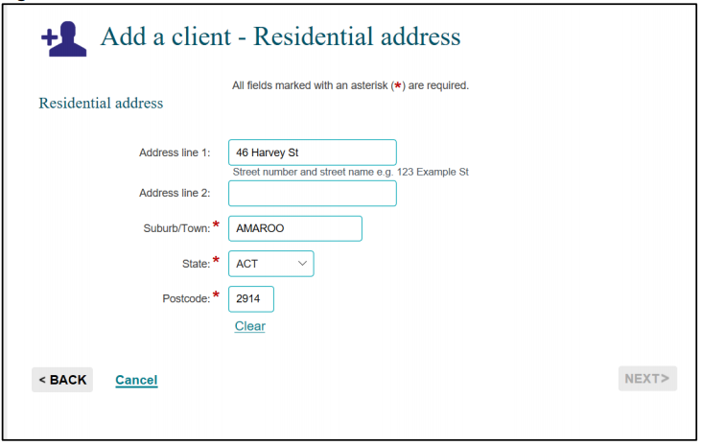
1
2
Notes:
So when you add a client in the Data Exchange, you’ll see a bunch of screens that look like this.
And you basically just need to go through each field and enter your client’s information.
There are some optional fields that you can use – so say for example a client doesn’t want to give you their real name, you can tick that box that says name provided is a pseudonym, which means the name you’ve entered isn’t real.
If the client doesn’t know their exact DOB, you can tick the box that says estimated date of birth. This will change the date of birth field, so you can just select the year that is closest to the clients estimated age.
The last field lets you enter ‘tags’. So this is a cool way to help you search for your clients later on. They work like search filters. So you could great a tag that is, for example 0-5 year olds, so next time you need to find one of the children that attend your playgroup, you can search by the 0-5 year old tag and you’ll hopefully be able to find the client you need much faster. You can create as many tags as you like, and they can be whatever you like as well. You could create a tag for young mothers, for over 65yos, for a specific suburb or LGA, whatever is most useful for you.
The last two pieces of information there, are the two consent statements that we all need to ask clients before we can enter their name and address into the Data Exchange. We discussed this in our previous webinar, but if a client does not consent to one or both of these statements then you need to make sure you untick the relevant box. Please see the previous webinar on consent and privacy for more information.
Once you’ve complete this first page, you’ll then be take to add the client’s address. You can enter their full address, or you can just enter the suburb, state and postcode.

Slide 20
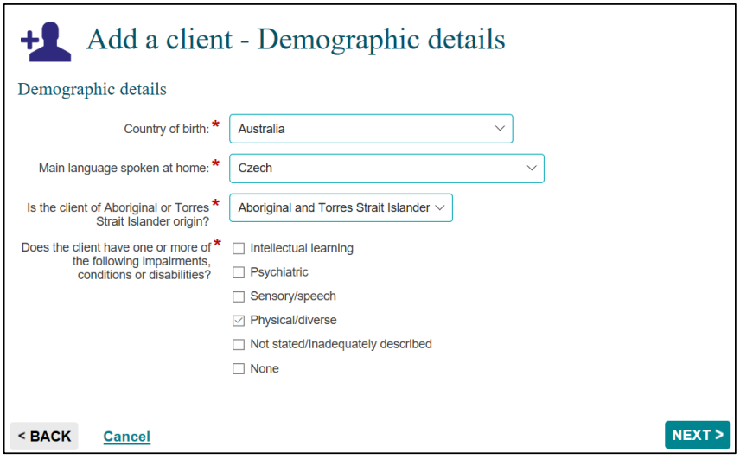
3
Definitions for disabilities are in the Data Exchange Protocols.
Notes:
After that you need to enter some demographic information. So this includes the client’s country of birth and the language they speak at home. These are just dropdown menus with a very extensive list of countries and languages for you to select from. You also need to state if the client identifies as Aboriginal or Torres Strait Islander – again this is a drop down menu with 4 different options for you to choose from.
And then the last one is if the client self-identifies as having a disability. They don’t need to be clinically diagnosed – if the client believes they have a disability that falls into one of these categories they can select the relevant option. There are definitions for these categories in the Data Exchange Protocols if you need more information about them.
If the client doesn’t want to disclose that they have a disability – you can select the ‘not stated’ option.

Slide 21
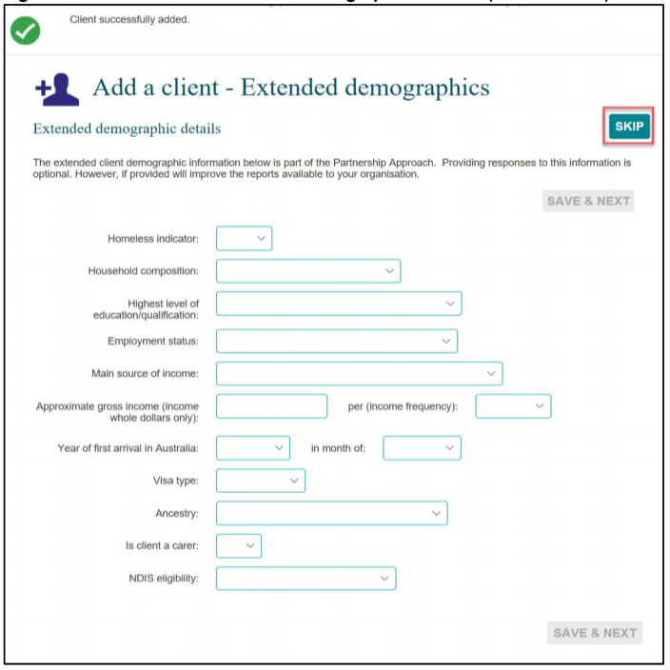
Partnership Approach
4
In the TEI program, you only need to collect the first two fields.
All other fields are optional.
Notes:
Ok, and then the last page you need to complete is the extended demographics. So these are all part of the partnership approach, but you do not need to collect all of this information.
You only need to complete the first two fields – homelessness indicator and household composition.
So homelessness indicator is a dropdown box and you can state if the client is homeless or if they are at risk of homelessness.
The household composition is also a dropdown box and you can use this to description the makeup of the home the client lives in. There are seven different options to choose from, ranging from a single person household, to a group household of unrelated adults.

Slide 22
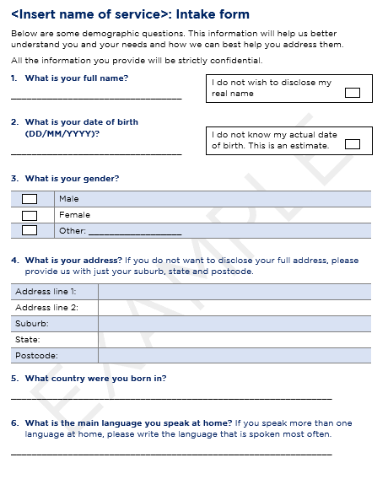
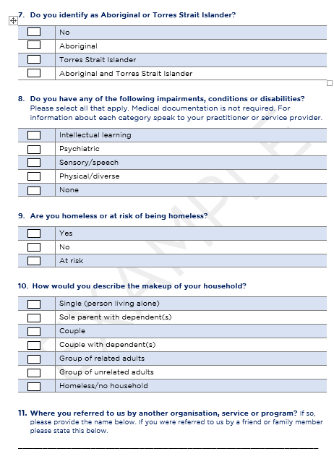
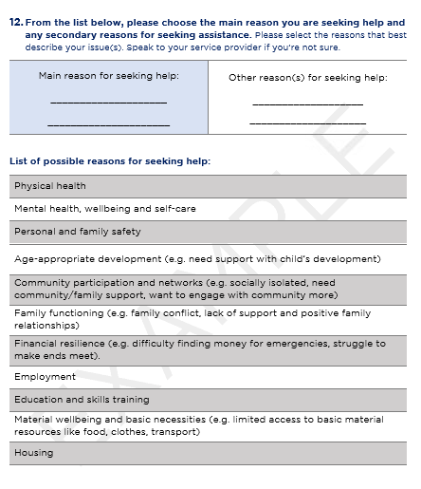
Example client intake form
Notes:
So, to help you collect all of this information from clients, we have developed an example of a client intake form. It includes all the questions you need to ask – and the response options that are in the Data Exchange platform so you can directly enter the information the client gives you.
You do not have to use this form – we know that lots of organisations already have their own client intake forms – but I would atleast have a look at it, and make sure that your own client intake forms include the same questions and the same response options so you can easily enter the information clients give you into the data exchange.

Slide 23
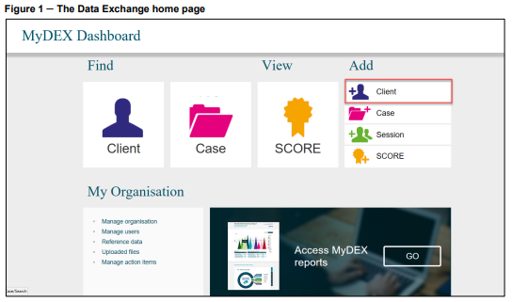
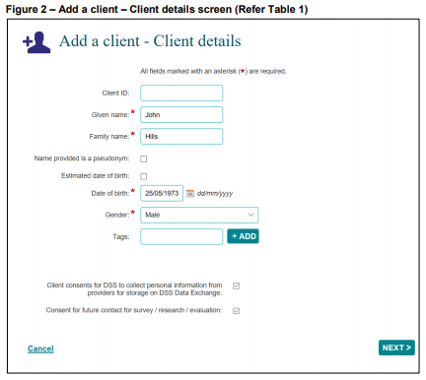
Adding individual clients to the Data Exchange
See the Add a client taskcard and the Add a client video
Notes:
When you’re ready to start entering clients in the in the Data Exchange, there are again a number of different resources you can go to for help. There is an ‘Add a client’ taskcard’ that takes you through the process step by step and there is also an e-learning module, or video where you can actually watch someone create a client record.
So if you ever need any help adding a client please see these resources.

Slide 24
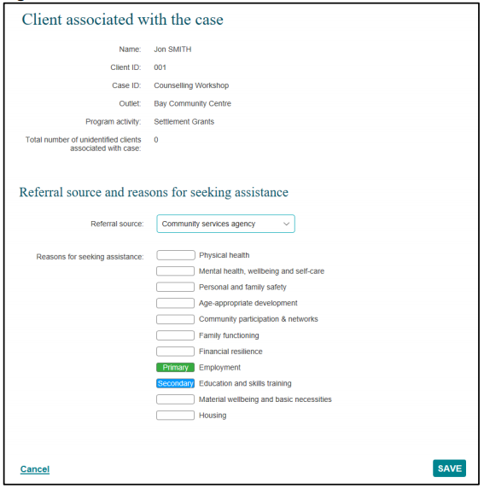
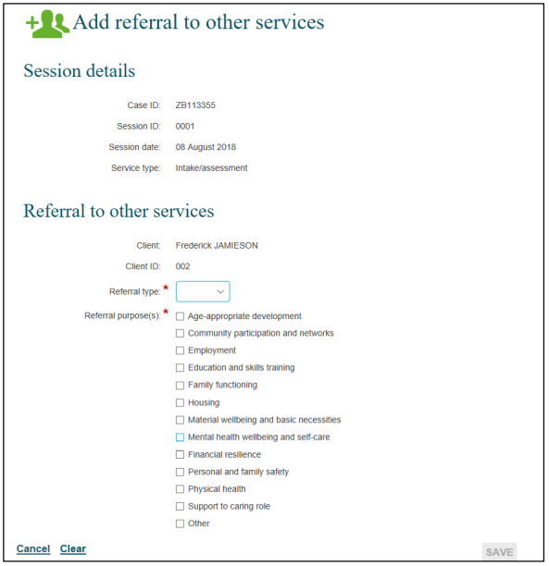
Recording referrals in and out
Referrals in – recorded at Case level. See Add a case.
Referrals out – recorded at Session level. See Add a session.
Notes:
So in addition to the client demographic information, you also need to record referrals in and out of your organisation.
So when a client participates in an activity for the first time, you need to record the referral in – so how they came into contact with your organisation. So this information is recorded at the Case level. So when you attach a client to a case, you should record the referral source – so how they can into contact with your organisation. This is a dropdown box with numerous options for you to choose from. The referral source could be from a health agency, an educational agency, the NDIS, it could be an internal referral, so maybe they’ve been referring to your specific service from another part of your organisation, or it could also be a self referral.
You also need to select the reasons why the client came to the service. There are 11 different options to choose from – you can select primary reason and a secondary reason that best describe why the client came to your service, why there are seeking assistance.
So this information is recorded at the Case level – if you need help figuring out how to record it please see the taskcard ‘add a case’. It includes a whole section on recording referrals into your organisation.
You also need to record referrals out – so when you refer a client to another service or another activity you need to record this also. So this information is recorded at the session level – so after you have delivered an activity, and attached your individual clients to the relevant session, you can record if any referrals were made.
So you need to enter the referral type – this is just a simple dropdown menu that has the options internal and external. So an internal referral would be if you referred them to another service within your own organisation. And an external referral is if you have referred them to another organisation. And then you also need to select the referral purpose – so why are they being referred to another service or activity? There are 11 options here for you choose from and you just need to select the option that best describes the reason for the referral. And more than one option can be selected.

Slide 25
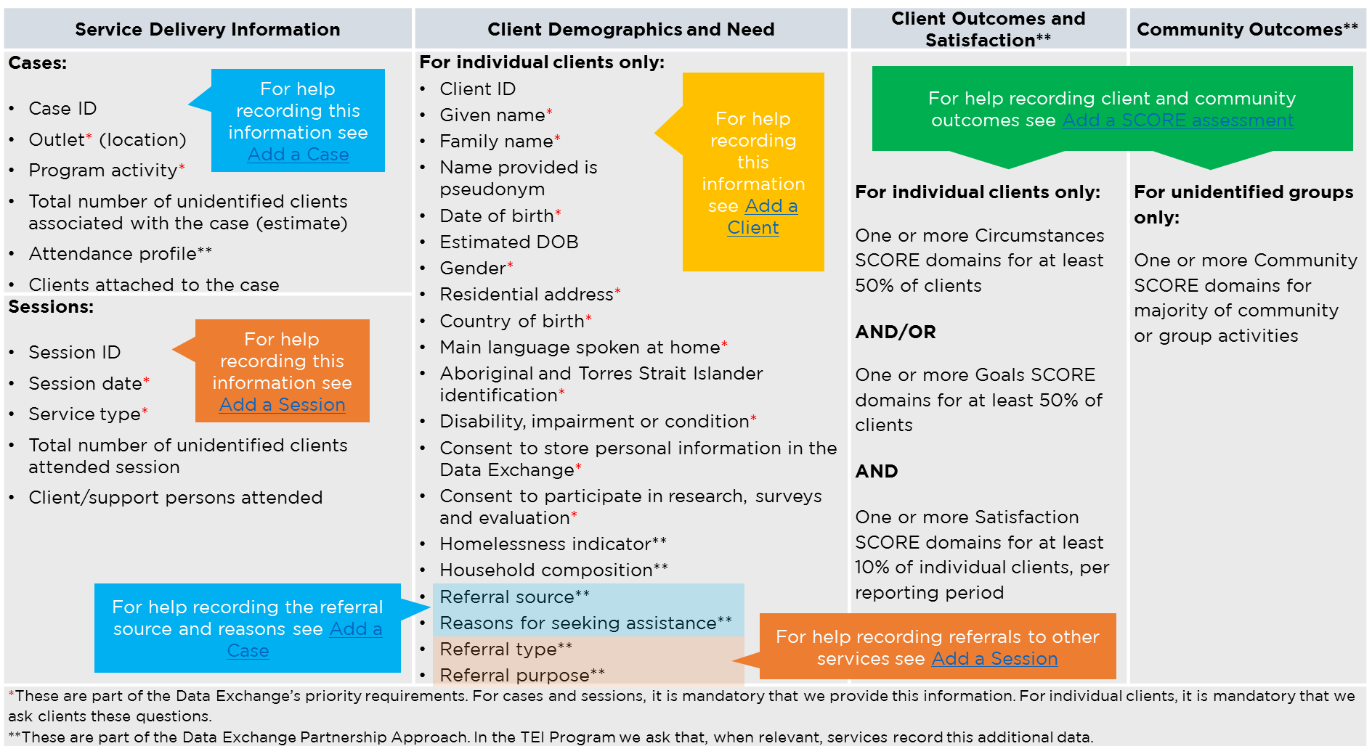
What information do I need to record in the Data Exchange?
We talk about this other webinars on SCORE.
Notes:
So, I know, that was a lot to take in. So we’ve got this little cheat sheet to help you understand how to report all of this information. You can find this table in the document I mentioned earlier, what information do I need to record in the Data Exchange?
And as you can see it includes little instructions for where to go for help recording this information.

Slide 26
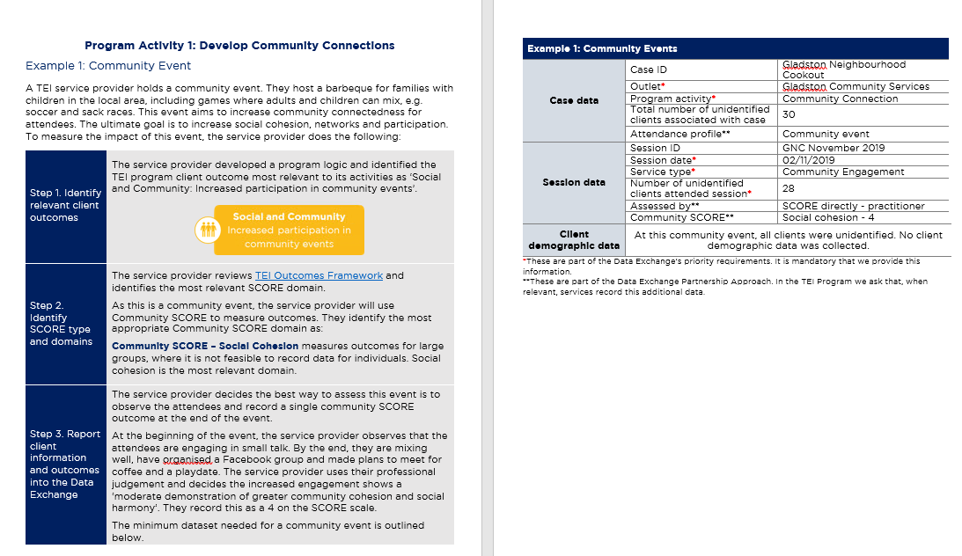
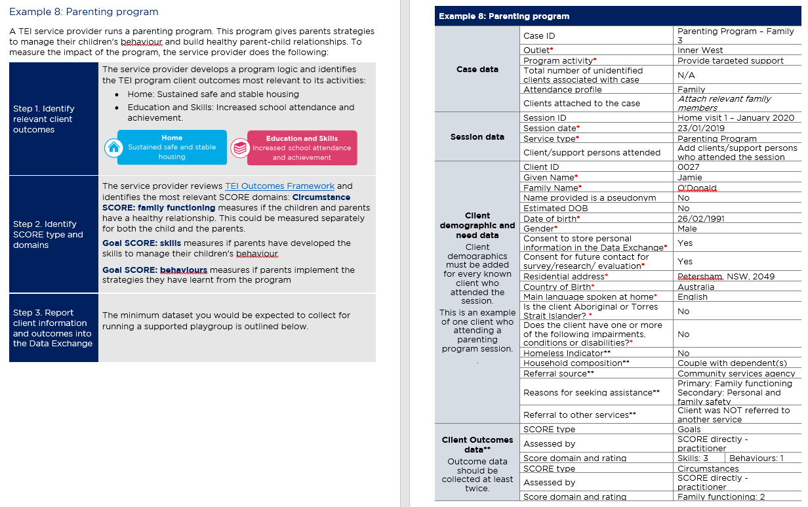
What information do I need to record in the Data Exchange?
Notes:
This resource, what information do I need to record, also includes a bunch of different examples of what information you need to enter for different types of activities. Obviously a community event, is going to look pretty different to info and advice, which will also look different to case management or a parenting program. So we’ve come up with a number of different examples to help everyone understand when they should record certain pieces of information.

Slide 27
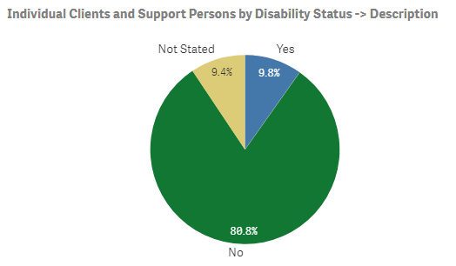
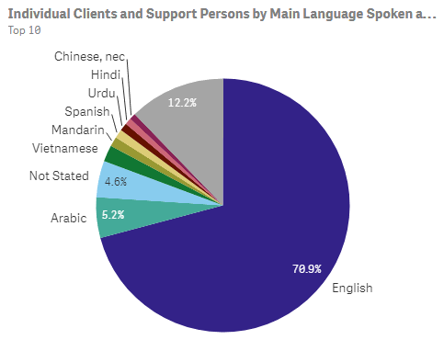
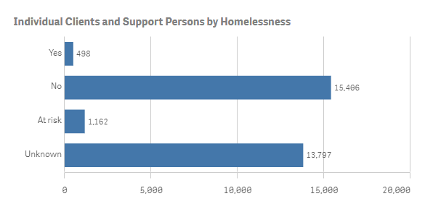
Client demographic data in the Data Exchange reports
Notes:
Before we wrap up, I just want to show you guys, some of the really great information that has already been reported into the Data Exchange.
When you start entering data, and you access your reports, you’ll be able to this same information about your own clients. You’ll have age breakdowns of clients, you’ll be able to see how many are homeless or at risk of homelessness, what disabilities people have, what languages people speak. And we can use this information to make sure we’re addressing our clients’ needs in the best possible way and that they’re receiving the right service for them.

Slide 28
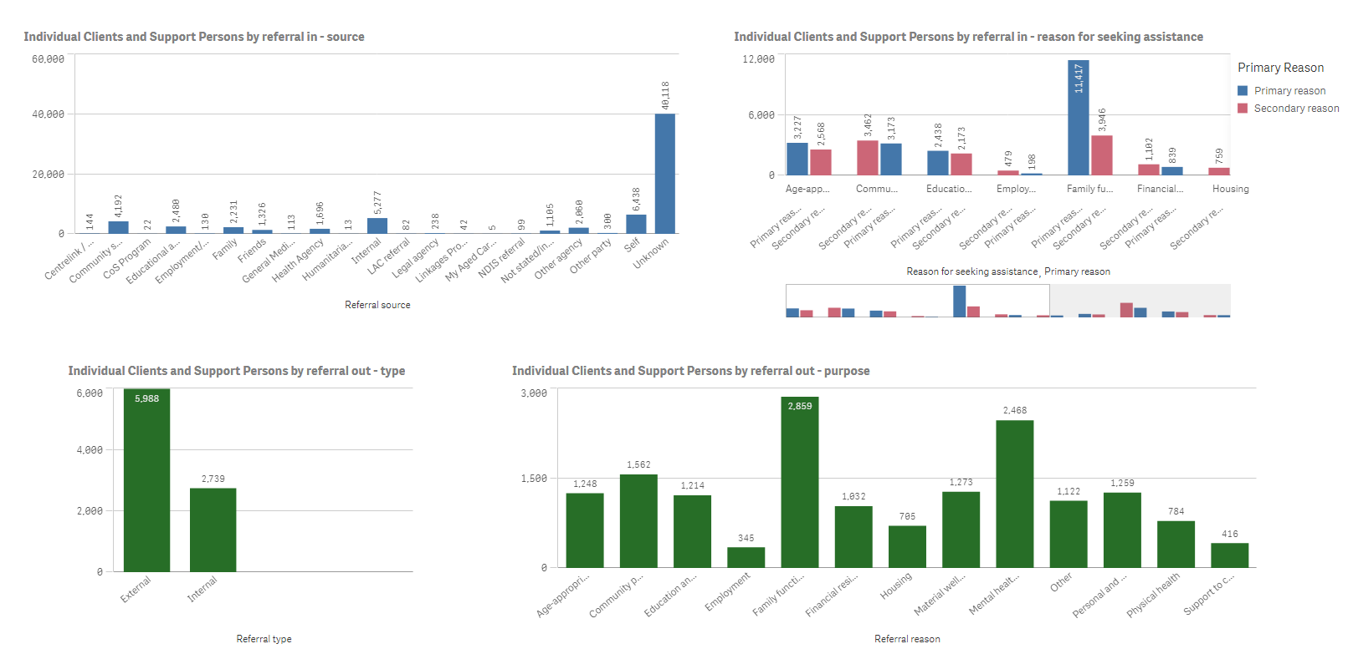
Referral data in the Data Exchange reports
Notes:
This next slide is some of the referral information that has already been recorded. So we can also start to see how clients are coming into contact with TEI services – some are being referred by health agencies, by educational agencies, there are lots of internal referrals and lots of self-referrals as well. Which I think is a good thing, because it means our program is functioning as the soft-entry point its meant to be. We can also see the reasons why people are coming to our services and then across the bottom we can see referrals out – whether they’re external or internal and the reason for the referral.
So we already are starting to see really useful information about how are clients are navigating the service system and what their needs are. And this is only going to become more and more useful as we collect more data.

Slide 29
Resources
TEI Resources
DSS Resources
How to set up cases, sessions and clients in DEX?
What information do I need to record in the Data Exchange?
Example client intake form
Taskcards
Add a case
Add a session
Add a client
Learning modules
Add a case
Add a session
Add a client
Notes:
Here are all the key resources I mentioned today.
On the left are the resources we, DCJ, have developed. Please download these and have a read. They include countless examples of how to record information in DEX and what to record. We update these documents all the time as well – so if you ever get stuck please hope onto our website and have a look.
On the right are all the resources DSS have developed – these walk you through how to navigate the Data Exchange platform.

Slide 30
Where can I go for help?
Contact | Type of Support
DSS Data Exchange Website | Training resources for the Data Exchange
DSS Helpline: dssdataexchange.helpdesk@dss.gov.au or 1800 020 283 (8.30am – 5.30pm Monday to Friday) | Technical issues with the Data Exchange web platform (NB: not myGovID or RAM)
TEI Website | Training resources tailored to the TEI program
TEI Inbox: tei@facs.nsw.gov.au | TEI specific questions which are unavailable in existing resources
myGovID and RAM support line: 1300 287 539 | Support for issues with myGovID and RAM
myGovID ‘Need help?’ webpage | Support resources for myGovID
RAM ‘Help’ webpage | Support resources for RAM
Notes:
And as always here are all the places you can go for help if needed.
Thanks everyone.

