Slide 1
Social and Affordable Housing Fund (SAHF) Phase 2 Overview of the SAHF NSW Fund
Philip Gardner – Deputy Secretary, Commercial
NSW Treasury
18 October 2017

Slide 2
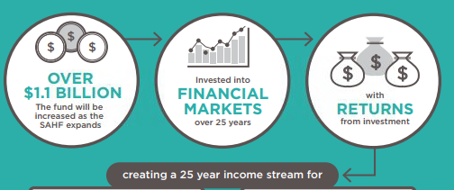
Overview of the SAHF NSW Fund
The SAHF has been set up with $1.1 billion in seed capital from the Government’s cash reserves, to be invested over a term of 25 years
The seed capital is managed by NSW Treasury Corporation (TCorp), with the fund’s investment earnings being used to meet the funding obligations (i.e. monthly service payments) of the contracts under the SAHF program
Source - facs.nsw.gov.au

Slide 3
SAHF dedicated for social & affordable housing initiatives
Security and assurance: The SAHF NSW Fund Act 2016 creates a ring-fenced structure, which ensures that the funds are quarantined for social and affordable housing initiatives
Should the fund out-perform the longer term, the excess earnings will go towards further social and affordable housing proposals
Separated funding: The SAHF expenditure is not within the Family and Community Services (FACS) budget. Therefore, funding is dedicated and not open to reprioritisation by FACS or Ministers
Transparency and accountability: Payments from SAHF NSW will be made in a transparent manner with the annual financial reports being published on the Treasury website and subject to audit by the Auditor-General
SAHF NSW Fund Act 2016

Slide 4
Governance and Investments in place
Expenditure Review Committee
Social and Affordable Housing NSW Fund Act 2016
Responsible Minister
Minister for Social Housing
Treasurer
SAHF NSW Special Deposit Account
$1.1 billion (Phase 1)
SAHF Program Advisory Board
Investment Function
Monthly Service Payments ($)
SAHF Program Control Group
Funding Function
Ring-fenced
Investment Strategy and Strategic Asset Allocation
Investment Manager
SAHF 1 contracts
1
2
3
4
5
Asset and Liability Committee (ALCO)

