Slide 1
Social and Affordable Housing Fund
Phase 2 Market Briefing

Slide 2
Social Housing in NSW – Future Directions
The SAHF is a key component the Future Directions for Social Housing in NSW Strategy
Future Directions is a long term plan based on three priorities:
More social housing
More opportunities, support and incentives to help people avoid or leave social housing
A better experience in social housing
Reforms under Future Directions will expand the social housing stock across NSW, while providing more pathways for clients to gain housing independence.

Slide 3
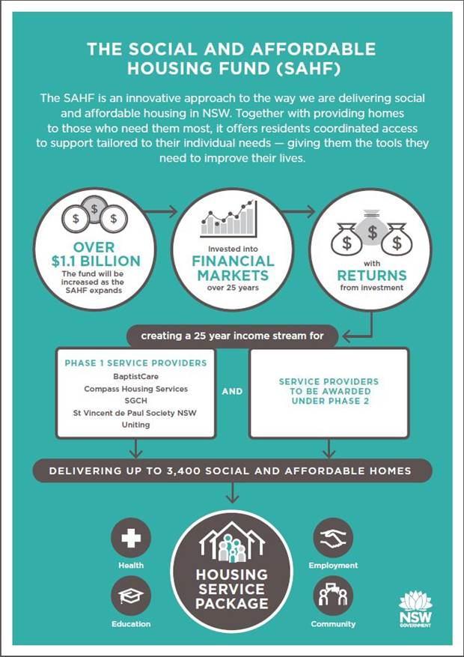
SAHF Overview

Slide 4
SAHF Phase 2 - Objectives
Increase supply of Social and Affordable Housing
Delivery and value for money
Unlock land contributions
Innovation through partnerships
Quality services that drive social outcomes
Increase social and affordable housing options for vulnerable households
Evidence building and continued reform
Strategic alignment
Promote regional areas

Slide 5
Overview of SAHF Phase 2 procurement
Similar
Oversight and team approach
Key commercial principles
Key Differences
Target cohort is general cohort with a priority for older women
Extended and better market engagement
Focused sounding on key issues from SAHF Phase 1
Streamlining processes and documentation

Slide 6
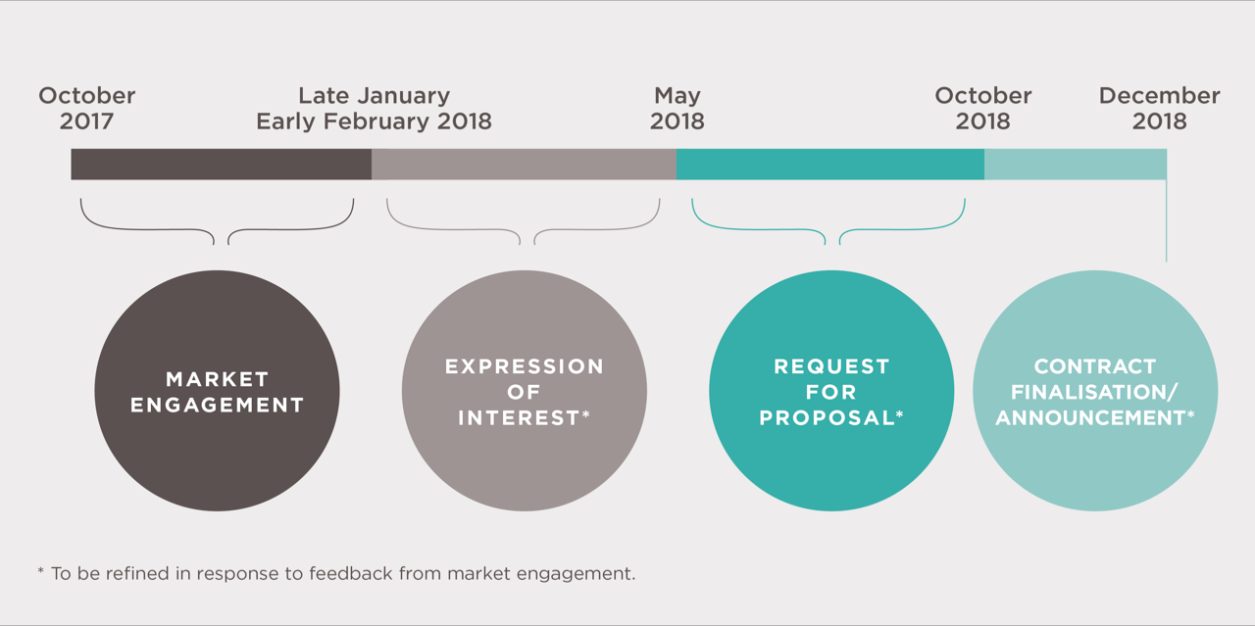
SAHF Phase 2 – Indicative Process

Slide 7
Building on lessons learned from SAHF Phase 1
Reducing complexity
Understanding high bid costs
Delivery risk during the dwelling acquisition phase
Dwelling delivery models
Cohorts and tenant eligibility
Identifying consortia partners and understanding eligibility
More time before procurement

Slide 8
SAHF Phase 2 Market Engagement Strategy
A 3 month Market Engagement Strategy where we will inform you, facilitate participation and respond to detailed feedback
In the background we are starting on activities like:
reviewing and streamlining project documentation and our own processes to identify ways of improving the tender
building on our own knowledge and lessons learnt from the procurement and managing SAHF Phase 1 contracts

Slide 9
Market Engagement Strategy
INFORM
Objective: participants will know and understand the SAHF and what government is seeking through SAHF 2
Includes:
Clear information on SAHF Phase 2 and SAHF Program through the website including access to key information such as, community housing registration
Opportunities for Q and A sessions with the SAHF team through targeted meetings where we will explain key elements of the program
Regular updates via website:
www.facs.nsw.gov.au/sahf

Slide 10
Market Engagement Strategy
2. FACILITATE
Facilitate informed participation in the SAHF
Work with peak organisations to provide:
Help identifying partners
More information on participating as a SAHF provider

Slide 11
Market Engagement Strategy
3. RESEARCH AND RESPOND
Detailed market sounding working on key issues to develop recommended adjustments to tender and tender process
Focused approach – taking what we have heard from the market and getting to the detail
Developing responses and formulating changes for consideration by government where required

Slide 12
Close
Q and A to be hosted by Eleri Morgan-Thomas (FACS) and Philip Gardner (NSW Treasury) after the following presentation.

